Slide 1

Combining Capacity Expansion & Production Cost With Weather, Load & Uncertainty
Prepared By:
Vibrant Clean Energy, LLC
Dr Christopher T M Clack
Prepared For:
PMAPS 2018 – Boise Idaho, USA
June 26th, 2018
Disclaimer:
This presentation has been prepared in good faith on the basis of information available at the date of publication. The analysis was produced by Vibrant Clean Energy, LLC. No guarantee or warranty of the analysis is applicable. Vibrant Clean Energy, LLC will not be held liable for any loss, damage, or cost incurred by using or relying on the information in this presentation.

Slide 2

What Most Commercial Models Currently Do
For production cost – typically short time periods & small geographic scope;
For capacity expansion – typically coarse data, large region, but simplified / no dispatch;
Typically many models do not consider demand side resources, transmission, storage, or other emerging technologies (EVs, heat pumps, water heaters, etc.);
Disaggregation of components of the system leads to inefficient future projections and diminishes value of certain resources;
Simpler modeling does not allow foresight beyond “knowns” for example, emergent behavior of market design, co-optimization of DERS, utility generation, transmission, and storage, reducing reliance on thermal generation for reserves, etc.
Ignoring the changing environment, i.e. outside a specific BAA will lead to over investment and stranded assets / addition costs to rate payers, as the external regions will impact the internal dynamics of the BAA.

Slide 3
What Models Should (& Will) Do
Combined capacity expansion and production cost model. They should combine:
  Continental-scale (globally capable), spatially-determined co-optimization of transmission, generation and storage expansion while simultaneously determining the dispatch of these sub systems at high resolution and fidelity (3-km, 5-min);
  Dispatch should includes:
    Individual unit commitments, start-up, shutdown profiles, and ramp constraints;
    Transmission power flow, planning reserves, and operating reserves;
    Weather forecasting and physics of weather engines;
    Detailed hydro modeling;
    High granularity for weather-dependent generation;
    Existing generator and transmission asset attributes such as heat rates, line losses, power factor, variable costs, fixed costs, capital costs, fuel costs, etc.
    Uncertainty estimations in weather, generation, transmission, & policy;
  Large spatial and temporal horizons;
  Existing policy and regulatory drivers such as PTC, ITC, RPS, etc.;
  Detailed investment periods ( 2-, 5-, or 10- year) out past 2050;
  Bringing together weather, load, capacity, generation & storage produces co-benefits and simplifications that enhance the system (WIS:dom already does this).

Slide 4
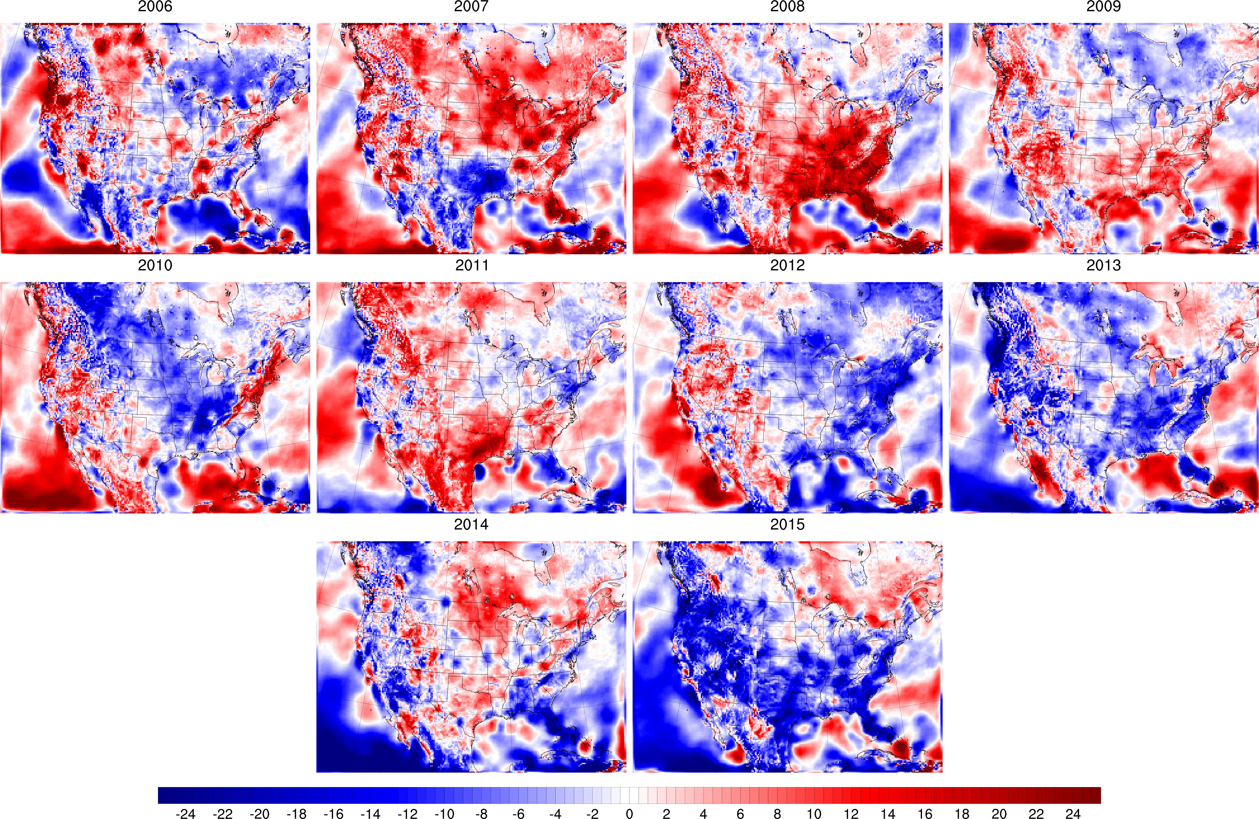
Multi-Year Data Considerations To Help Determine Uncertainty in “Fuel”
80m AGL

Slide 5
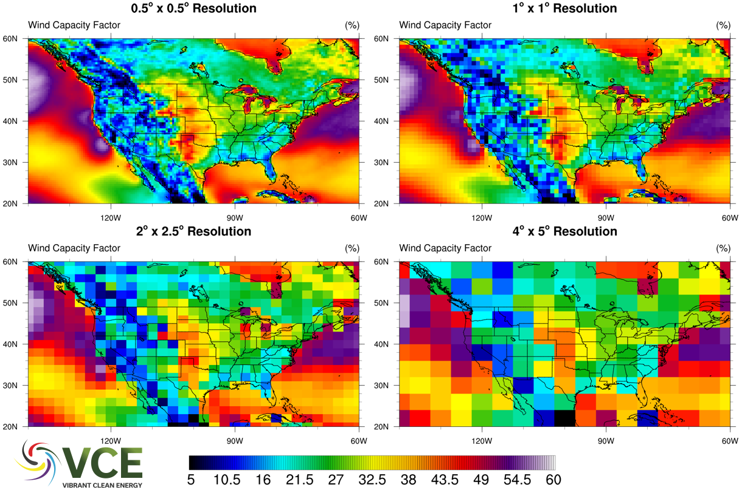
Resolution Considerations To Determine Uncertainty & “Fuel” For Resources

Slide 6
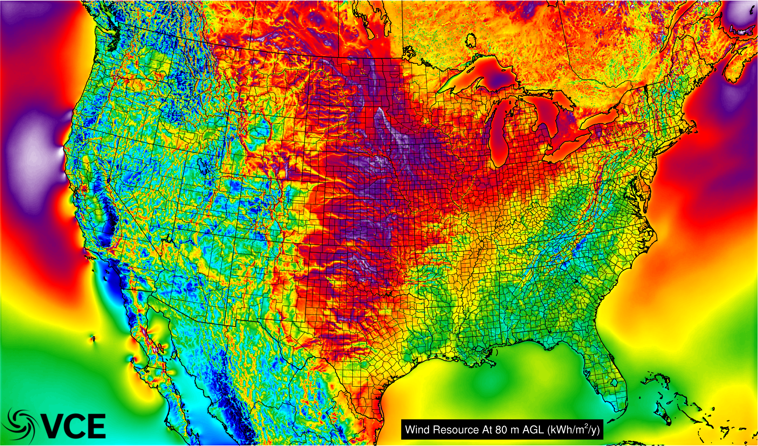
Resources Are Not Singular With Technology

Slide 7
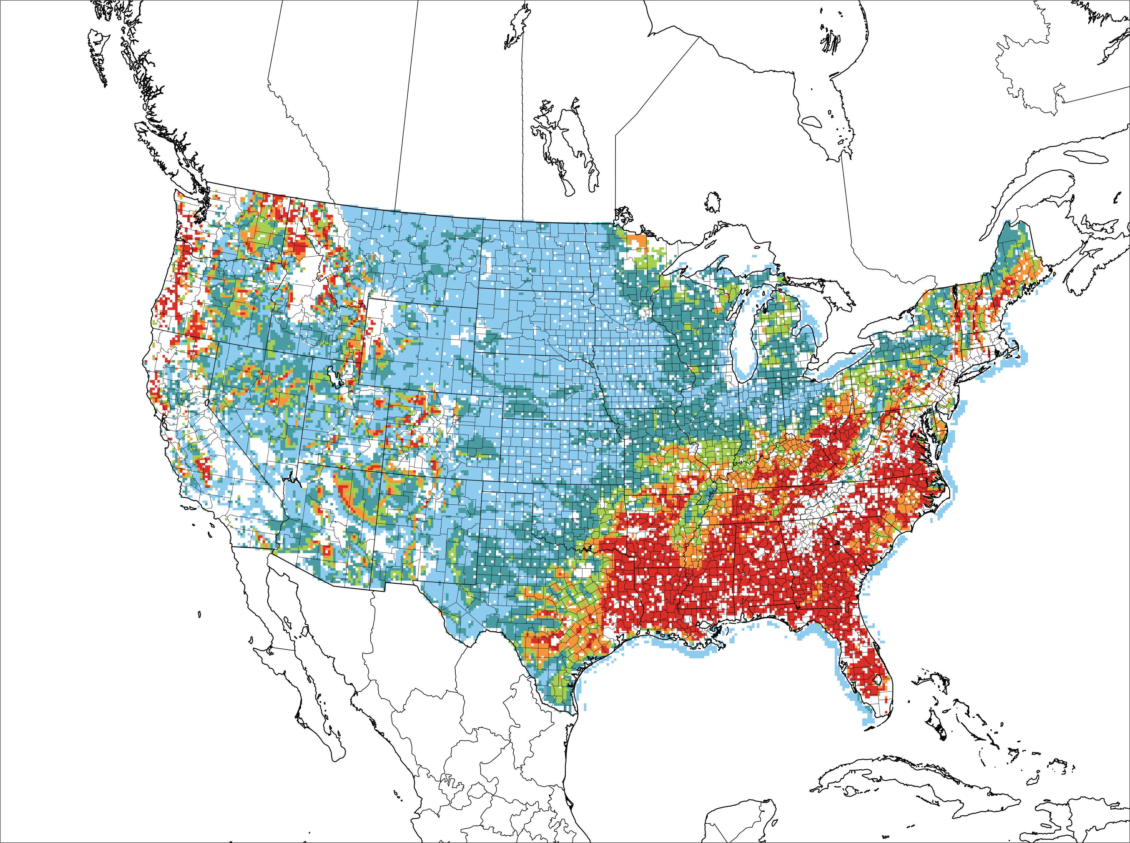
Multiple “Flavors” of Technologies
100m
80m
120m
160m
140m

Slide 8
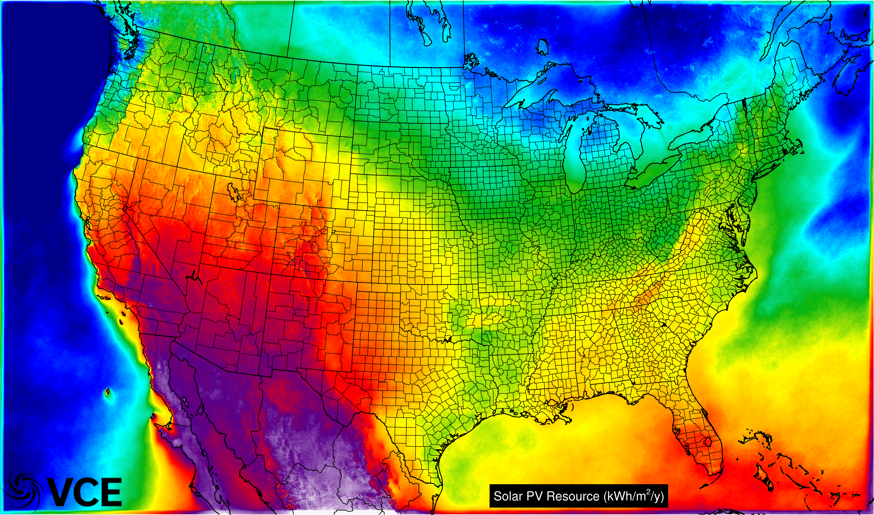
Solar PV Resource Has Options Too
Notes:
Different flavors of solar…

Slide 9
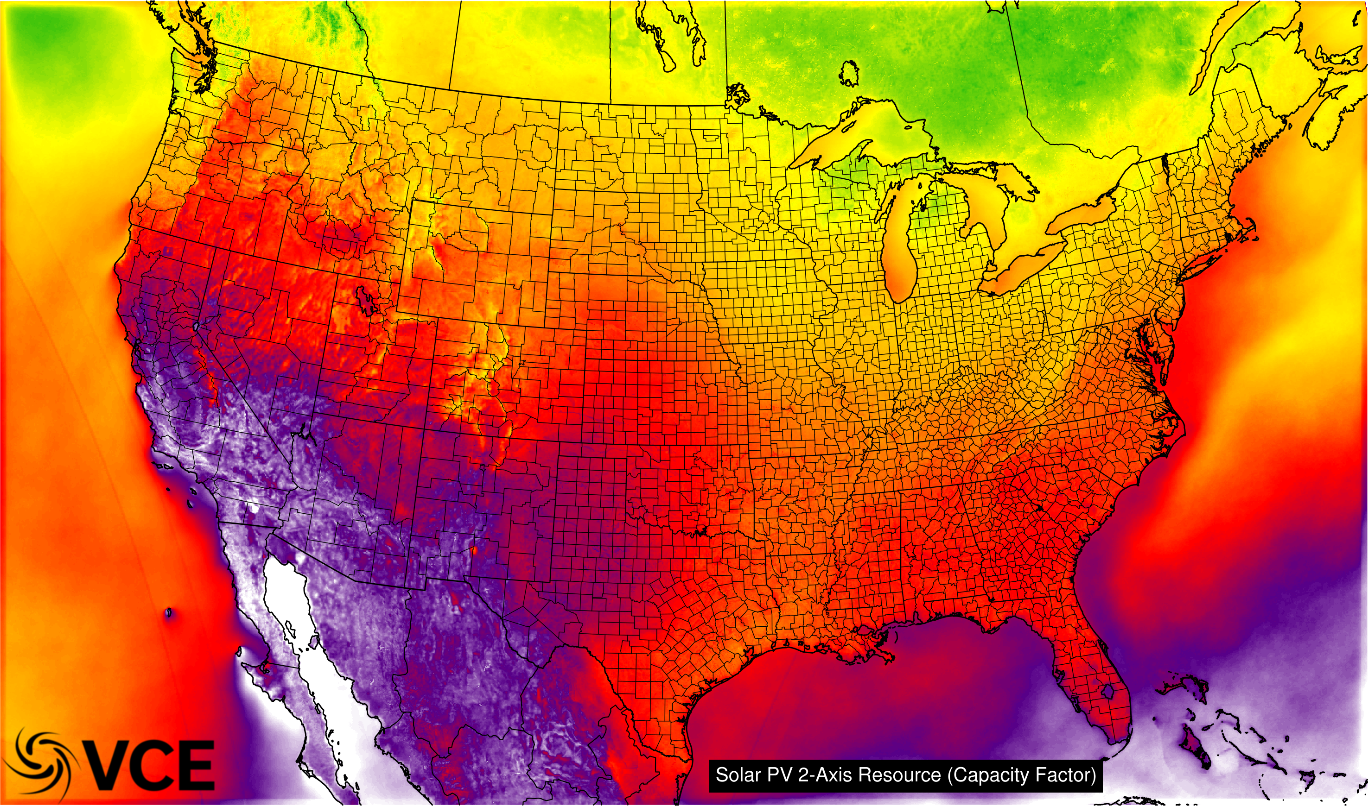
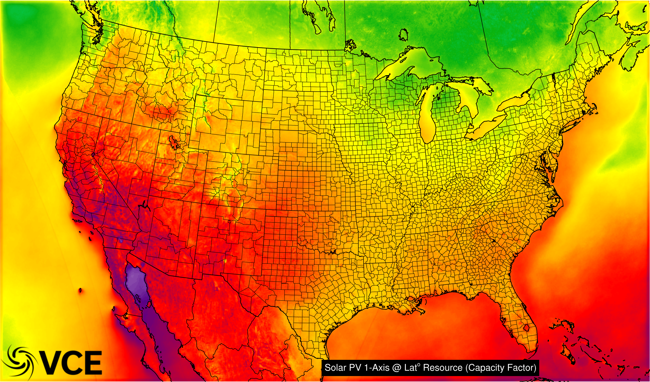
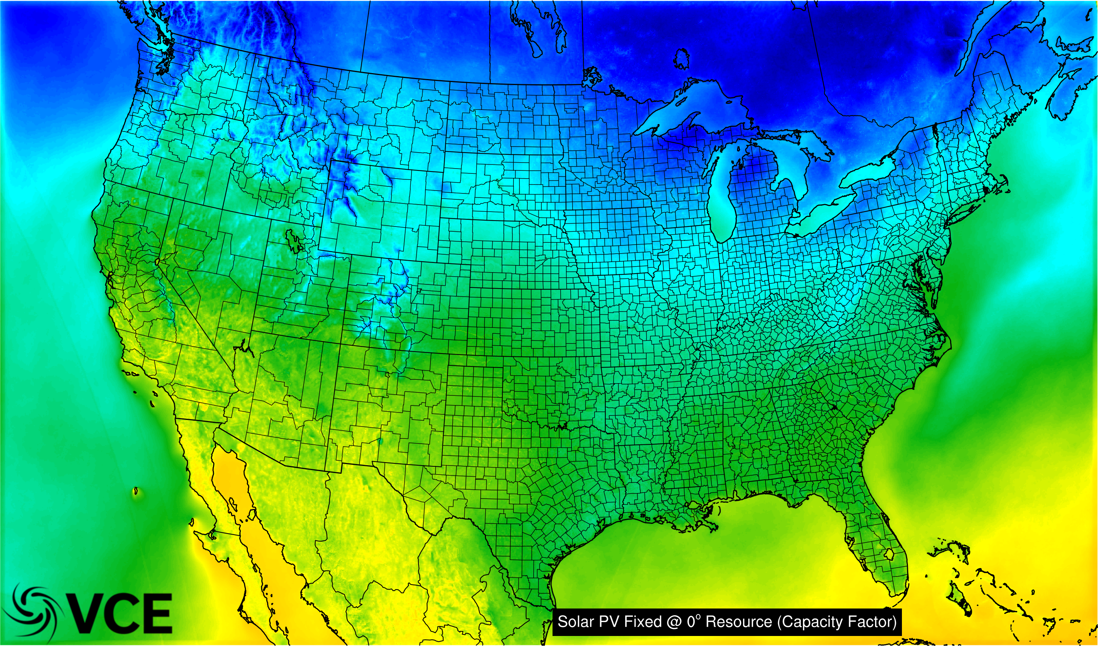
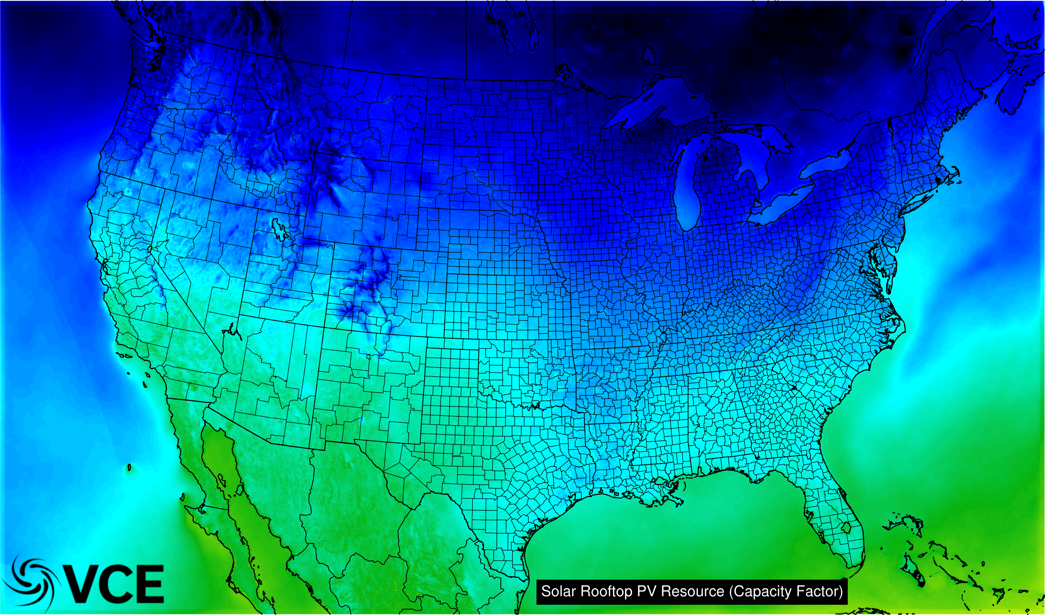
Multiple “Flavors” of Technologies
Notes:
Different flavors of solar…

Slide 10
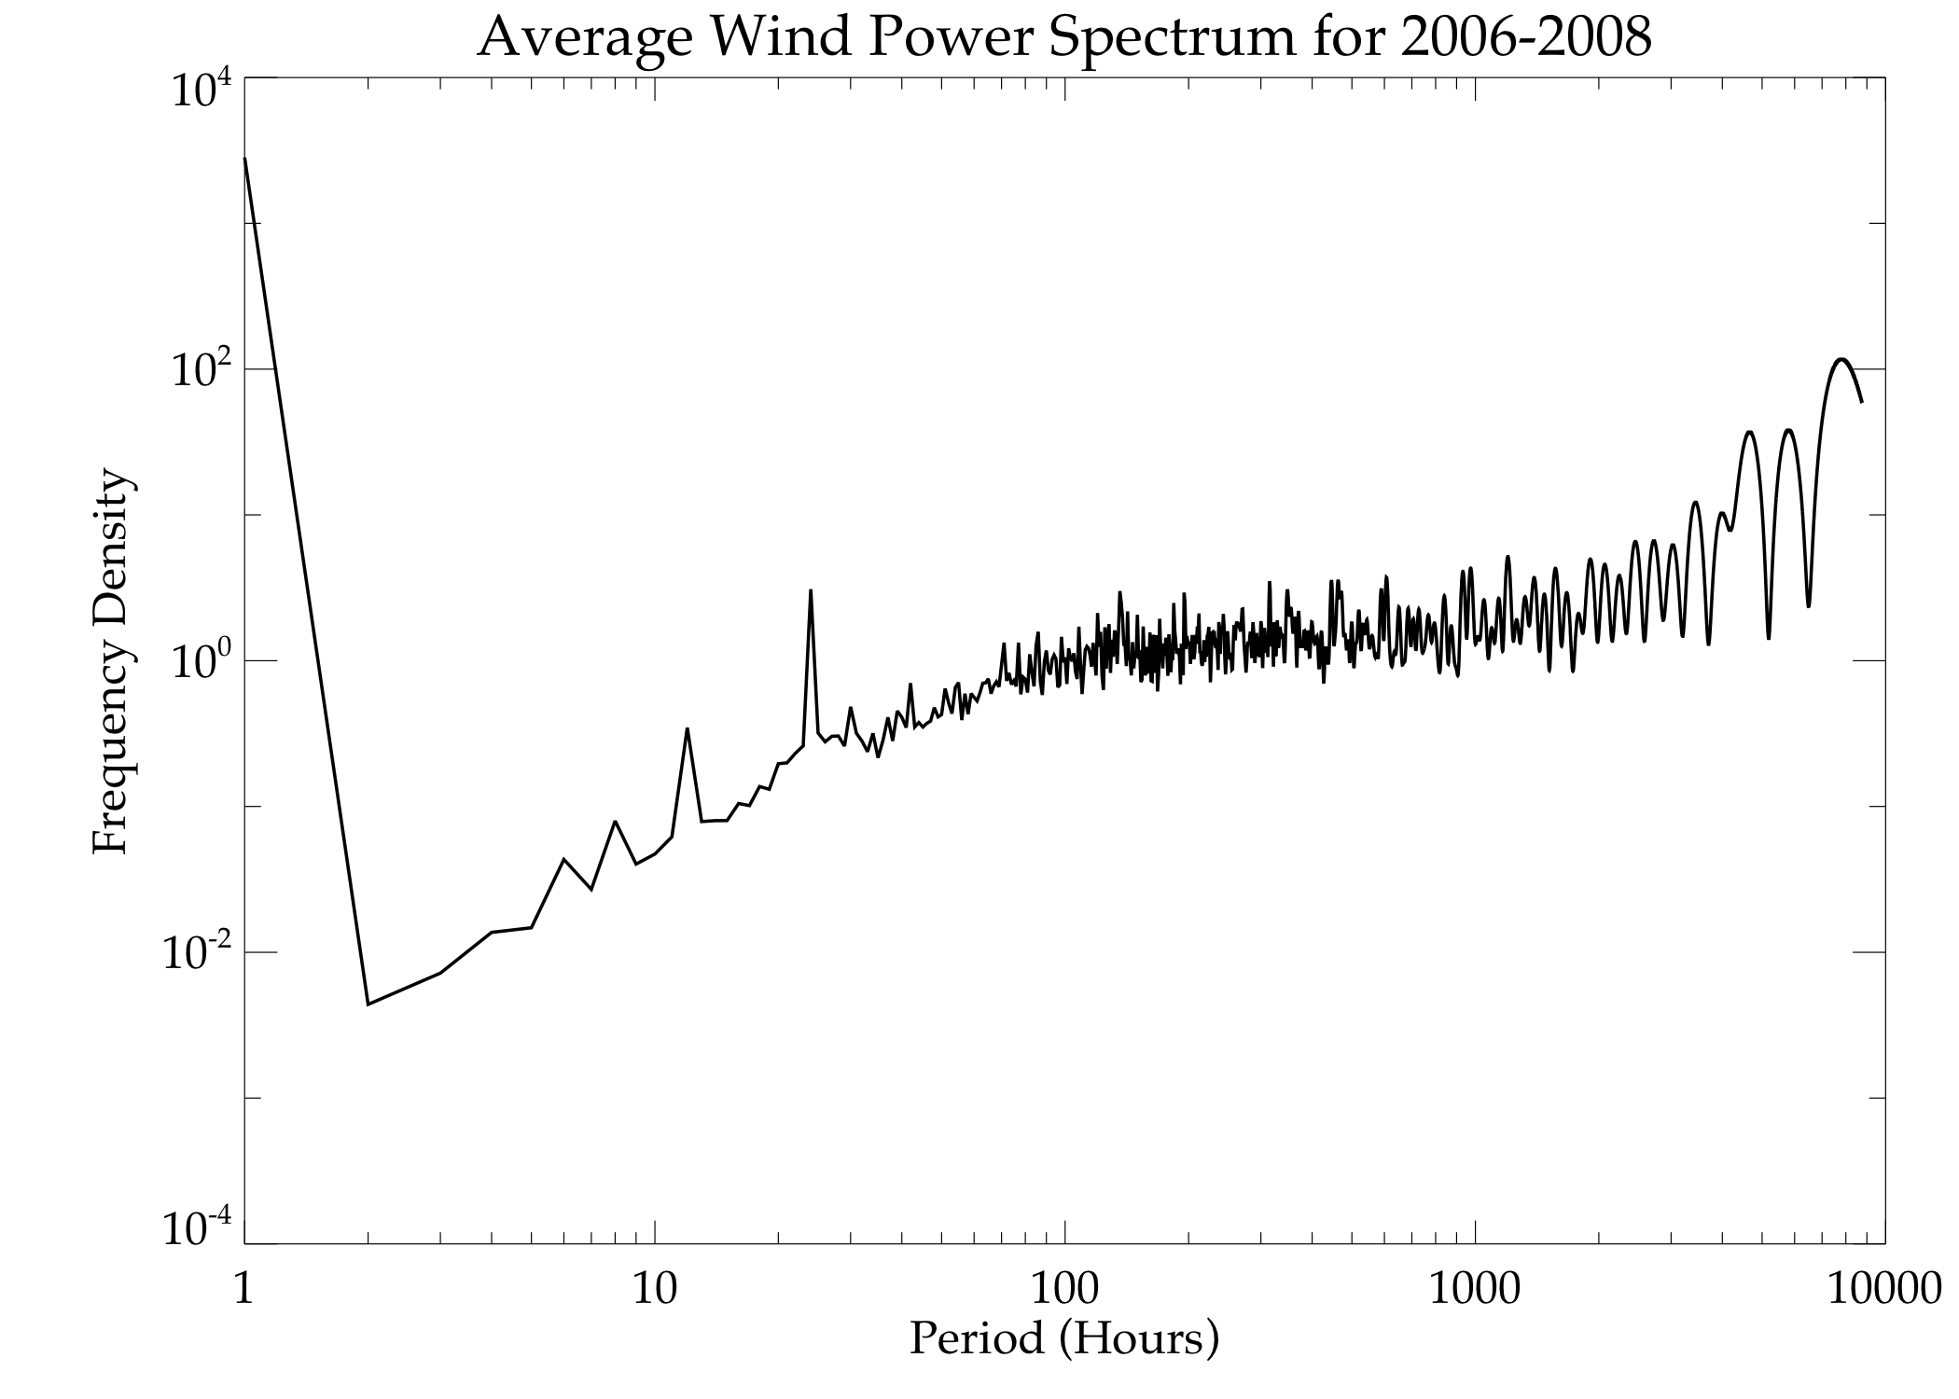
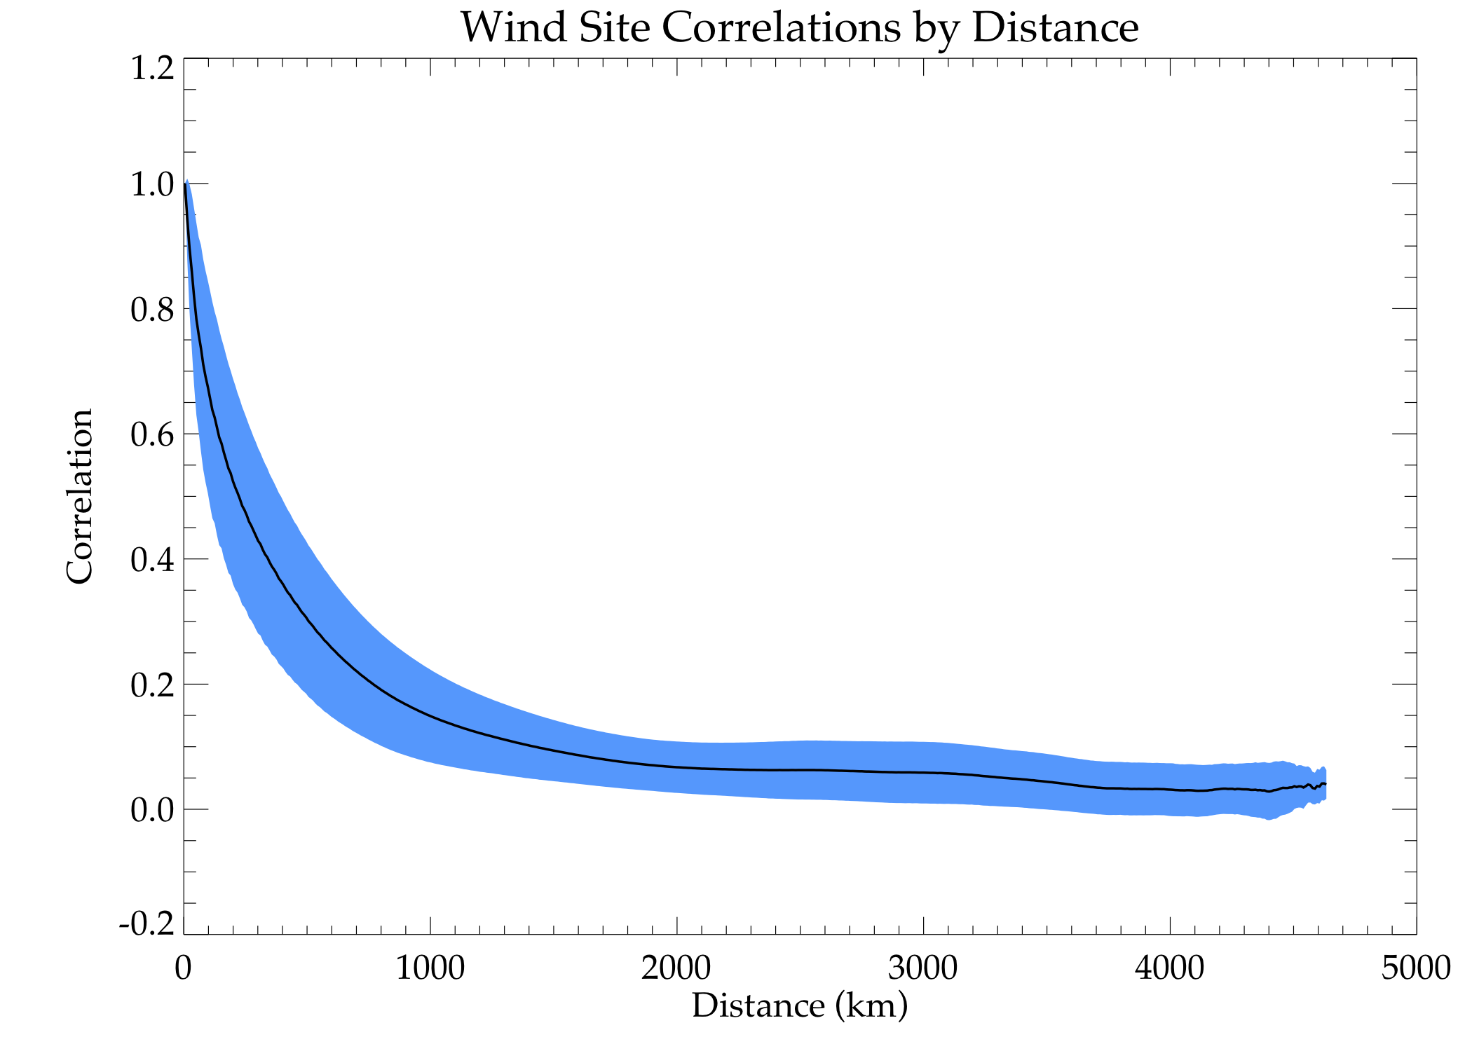
Wind & Solar Are Created By Chaotic Not Random Processes
Therefore, patterns emerge that can be taken advantage of!
24hr
12hr
8hr
After 1,200 km correlations are very low
6hr
Energy Density Accumulates At Predictable Times & Sites Decorrelate Rapidly
Thus, uncertainty in resources can be incorporated directly into modeling – if high resolution and long time horizons are utilized.

Slide 11
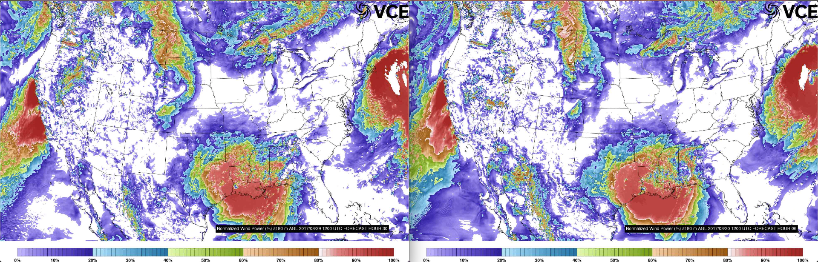
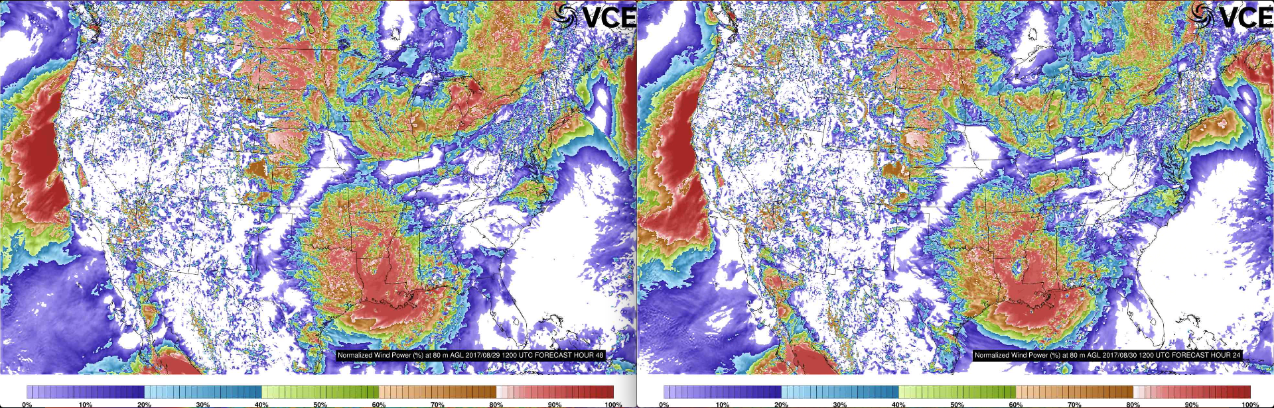
Weather Forecasts Bring New Uncertainty
30 hours
6 hours
48 hours
24 hours
Notes:
Different flavors of solar…

Slide 12
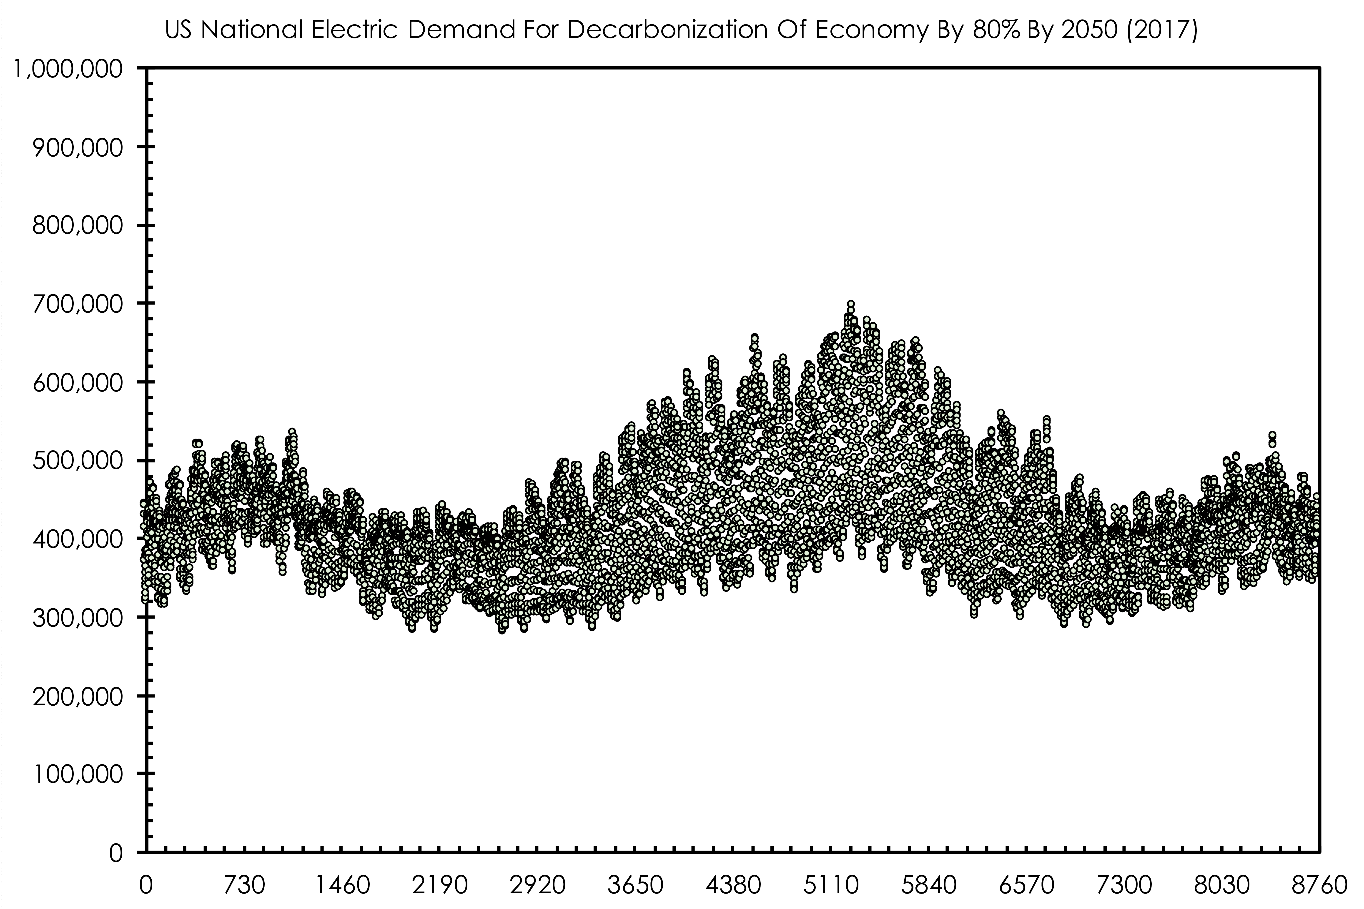
Can Reduce Uncertainty With New Loads That Are More Flexible
EVs;
Space Heat Pumps;
Water Heat Pumps;
Renewable Controls;
Transmission Control;
Storage.
Notes:
Load is driven substantially by the weather, and we want that to be more so, not less…

Slide 13
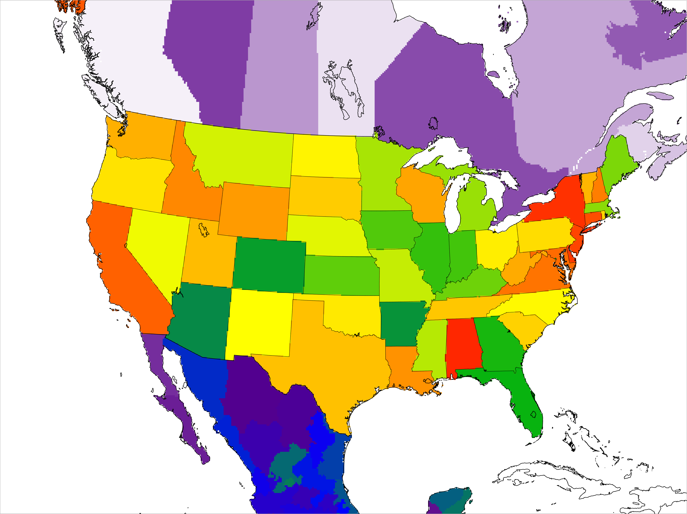
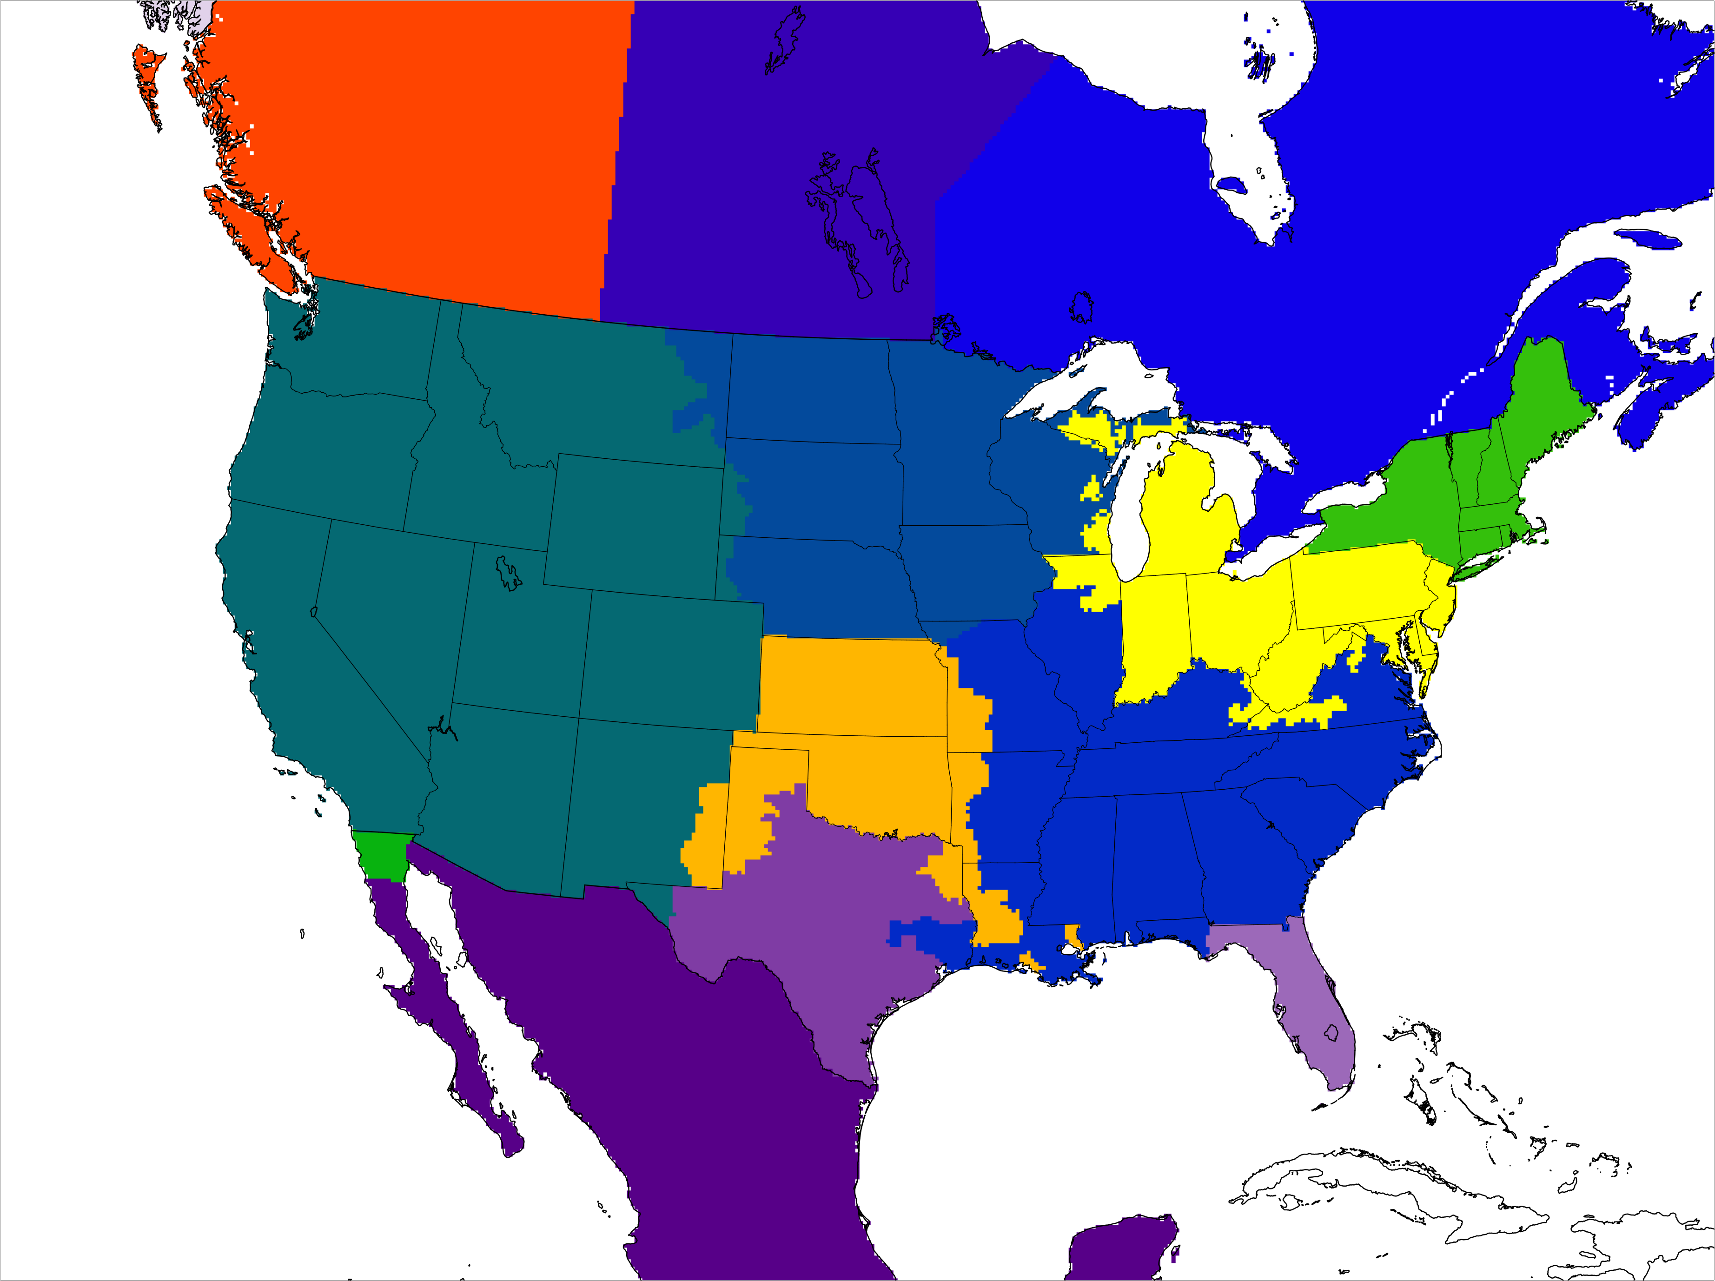
Consider: Various Scales Simultaneously To Enable Uncertainty incorporation of cooperation & competition between regions [Transmission Also]

Slide 14
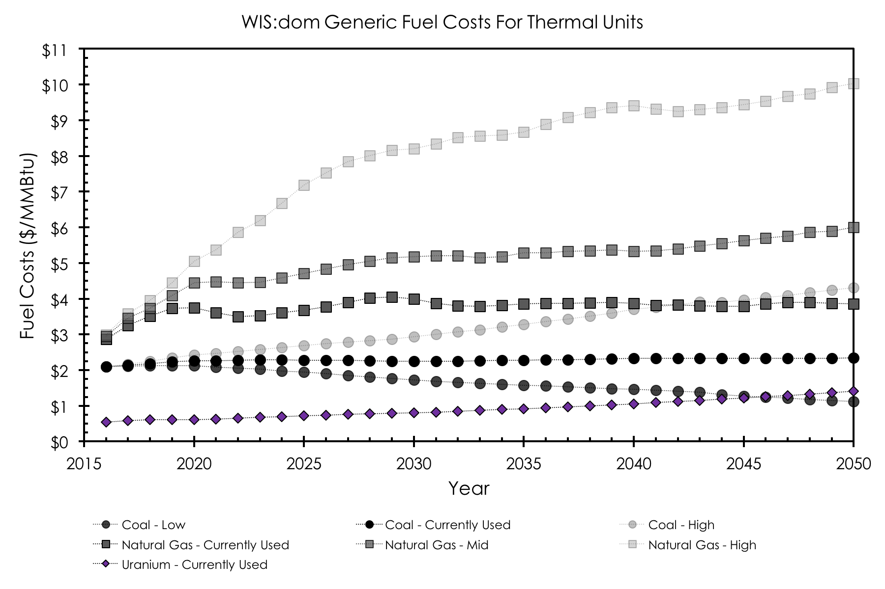
Fuel Costs Have Uncertainty & Can Solve With Probability Or Shadow Pricing
Notes:
Different flavors of solar…

Slide 15
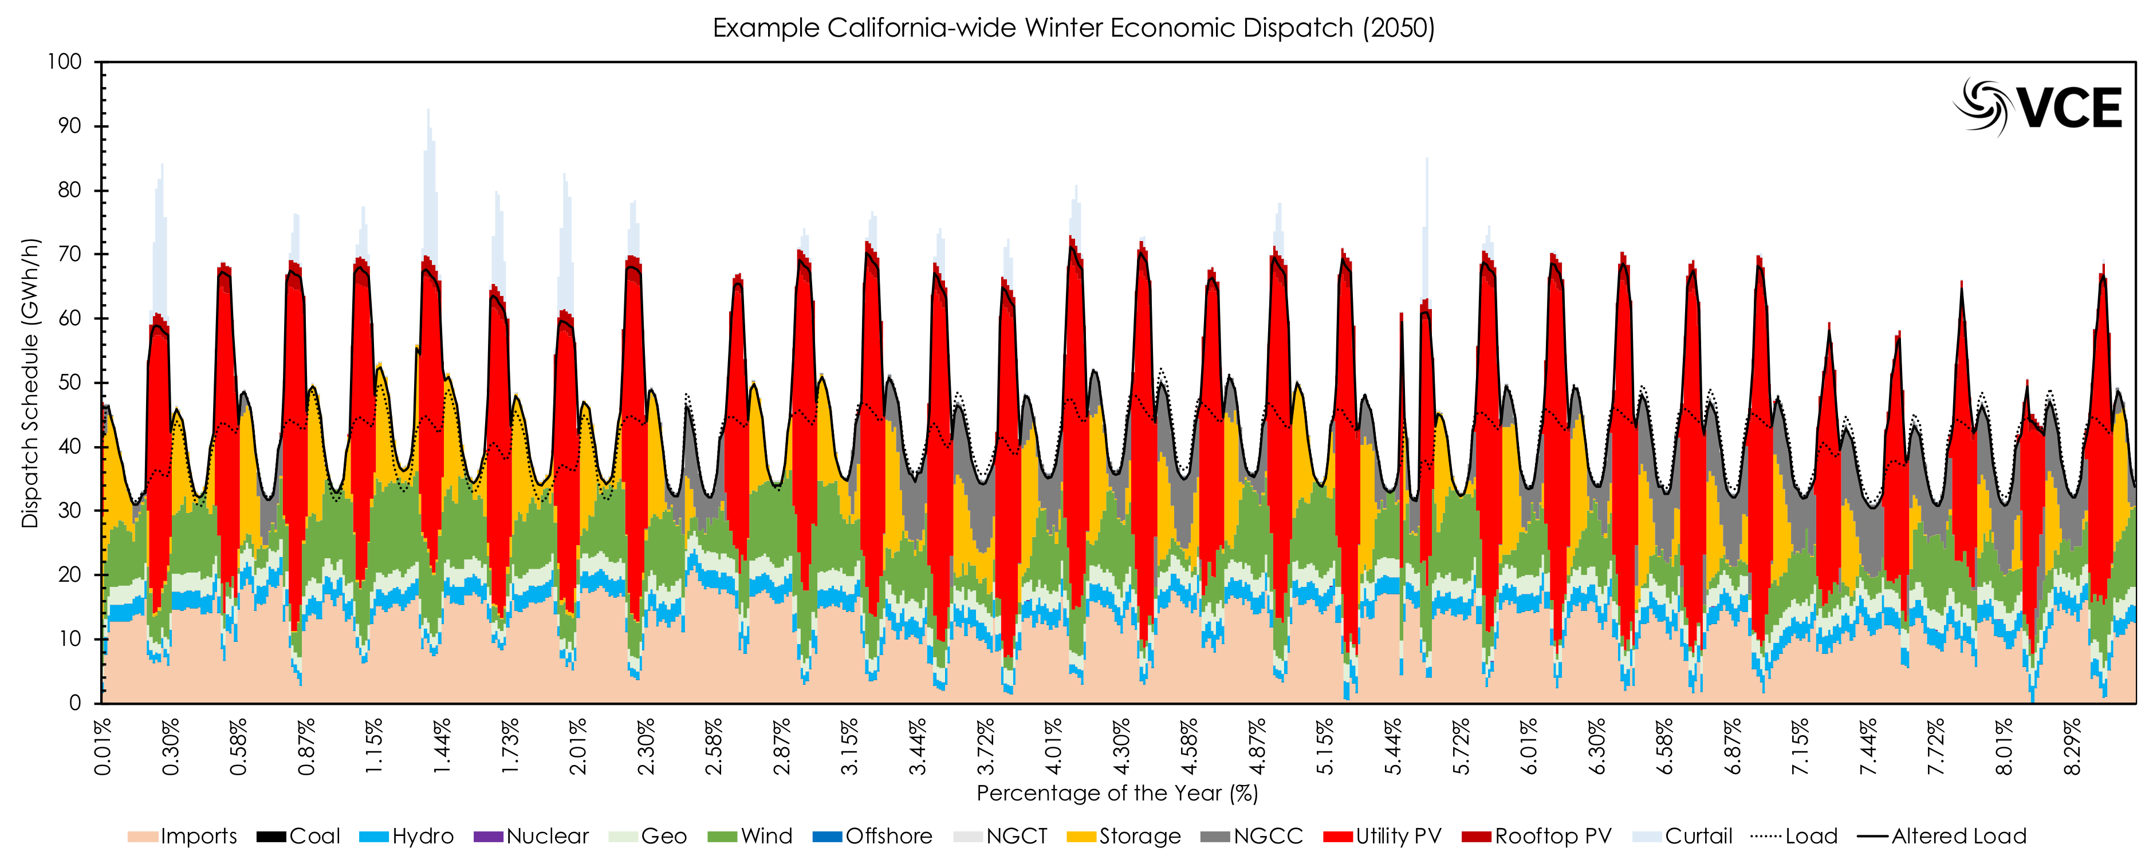
Summary
In general, more flexibility provided by VRE generation, robust transmission investment, electrified loads, & storage coming online will reduce the focus on uncertainty and move focus to data management and security.
Notes:
Different flavors of solar…

Slide 16
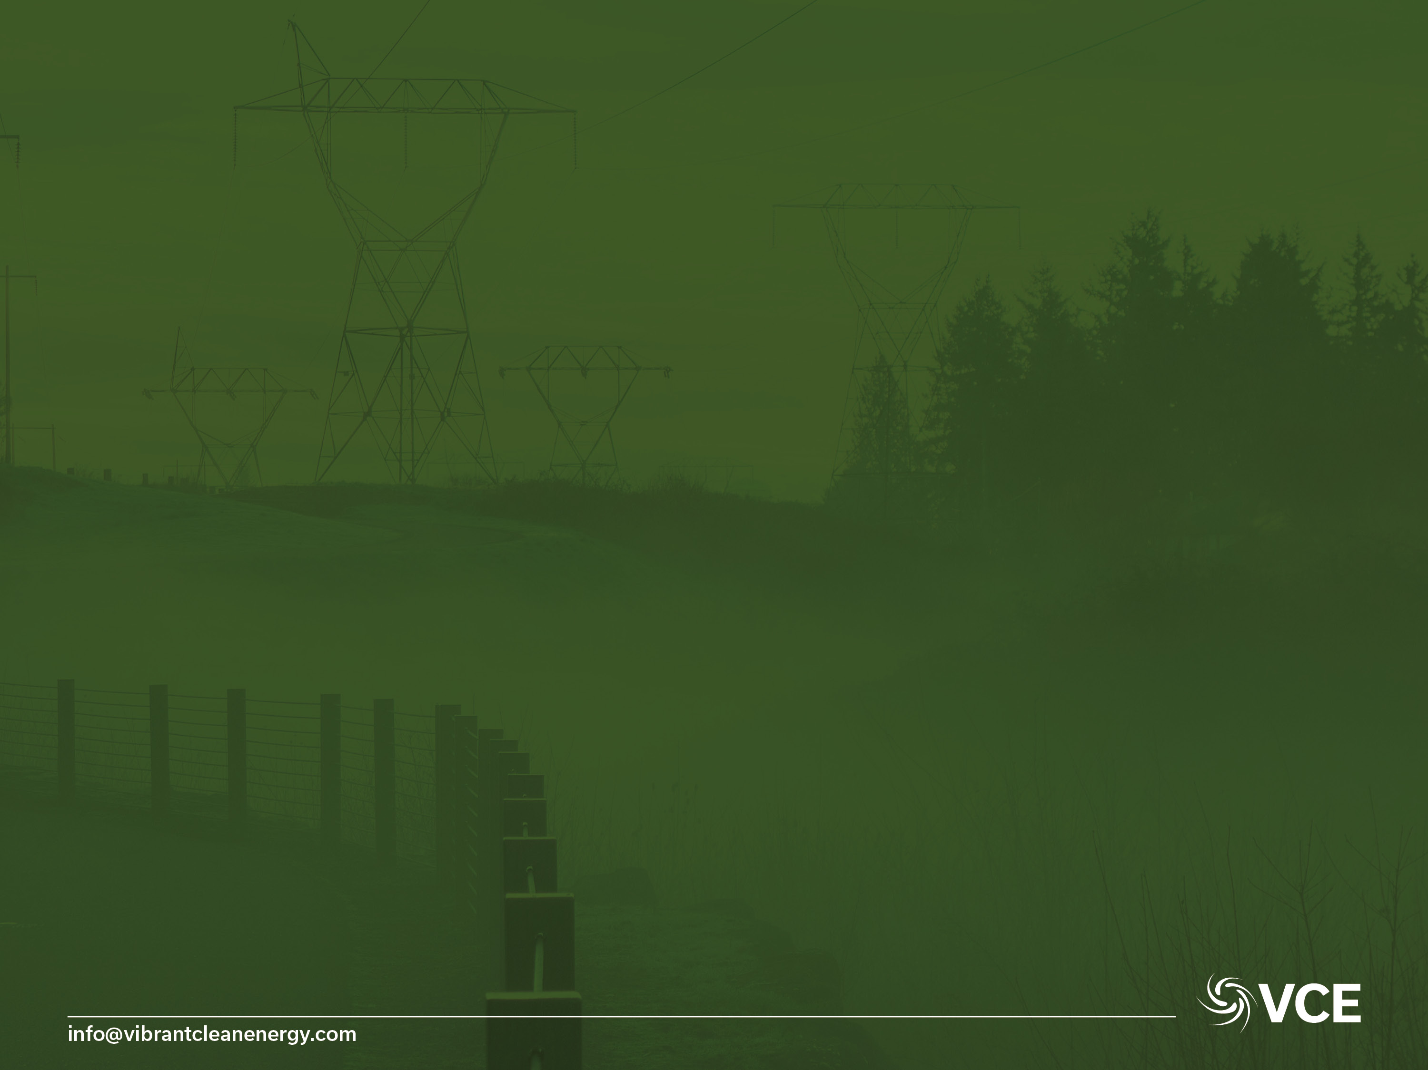
Thank You
Dr Christopher T M Clack
CEO Vibrant Clean Energy, LLC
Telephone: +1-720-668-6873
E-mail: christopher@vibrantcleanenergy.com
Website: VibrantCleanEnergy.com
Twitter: @Clacky007

