Slide 1
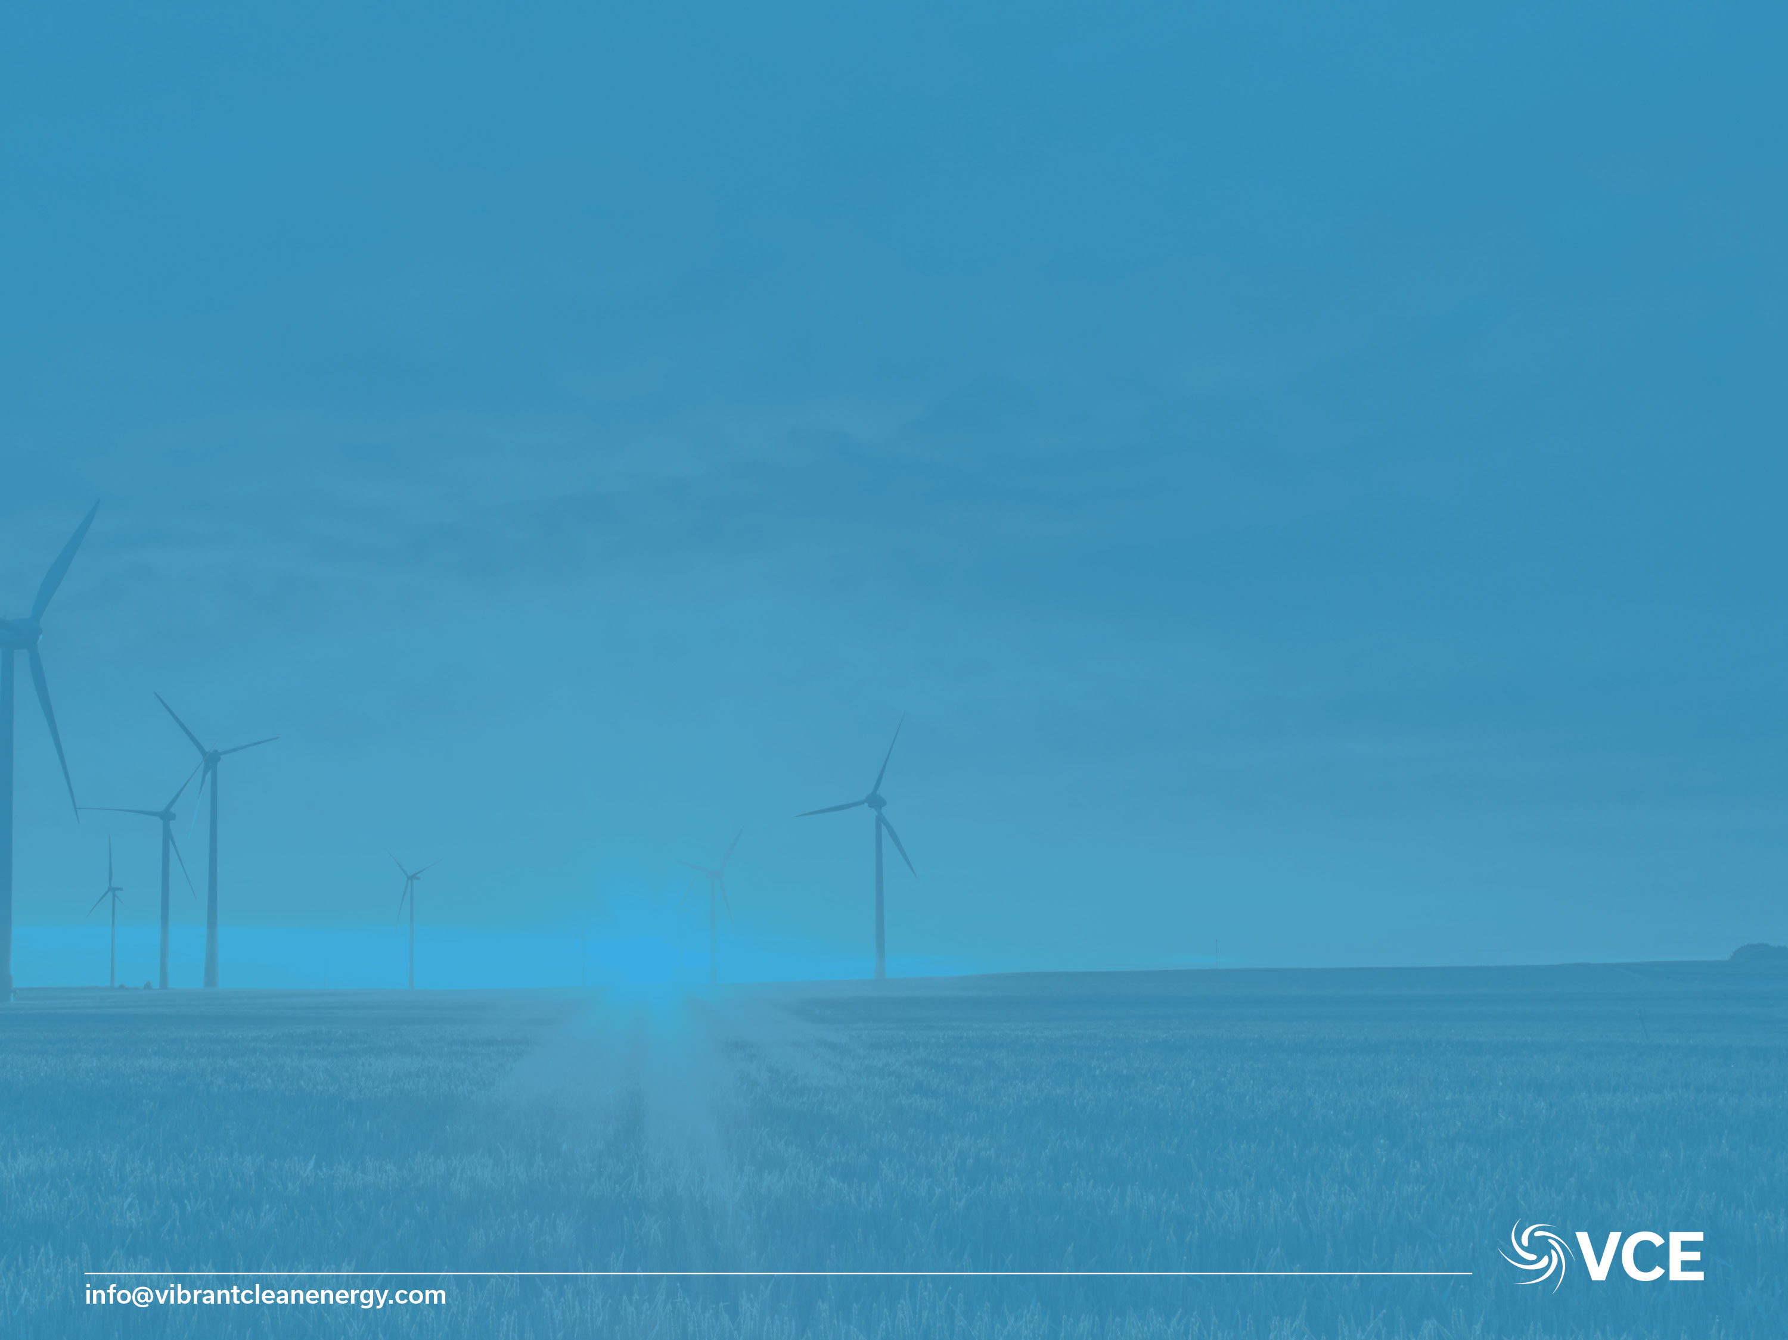
Beyond 30% Renewable Electricity in Alberta:
Supply-Mix Considerations
Prepared By:
Vibrant Clean Energy, LLC
Dr Christopher T M Clack
Prepared For:
Solar Canada 2018
BMO Centre Calgary AB, Canada
June 20th, 2018
Disclaimer:
This presentation has been prepared in good faith on the basis of information available at the date of publication. The analysis was produced by Vibrant Clean Energy, LLC. No guarantee or warranty of the analysis is applicable. Vibrant Clean Energy, LLC will not be held liable for any loss, damage, or cost incurred by using or relying on the information in this presentation.

Slide 2

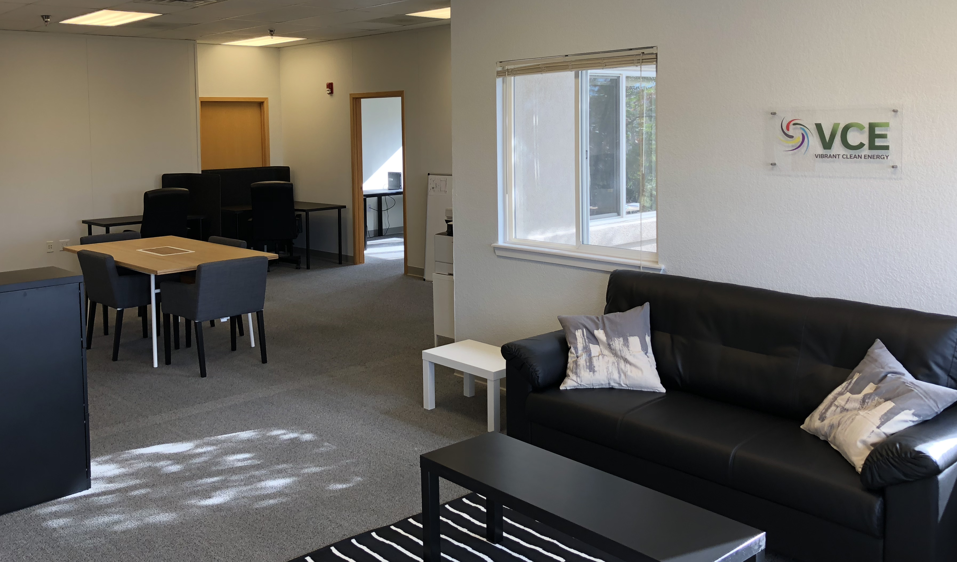
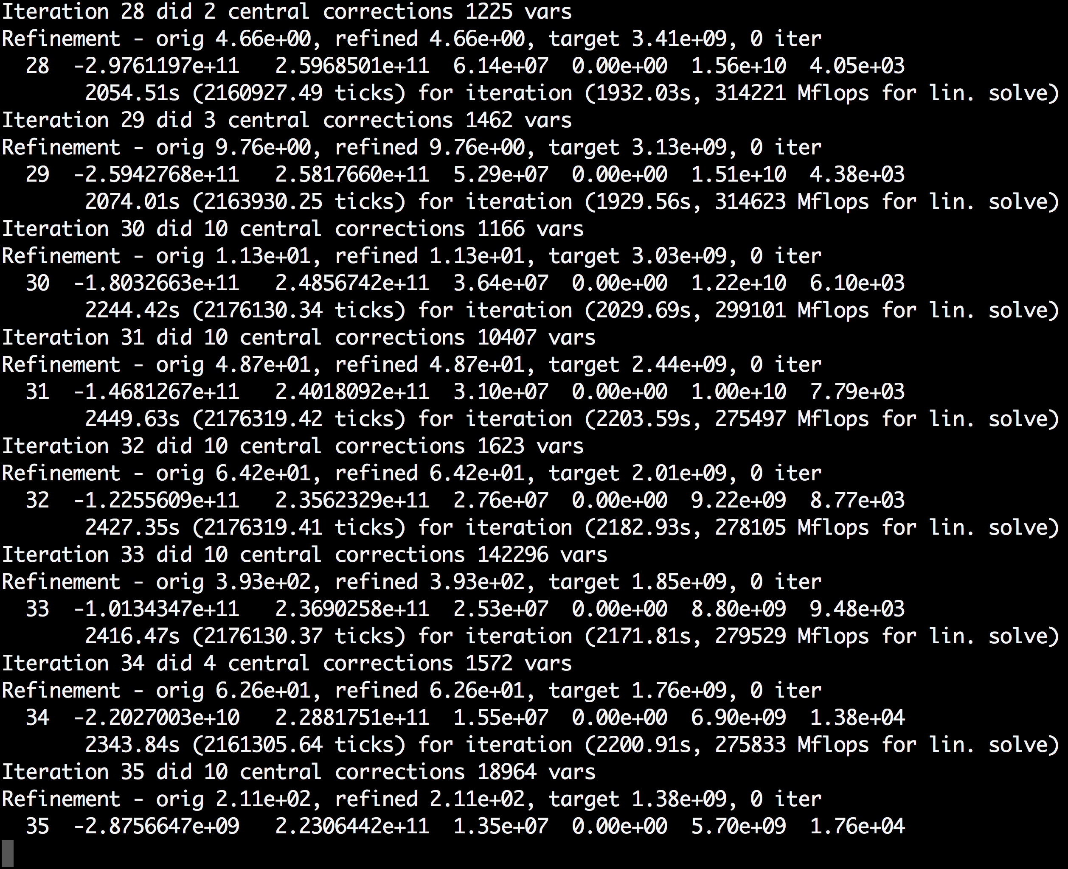
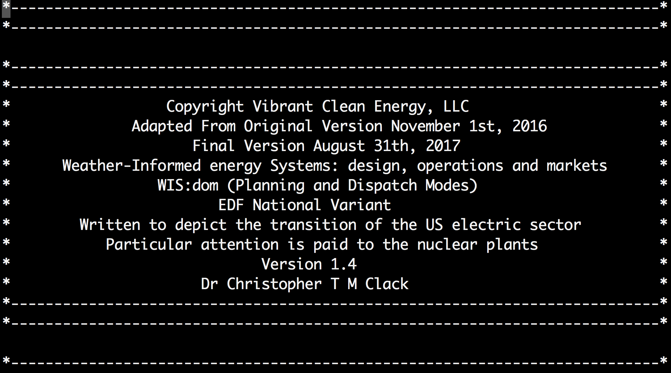
Vibrant Clean Energy
Purpose of Vibrant Clean Energy, LLC:
Reduce the cost of electricity & help evolve economies to near zero emissions;
Co-optimize transmission, generation, storage, & distributed resources;
Increase the understanding of how Variable Generation impacts & alters the electricity grid and model it more accurately;
Agnostically determine the least-cost portfolio of generation that will remove emissions from the economy;
Model the electrification of industry, heating & transportation;
License WIS:dom optimization model and/or perform studies using the model;
Assist clients unlock and understand the potential of high VRE scenarios, as well as zero emission pathways.

Slide 3
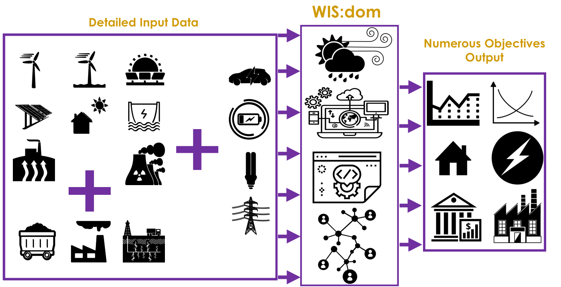
Pushing The Envelope: The WIS:dom Model

Slide 4
How Does Weather Work?

Slide 5
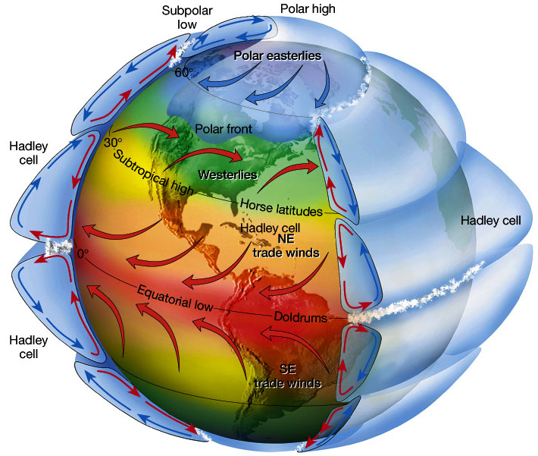
Global Heat Transfer Drives Wind & Solar Constantly
This global heat engine runs constantly driving wind and cloud patterns.
Processes are well understood.
Driven By Solar Irradiance & Earth-Sun Distance.
Therefore “variability” is a local effect.
Image Credit: Figure 7.5 in The Atmosphere, 8th edition, Lutgens and Tarbuck, 8th edition, 2001

Slide 6
Variability Of Wind & Solar Shrinks With Larger Areas
Canada
New Brunswick
Alberta
Wind & solar can back each other up using their nature

Slide 7
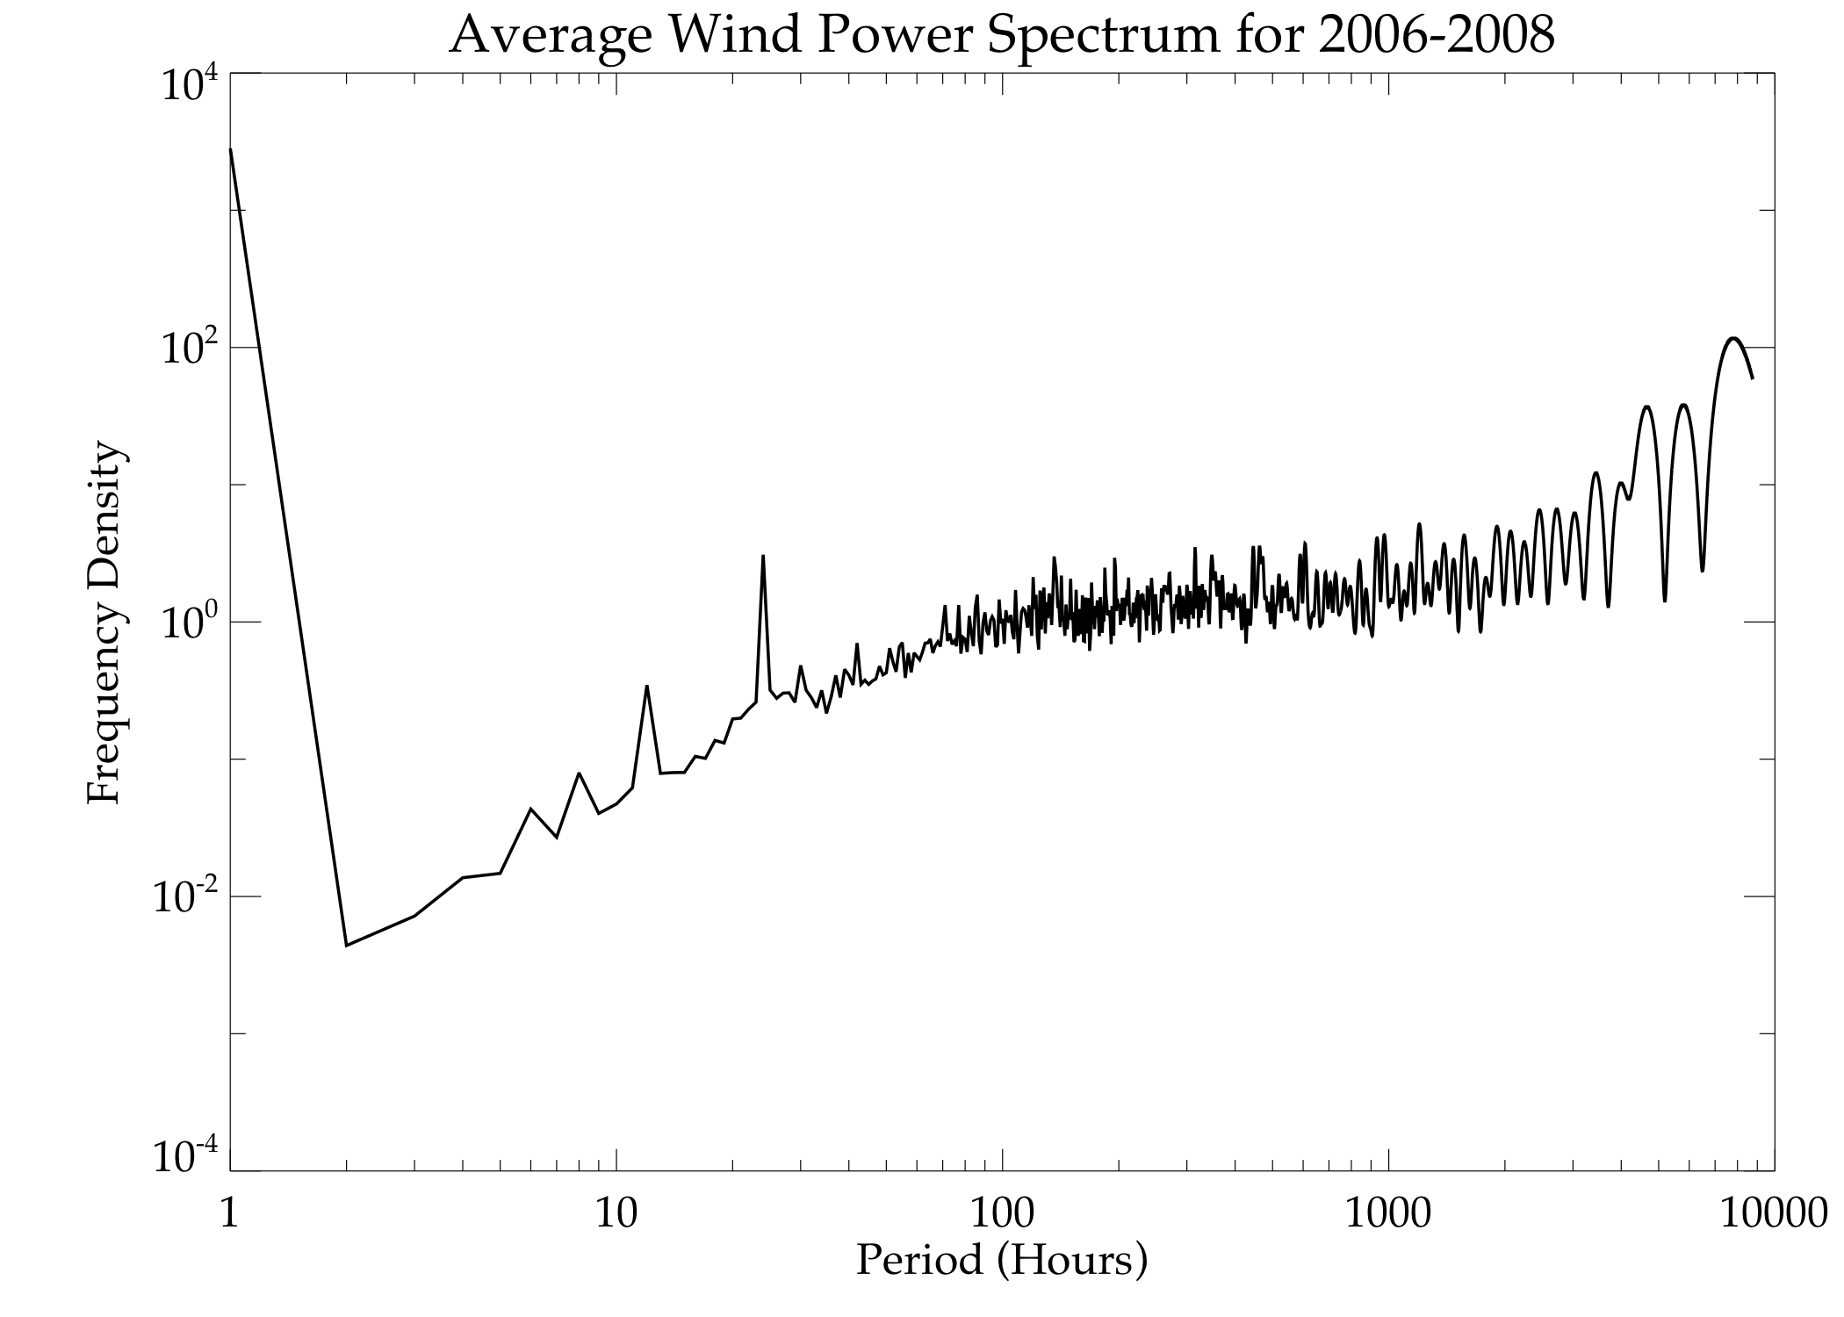
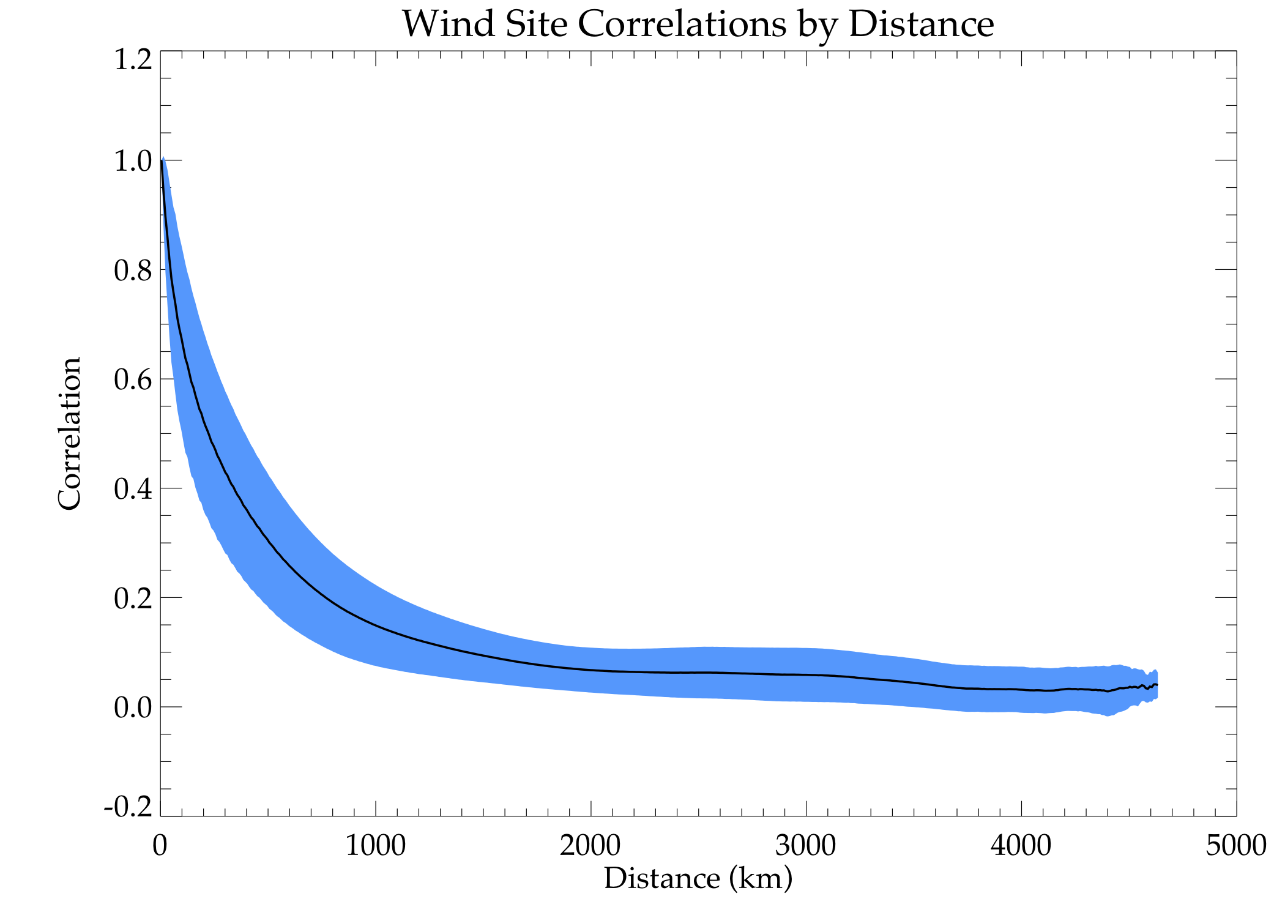
Wind & Solar Are Created By Chaotic Not Random Processes
Therefore, patterns emerge that can be taken advantage of!
24hr
12hr
8hr
After 1,200 km correlations are very low
6hr
Energy Density Accumulates At Predictable Times & Sites Decorrelate Rapidly

Slide 8
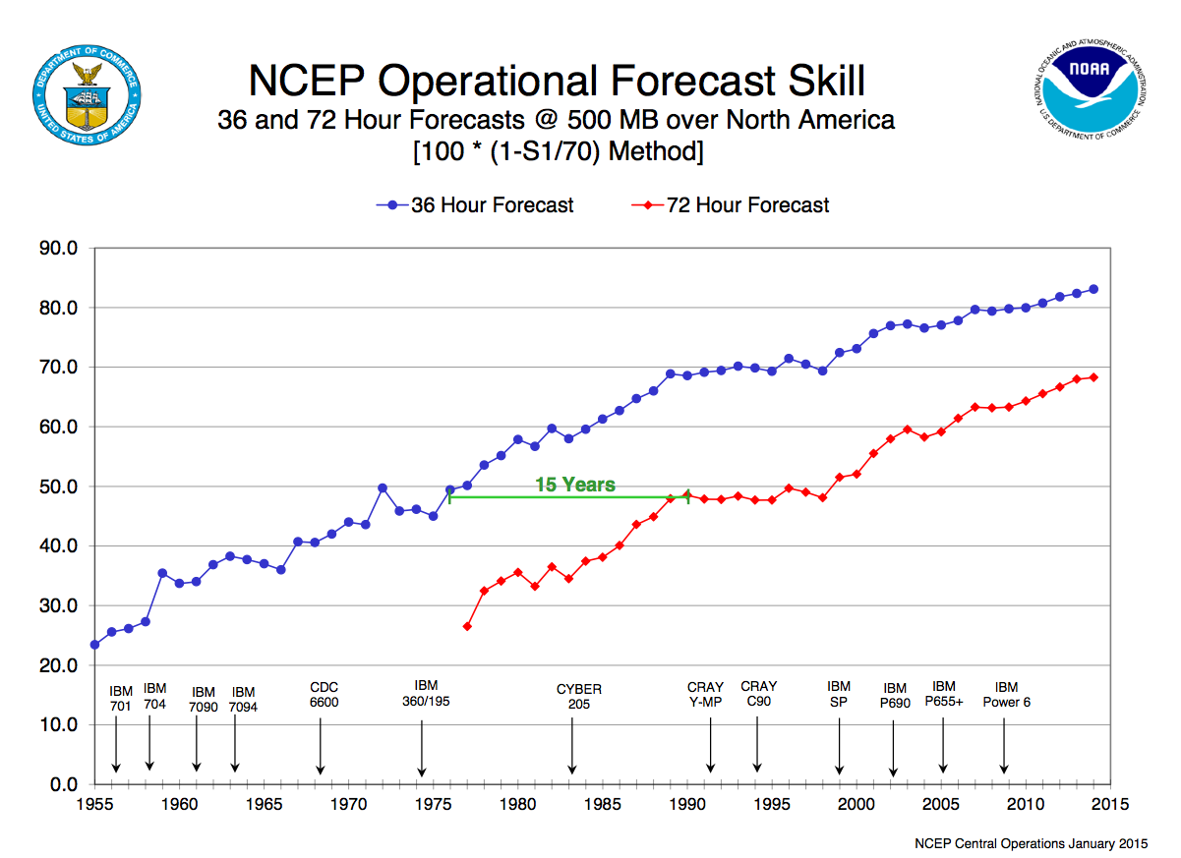
Weather Forecasts Are Always Improving
Forecasts Accurate Enough To Rely On For Large Areas (local errors cancel)

Slide 9
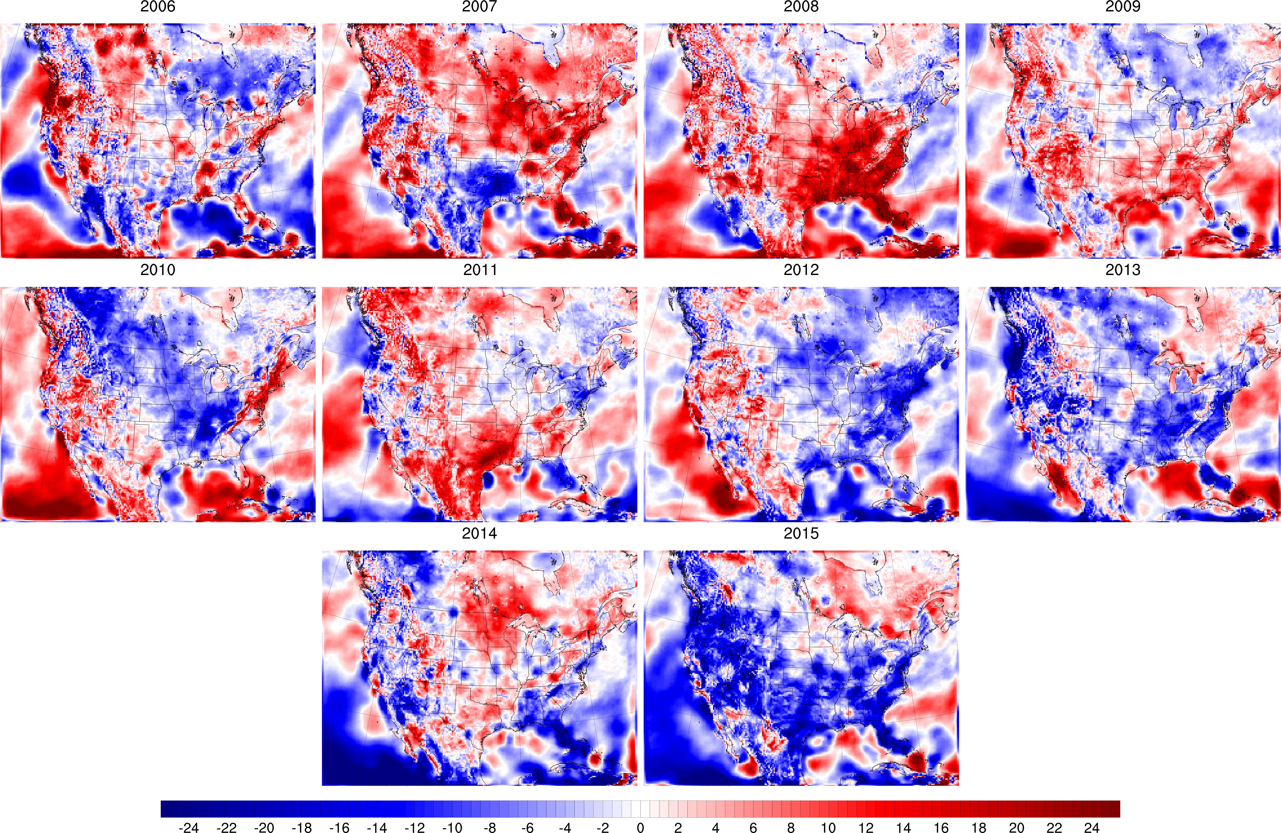
Wind & Solar Are Variable So Need Careful Consideration
Long-term, high-resolution data are essential to understand the processes
There is no “gut feeling” or “randomness” about the weather!

Slide 10
There is not a single “wind” technology
Cannot assume that all wind hub heights (and technology) behave the same

Slide 11
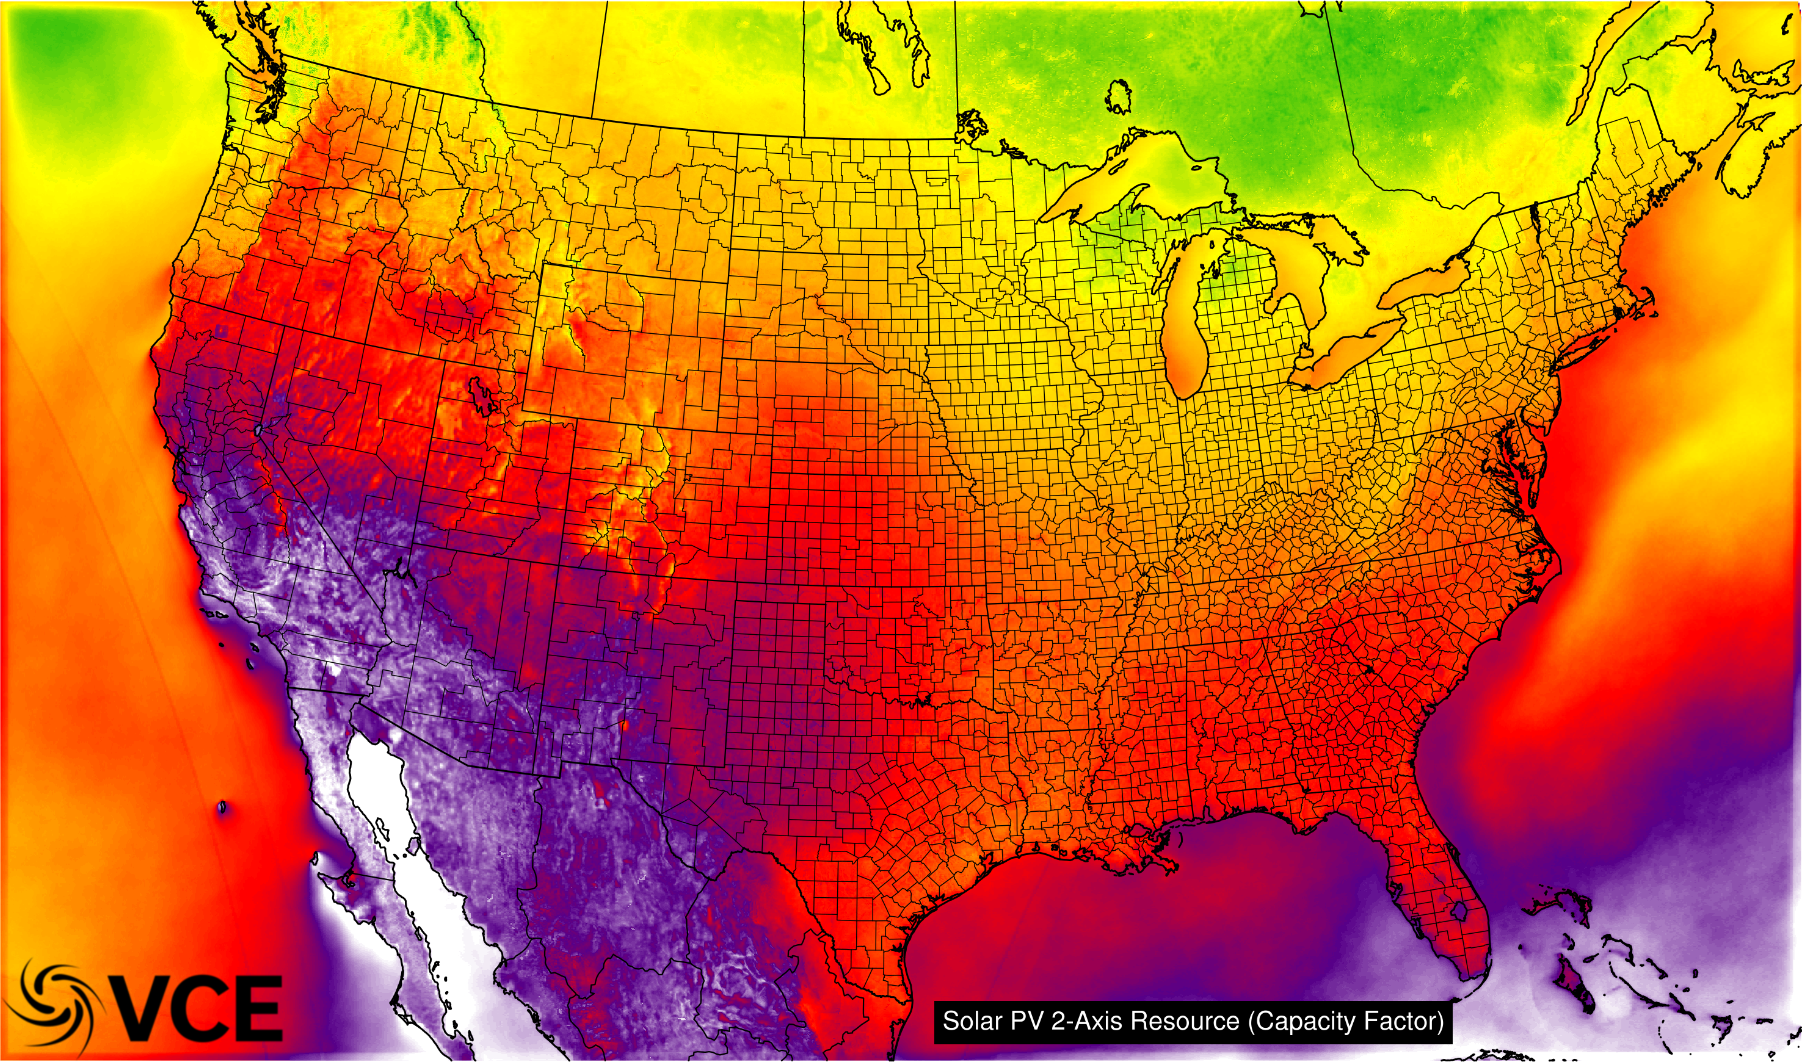
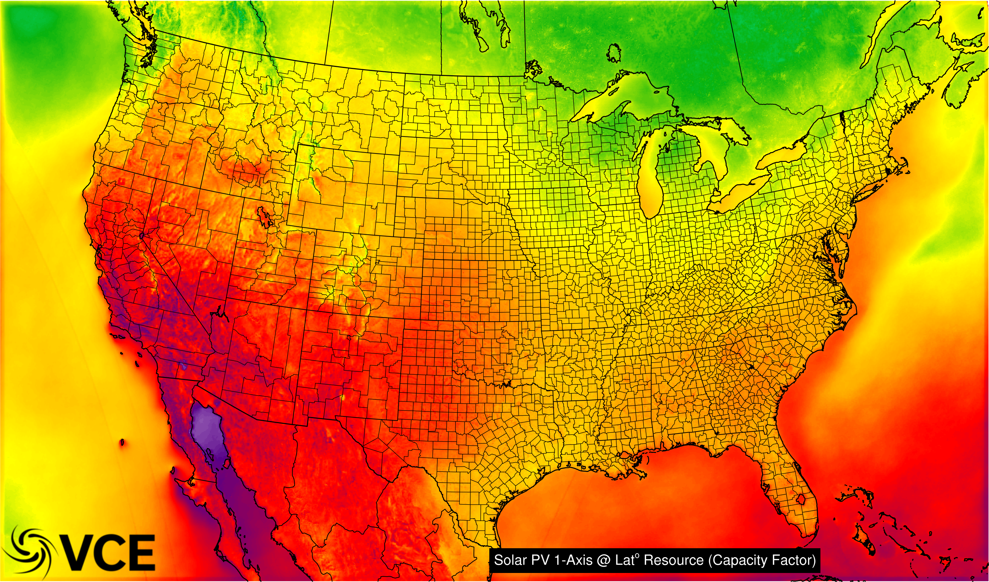
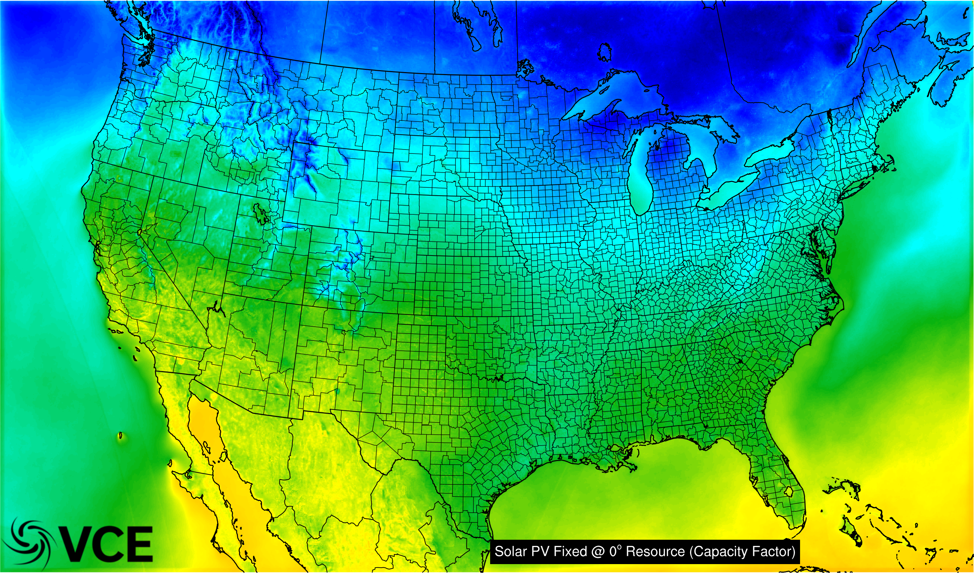
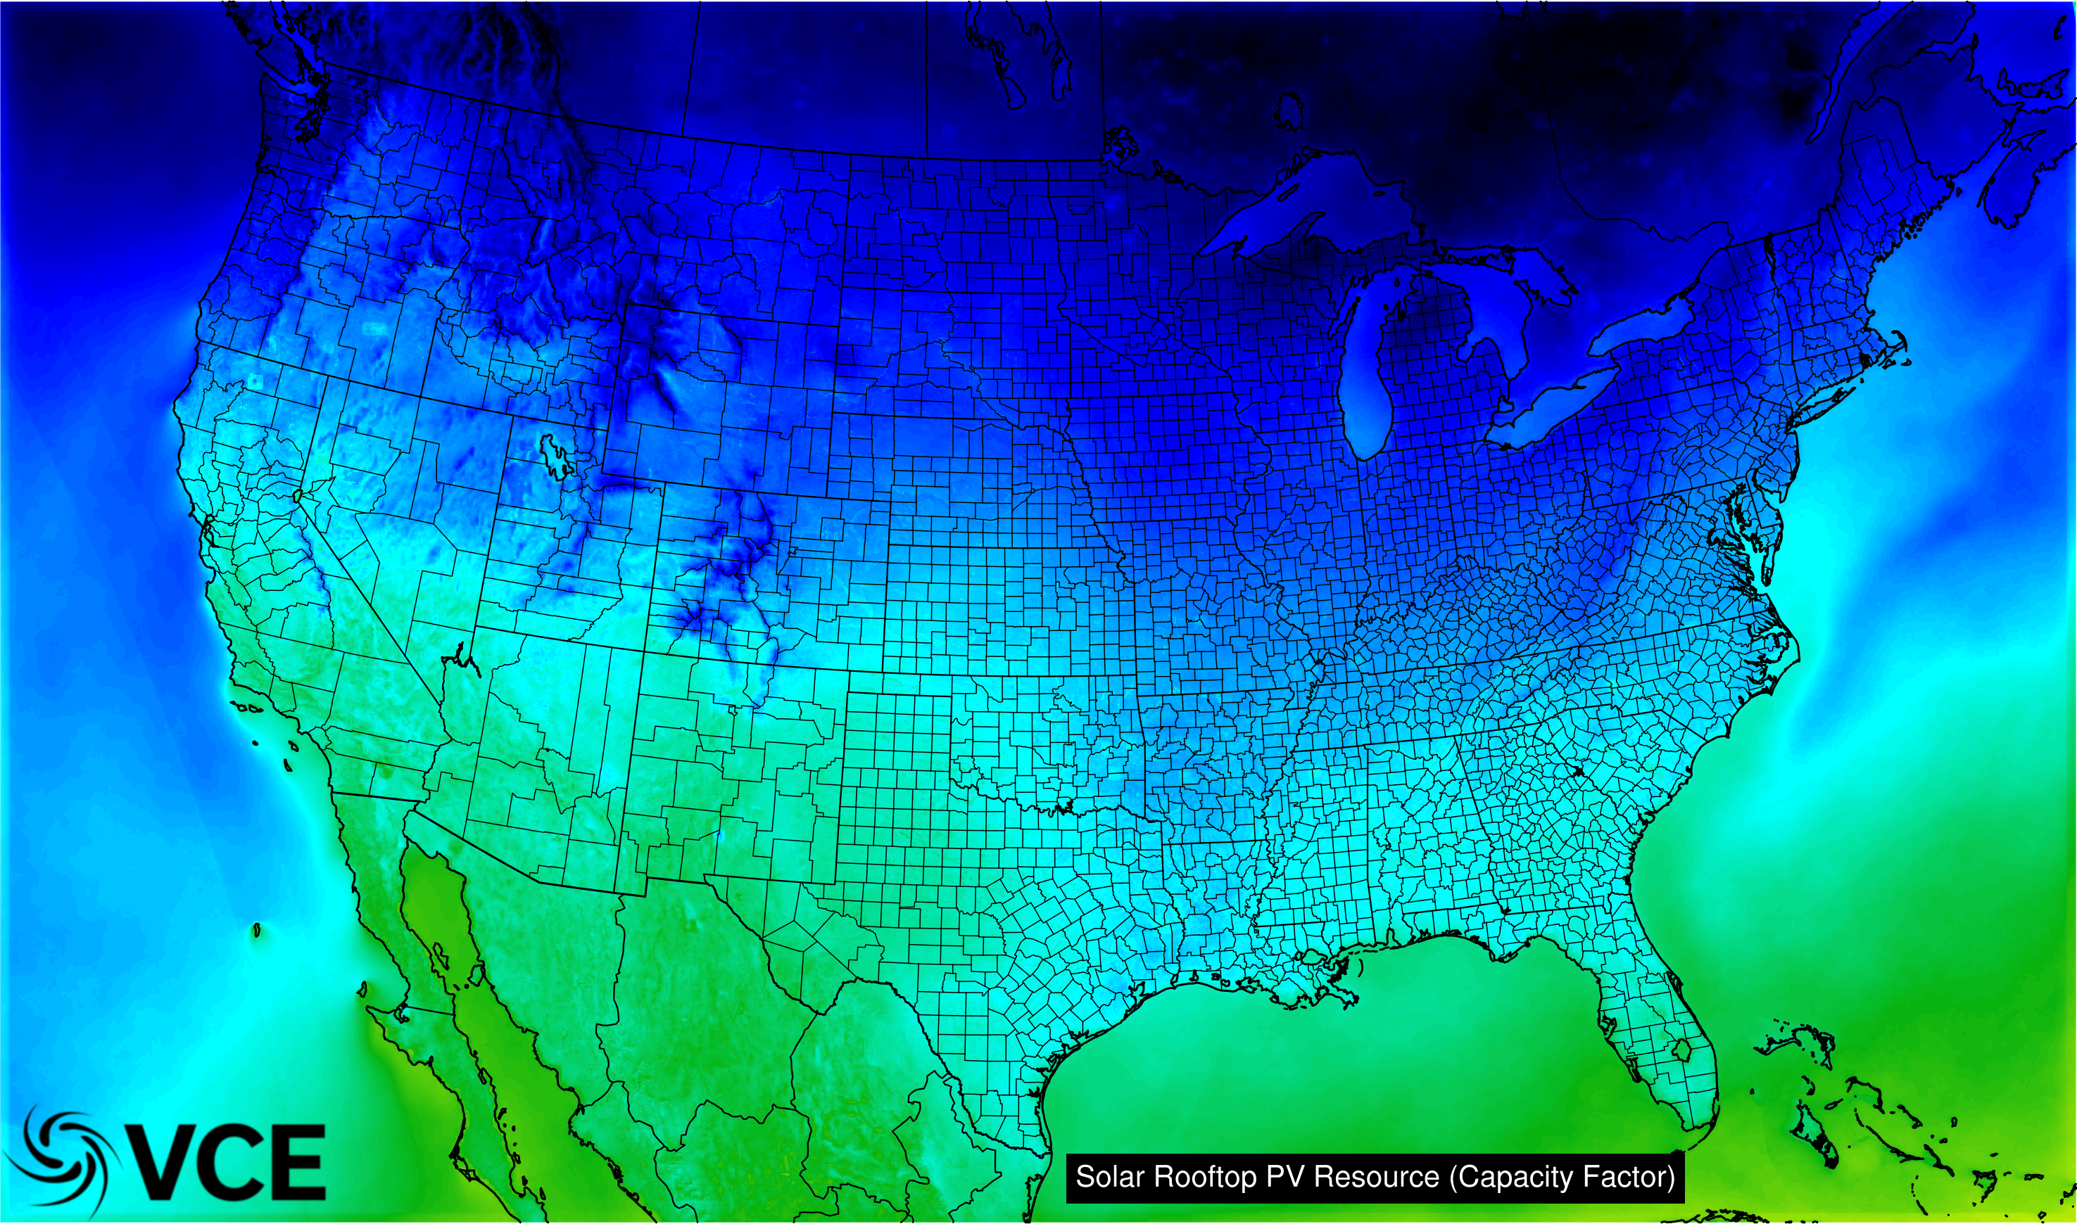
Similarly There Is Many Types of ”Solar PV”
Different types of solar create unique time series power production

Slide 12
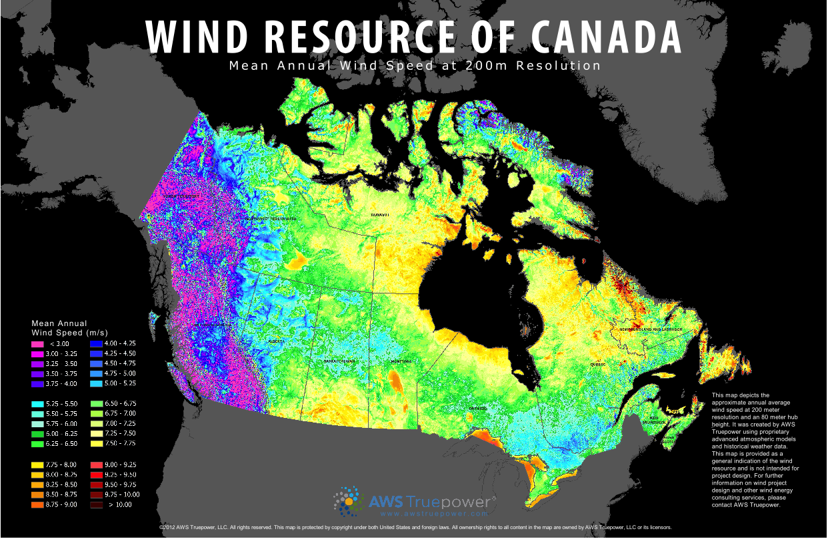
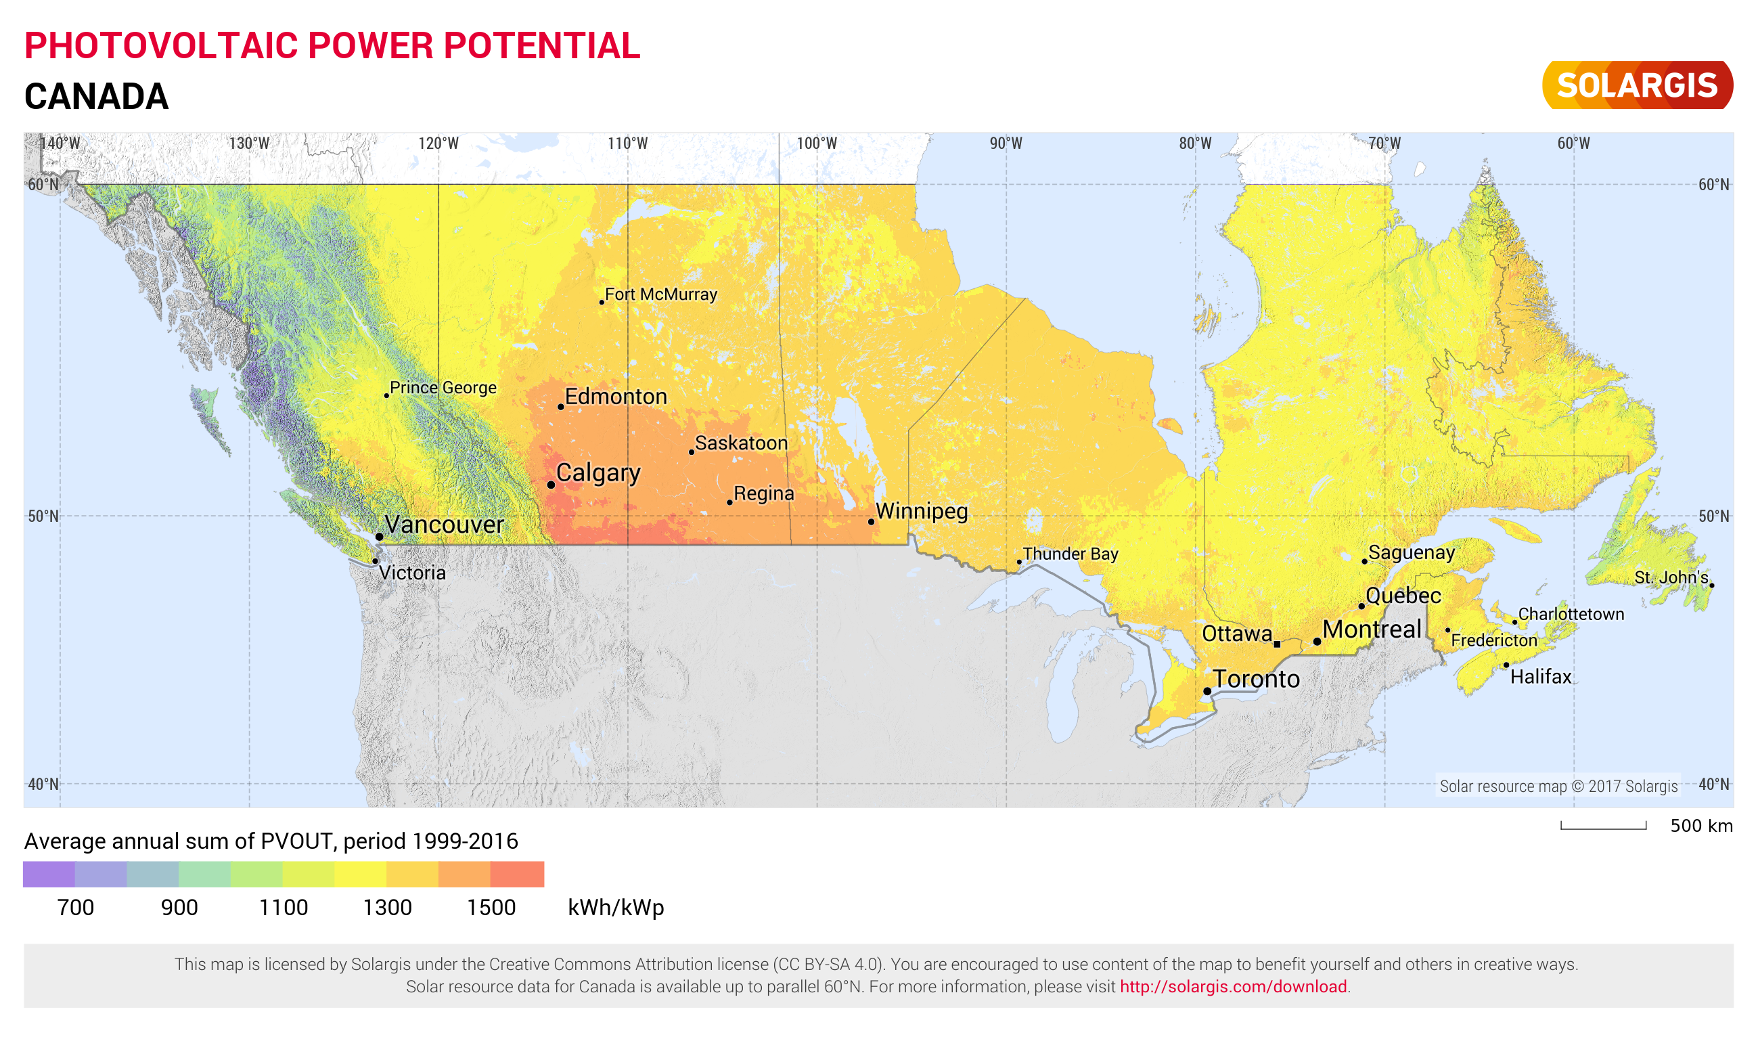
Alberta Has High Value Wind & Solar Resources
Despite Alberta’s high latitude, the solar potential is high
Solar has a larger region of Alberta that is feasible!

Slide 13
Important Grid Properties?

Slide 14
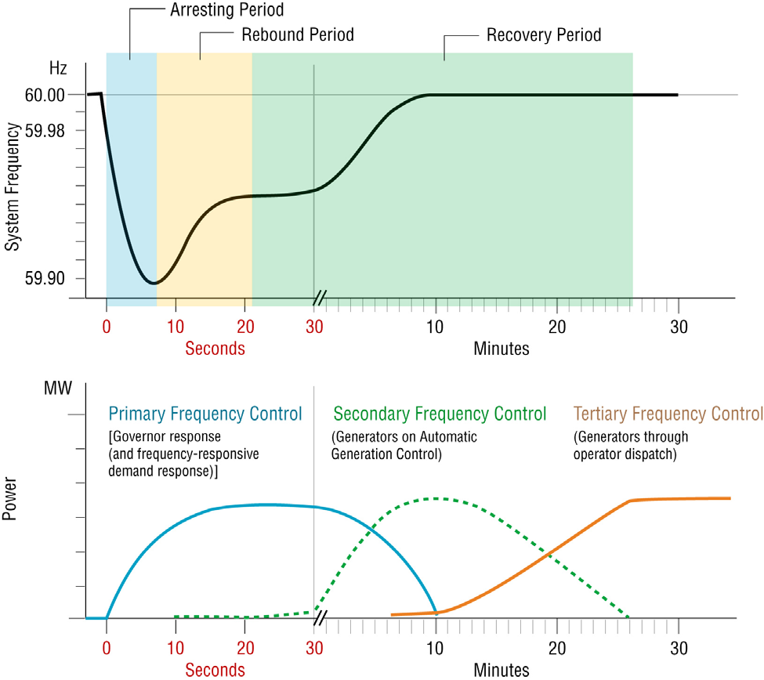
Frequency Response & Inertia Can Come From Wind & Solar
Disturbance
(e.g., loss of a large generating unit)
Primary frequency response stabilizes the frequency
Synchronous inertial response sets initial slope
Additional power from regulation and dispatch compensates for lost resources to bring the system frequency back to 60 Hz
Fast frequency response establishes the minimum frequency point (“nadir”)
Inertia & Frequency Response are properties of the entire Interconnection
Details & slide thanks to Mark Ahlstrom (ESIG) & Figure from J. Eto, LBNL,
https://www.ferc.gov/industries/electric/indus-act/reliability/frequencyresponsemetrics-report.pdf
Notes:
“Inertia stops the frequency from falling”
No, frequency will continue to fall without other actions
Inertia only sets the initial rate at which the frequency falls; it buys you time
“Coal plants are the best source of inertia”
Not really; combined cycle gas plants provide more synchronous inertia on a nameplate basis (i.e., they have a higher “inertial constant”)
Synchronous motors and synchronous condensers (which are essentially synchronous generators without a fuel source) also provide inertia
“The amount of inertia depends on the plant’s current output level”
No, the plant must be online and synchronized to the grid, but then the inertial contribution is the same regardless of the output level
Conventional power plants are electro-mechanically coupled to the grid
Heavy generators spinning at the grid frequency
Wind and solar power plants are electronically coupled to the grid
Inverters with very fast power electronics (DC to AC converters)
This is a digital revolution in power generation, with the ability to program the behaviors that we want to see, but we need to specify the behaviors we want

Slide 15
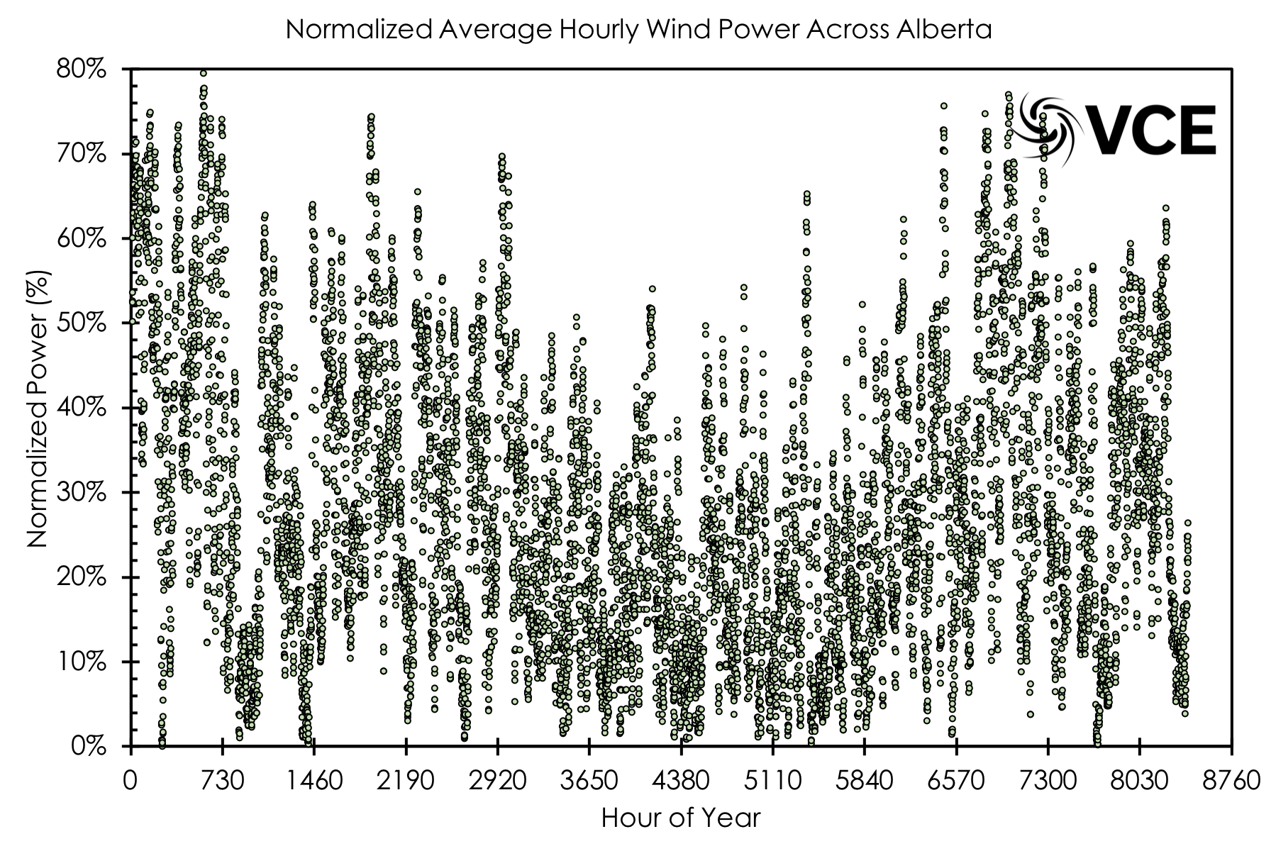
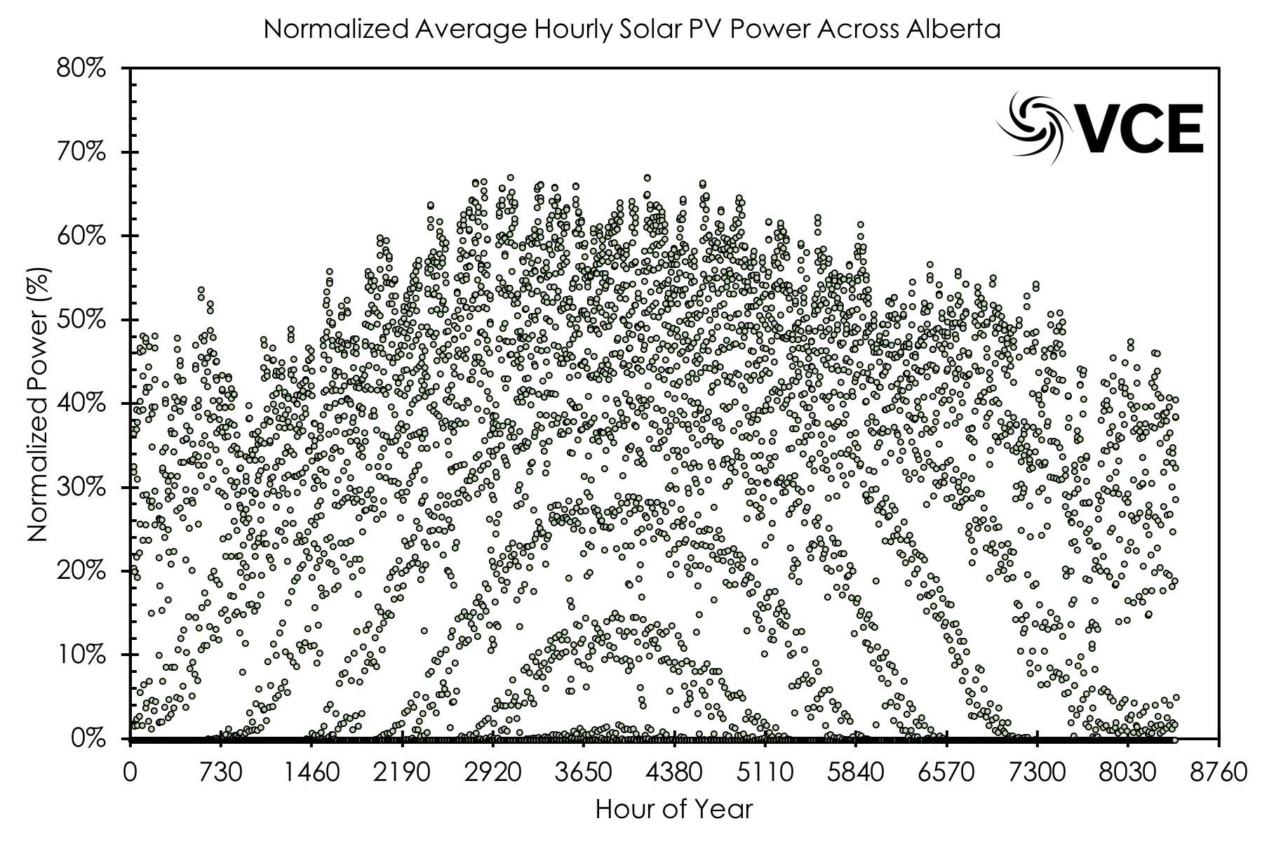
Combining Wind & Solar Power Improves Availability
”Virtual Power Plants” or “VRE portfolios” Can Provide robust electricity supply

Slide 16
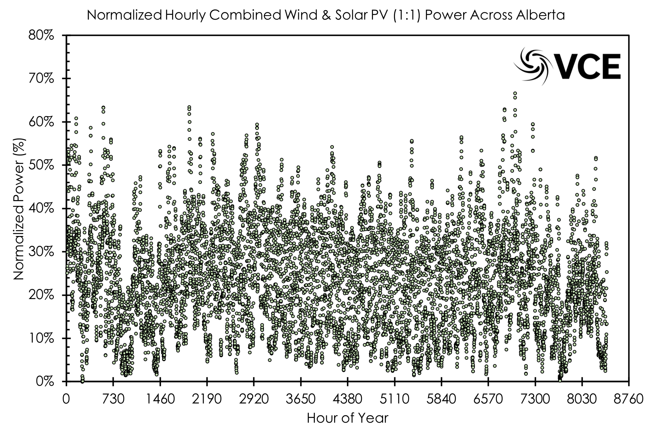
Combining Wind & Solar Power Improves Availability
”Virtual Power Plants” or “VRE portfolios” Can Provide robust electricity supply

Slide 17
Baseload Generation Is Not A Necessity
As long as generation is produced when needed, the source does not matter
Can replace baseload generation with a combination of:
Natural Gas flexible generation,
Wind,
Solar,
Storage,
Demand Side Management,
Distributed Resources,
Electrification of Heating & Transportation,
Transmission Exchanges,
Energy Efficiency.
NOTE: All these resources are modular, and allow trajectory correction if pathway is not achieving the desired goals.

Slide 18
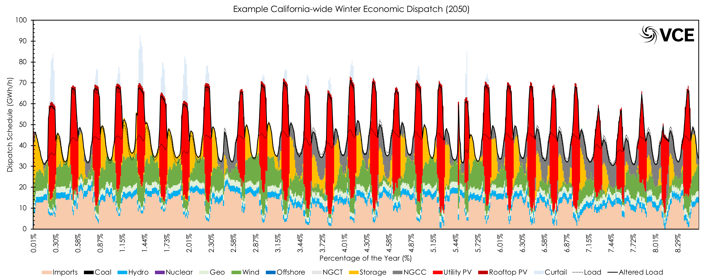
Baseload Generation Is Not A Necessity
As long as generation is produced when needed, the source does not matter

Slide 19
Electrification & Decarbonization
Co-Benefits

Slide 20
Electrification Increase Demand & Customers

Slide 21
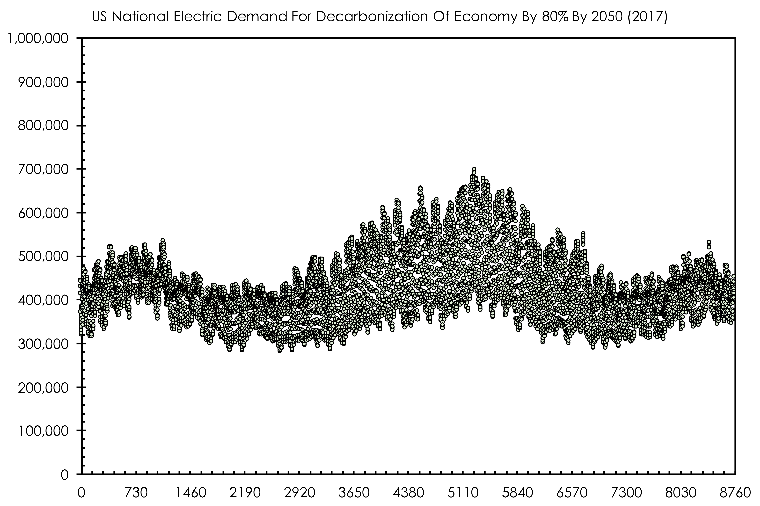
The Electricity Demand Becomes More Flexible
EVs;
Space Heat Pumps;
Water Heat Pumps;
Renewable Controls;
Transmission Control;
Storage.

Slide 22
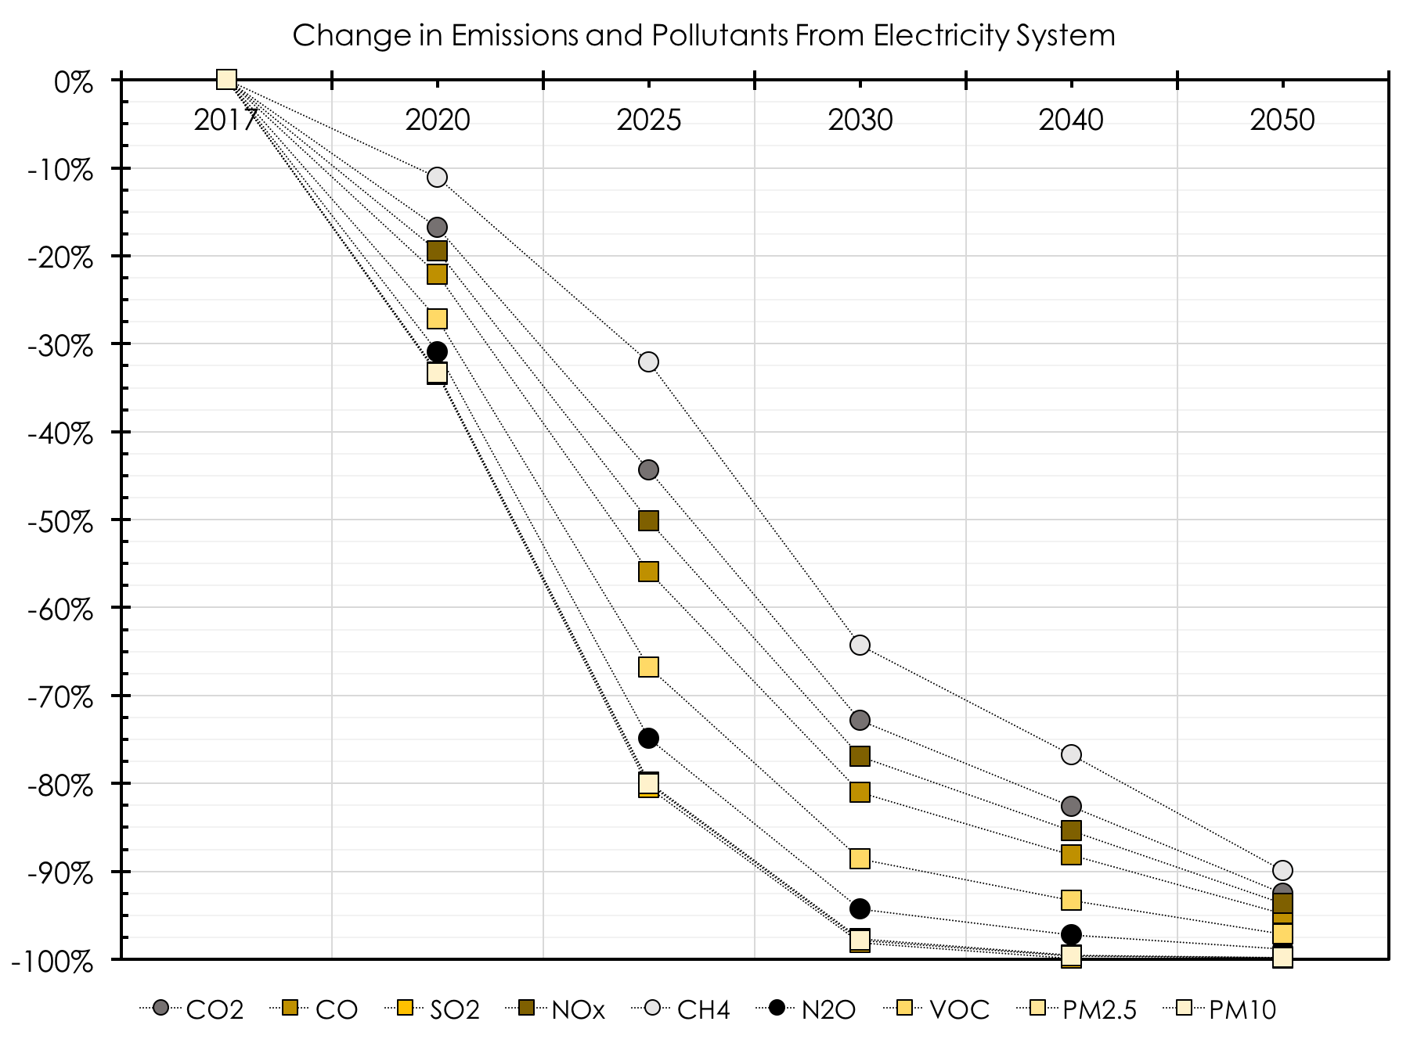
Modeling (US) Shows E&D Reduces Economy Emissions

Slide 23
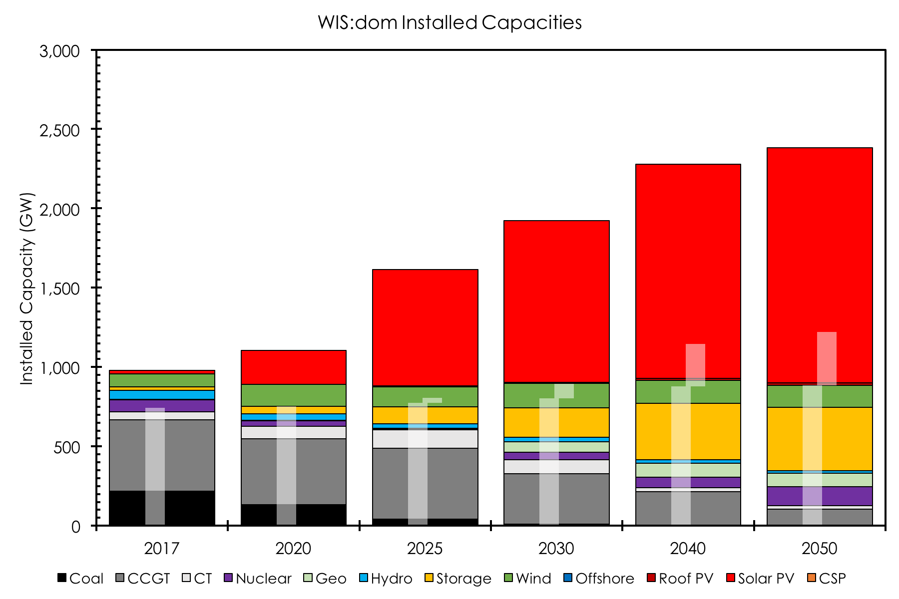
E&D Increases Installed Capacity / Jobs / Taxes

Slide 24
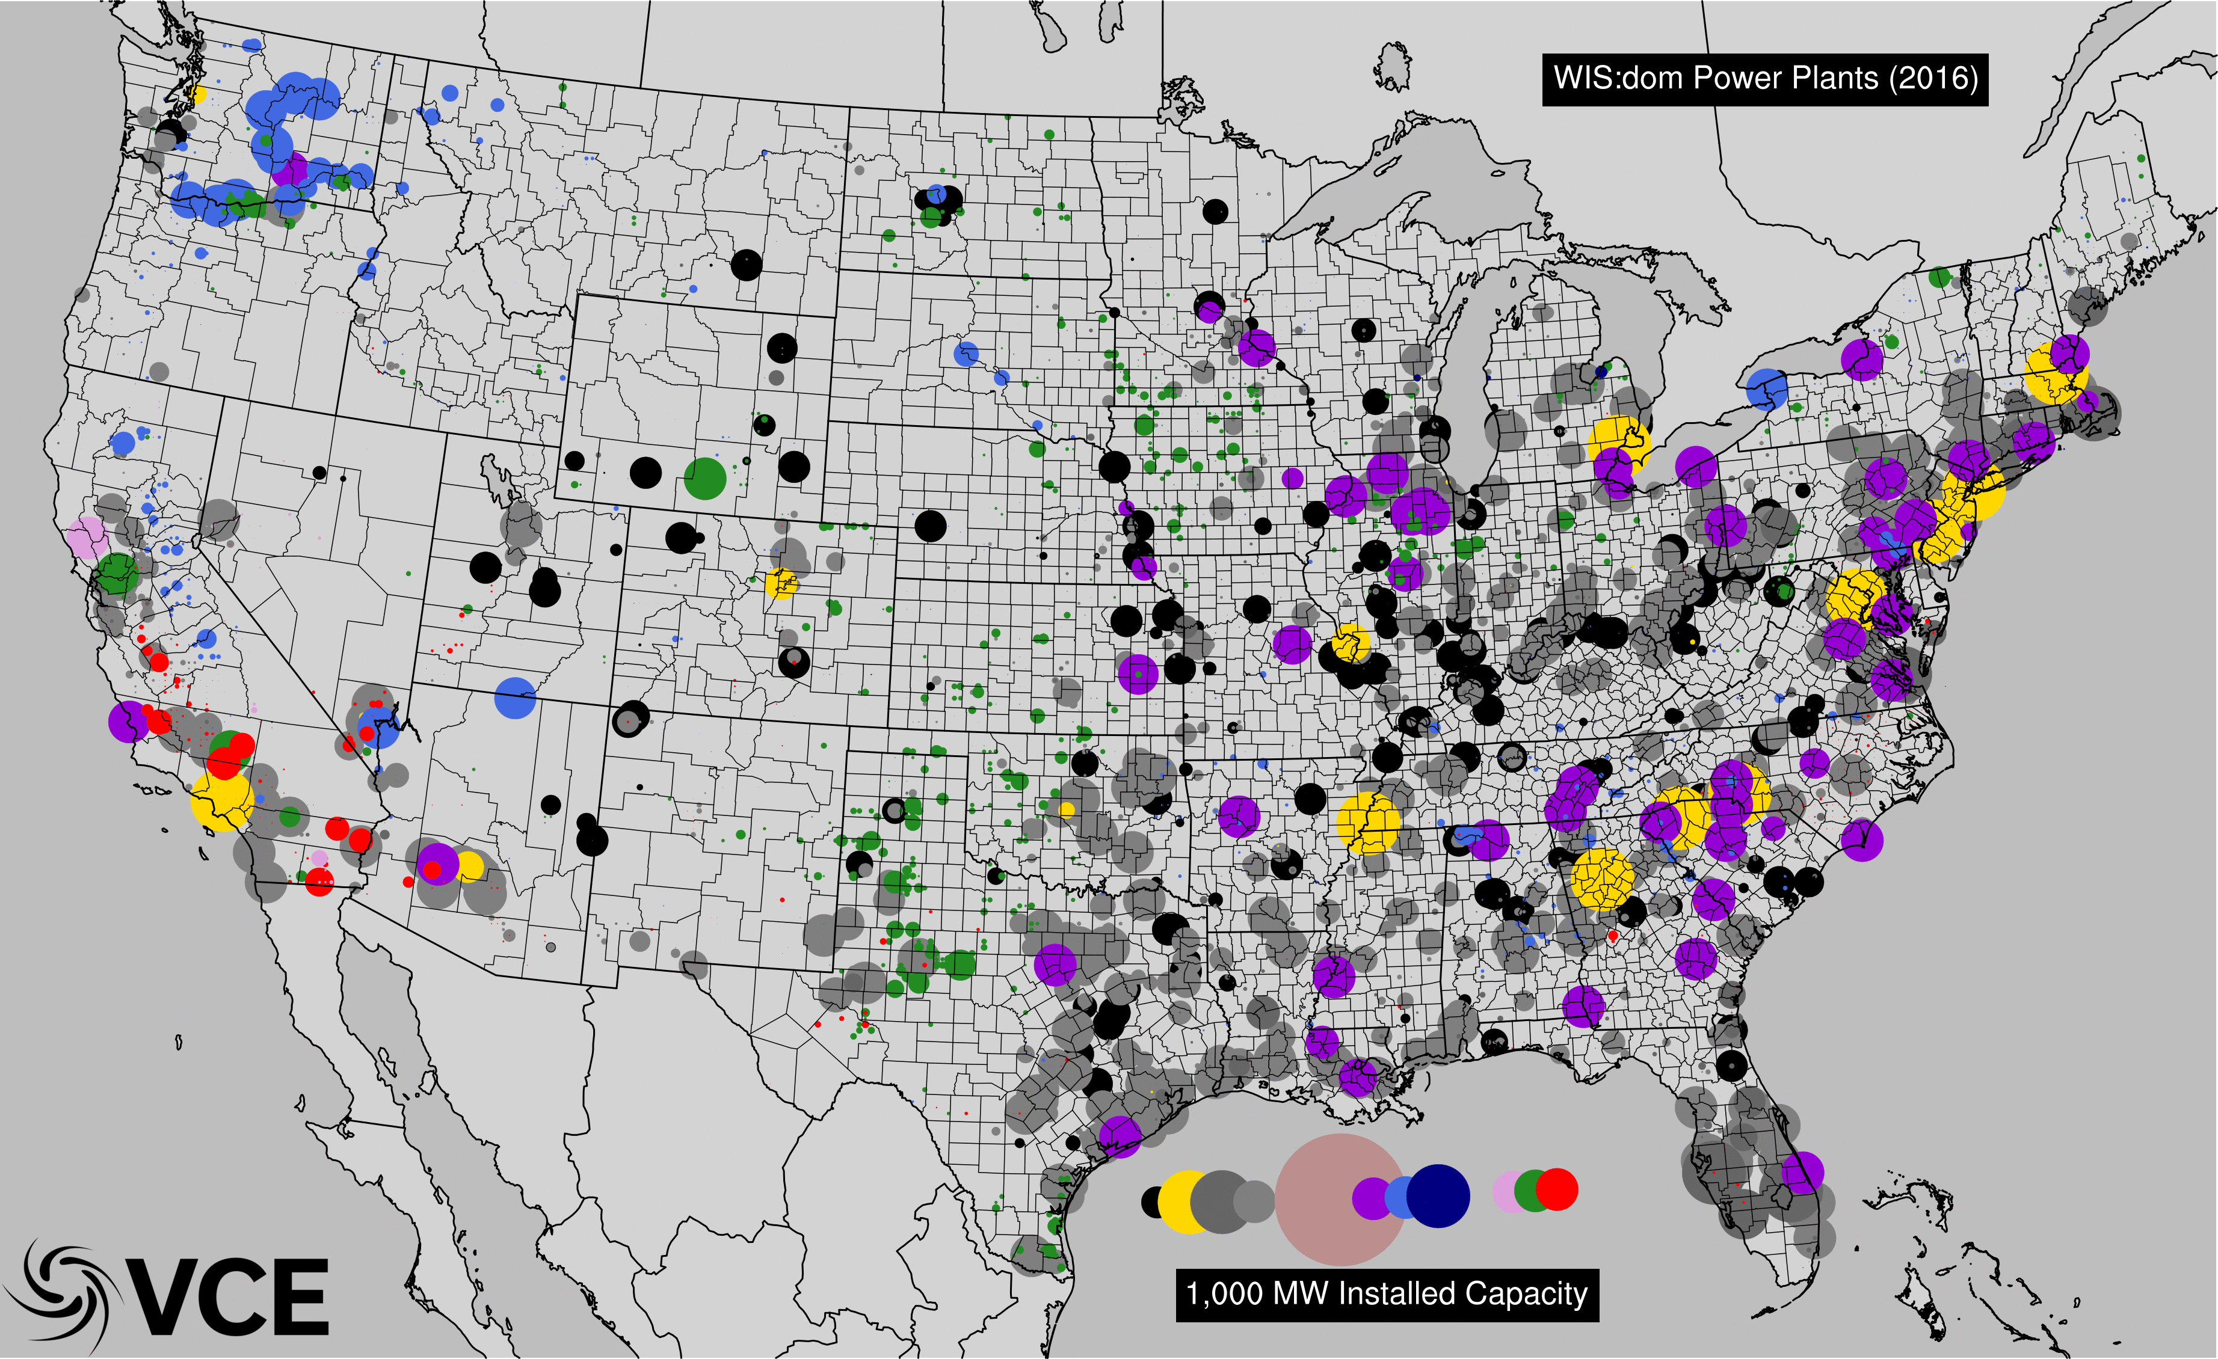
E&D Creates More Modular Grid Enabled By Transmission

Slide 25
Can Alberta Achieve The Same?

Slide 26
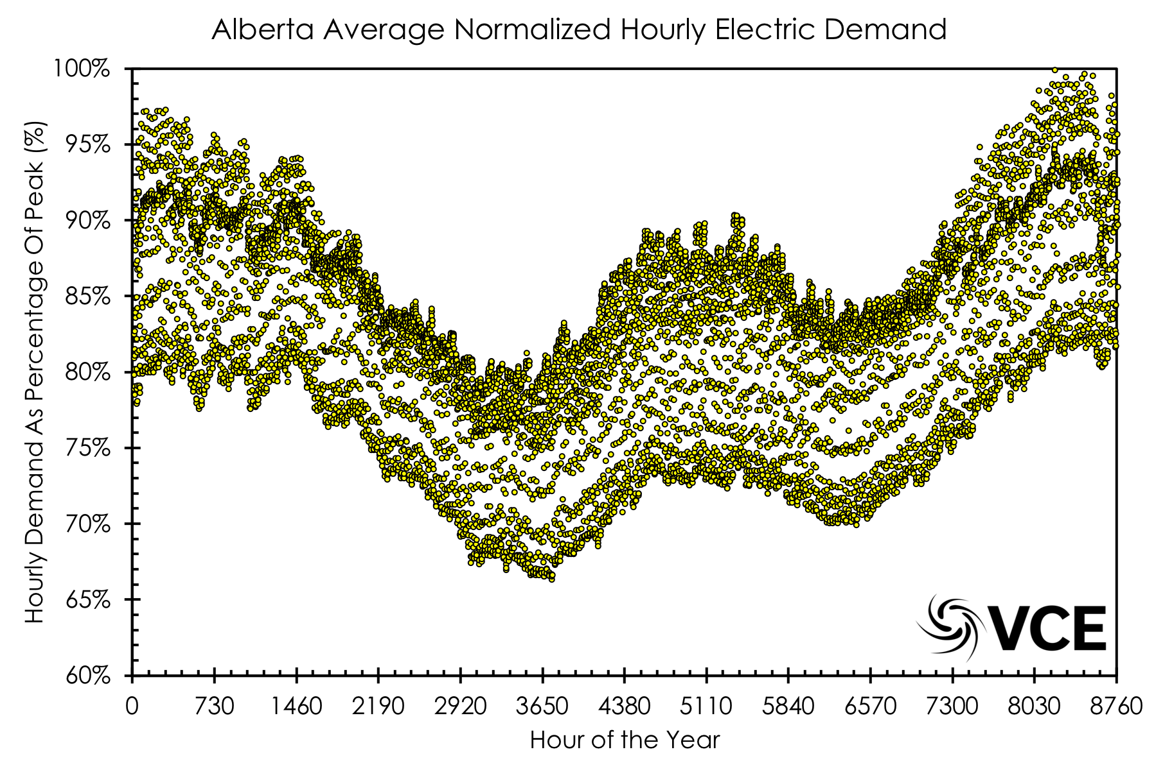
Use Actual Grid, Weather & Load Data For Accuracy

Slide 27
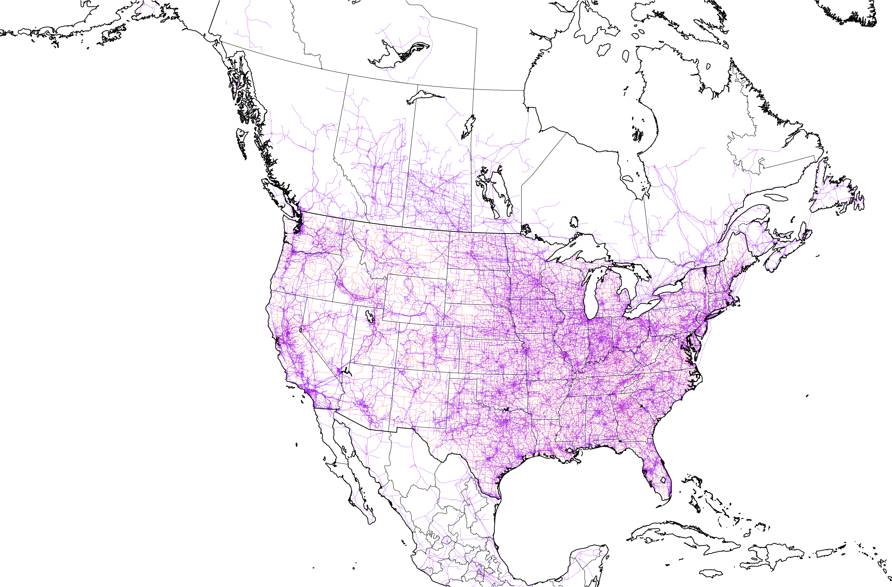
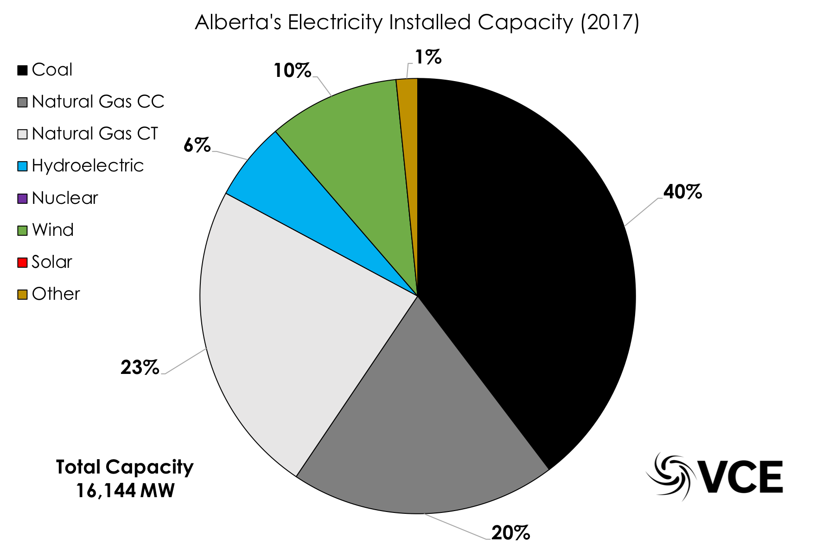
Use Actual Grid, Weather & Load Data For Accuracy

Slide 28
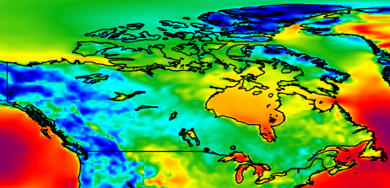
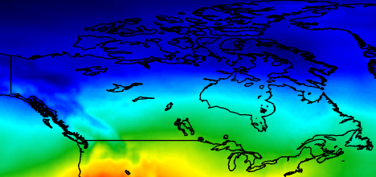
Use Actual Grid, Weather & Load Data For Accuracy
Wind
Solar PV

Slide 29
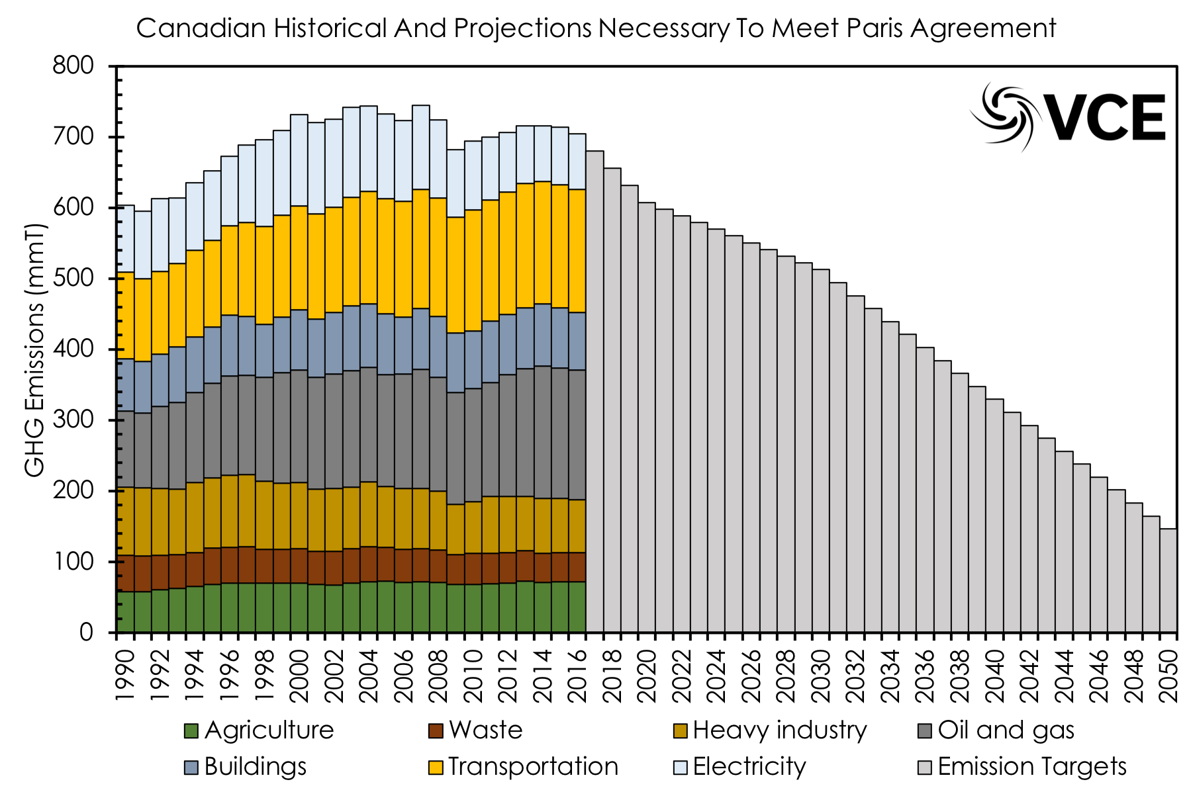
Emissions Targets Necessary To Meet Paris

Slide 30
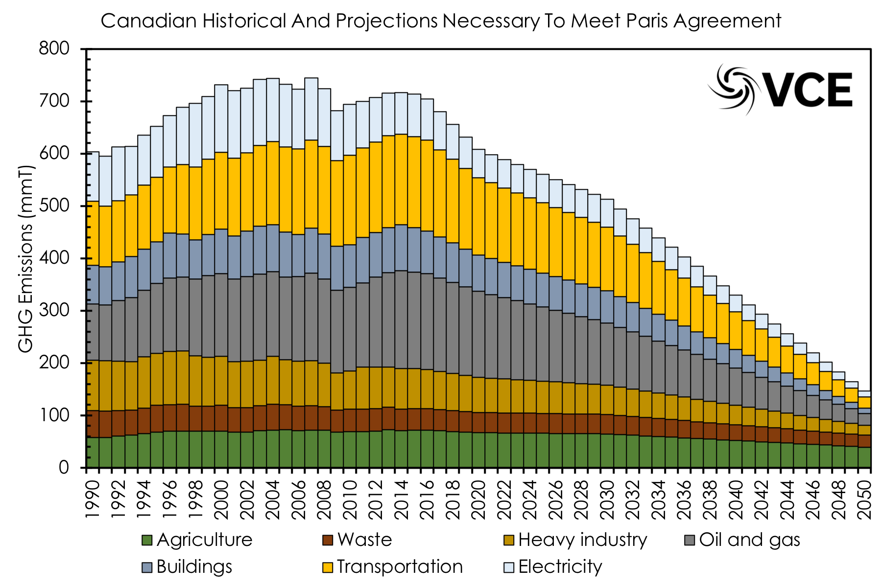
Emissions Targets Necessary To Meet Paris

Slide 31
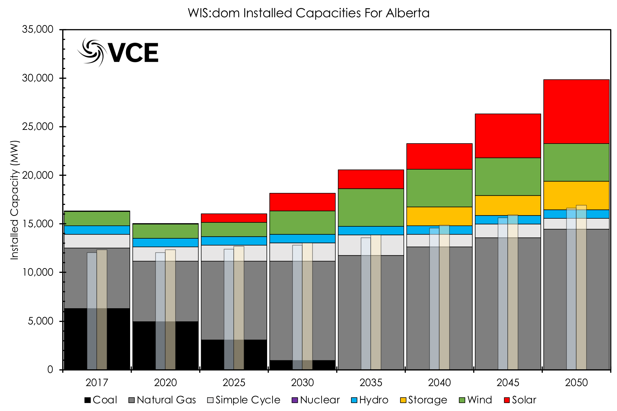
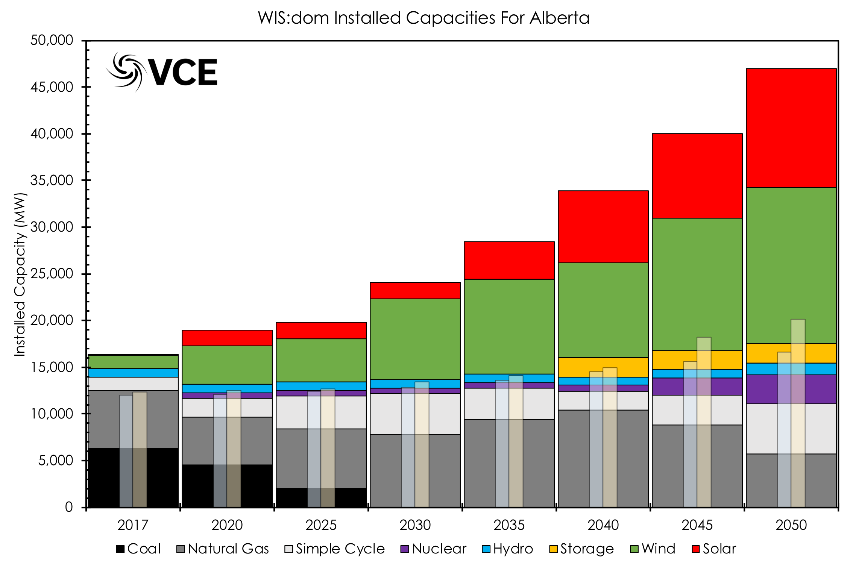
BAU vs E&D of Alberta
BAU
E&D
Gas Dominates with wind and solar strong
Wind & Solar Become Dominant

Slide 32
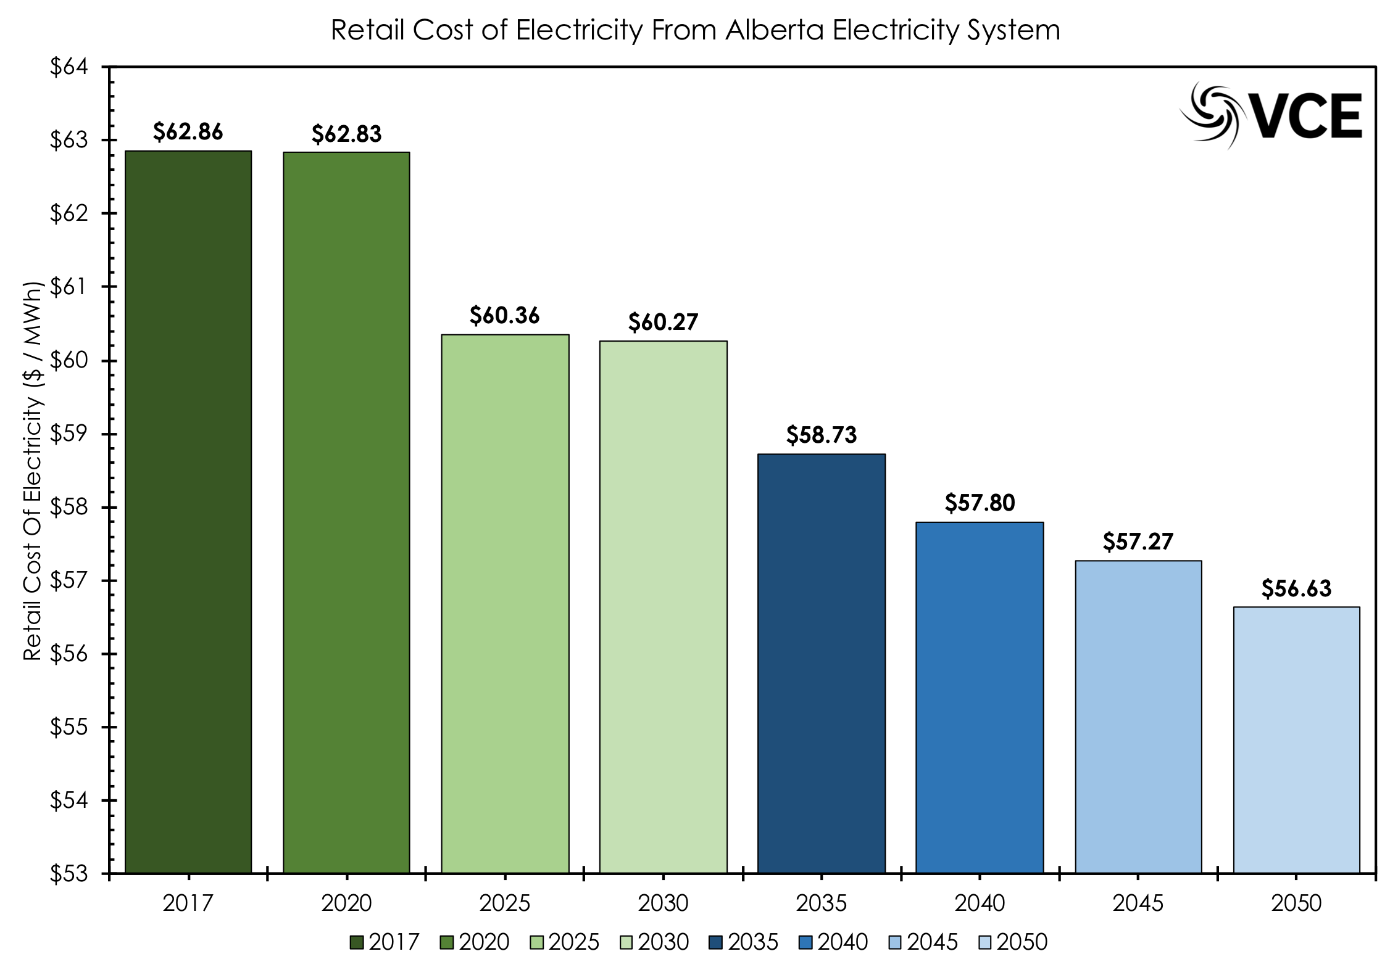
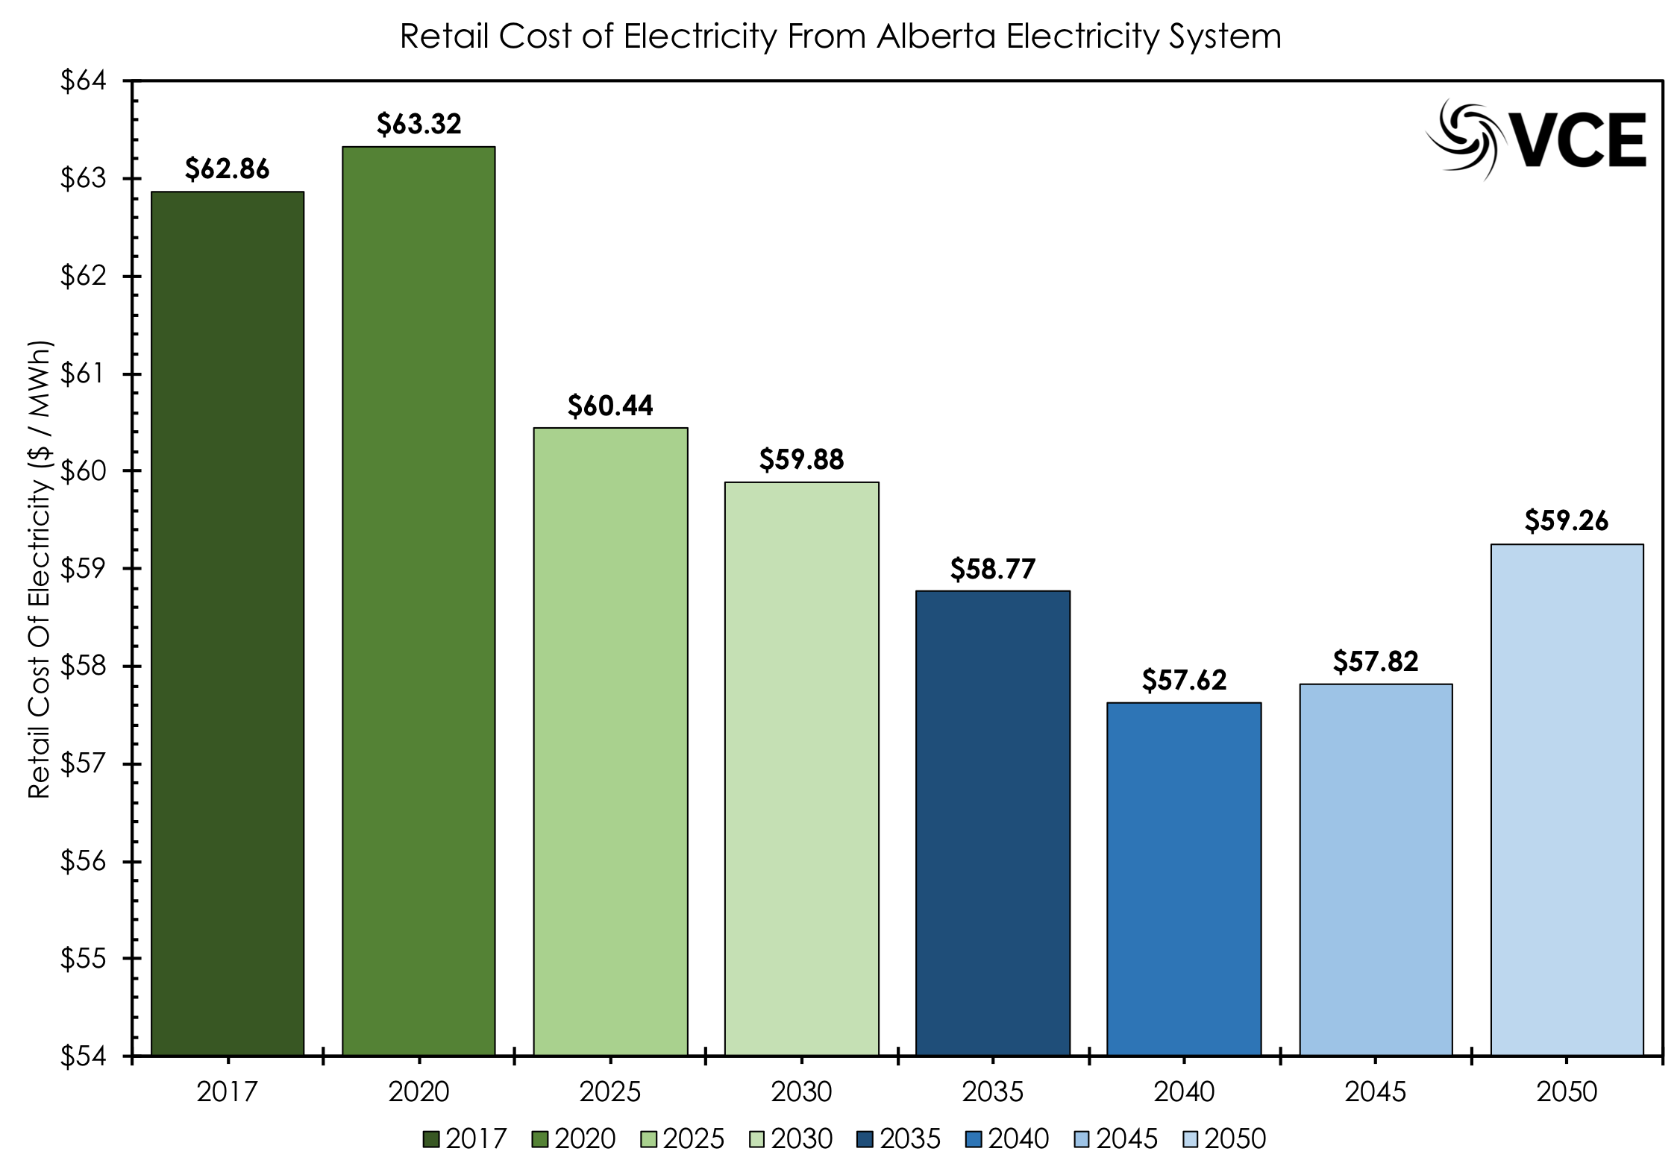
BAU vs E&D of Alberta
BAU
E&D
Costs For Electricity Production Declines
Costs For Electricity Also Falls; But Less Spending In Other Sectors

Slide 33
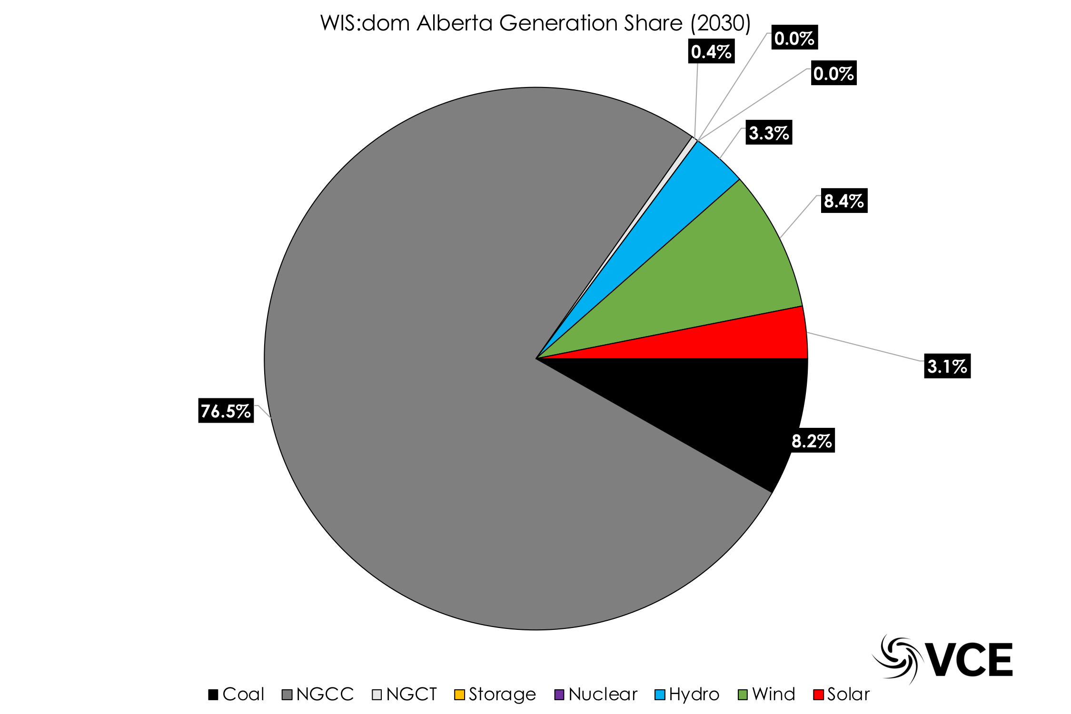
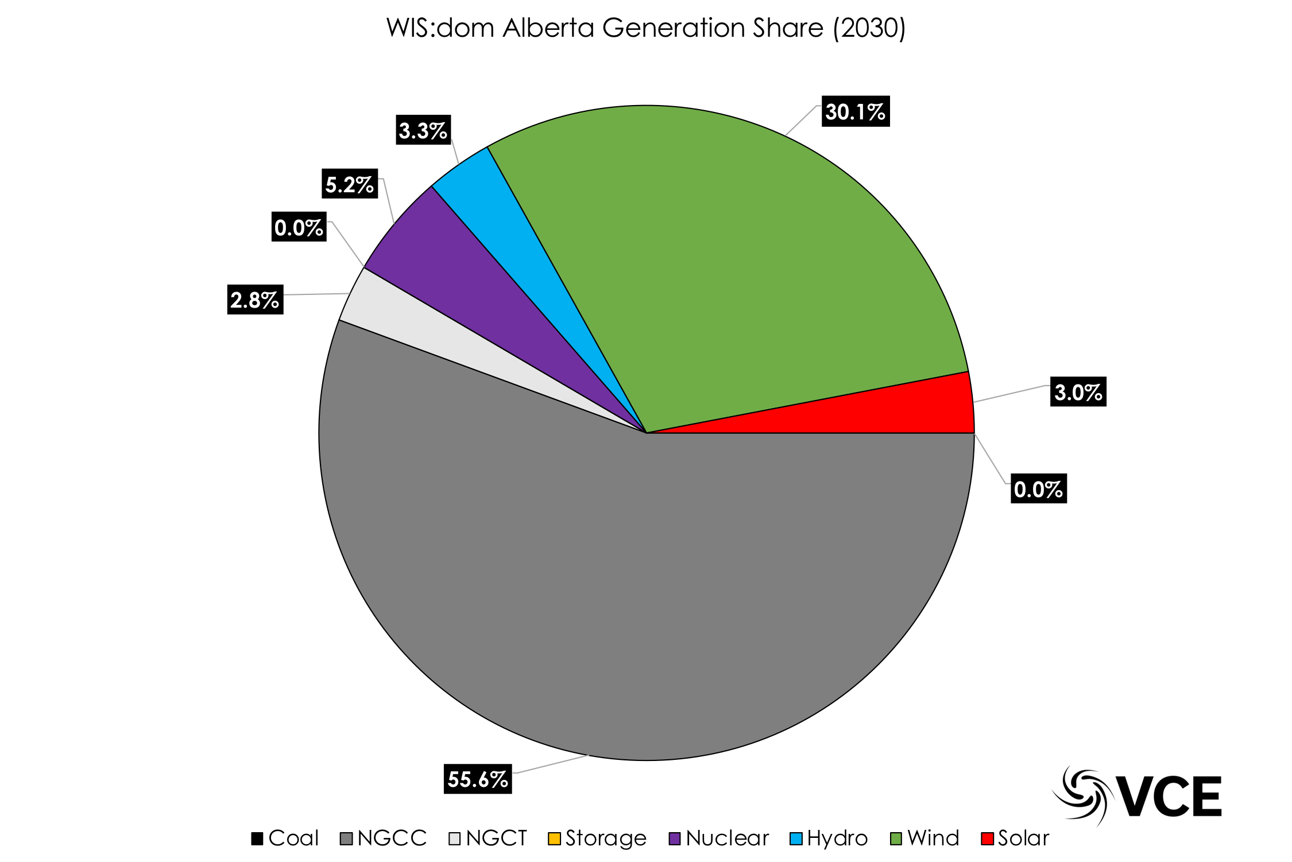
BAU vs E&D of Alberta
BAU (2030)
E&D (2030)
Majority Of Generation Is Fossil Thermal!
Over Half Still Fossil, but All Coal Gone & VREs up!

Slide 34
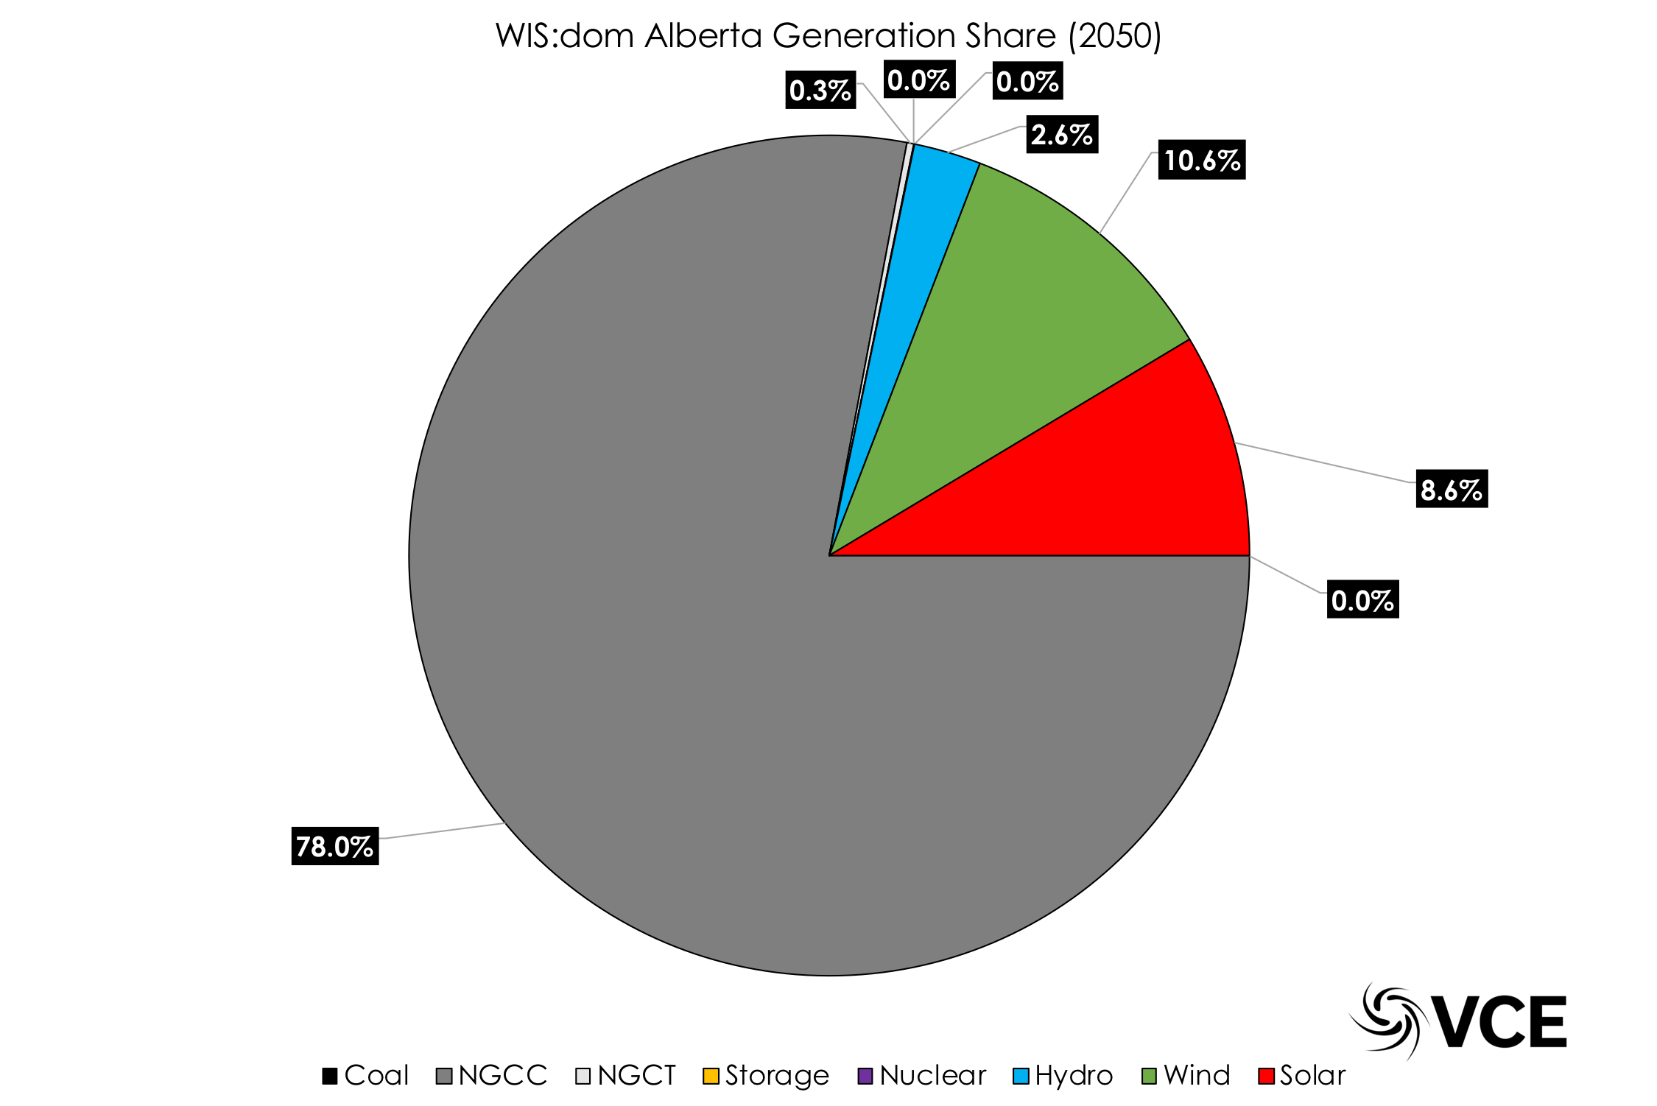
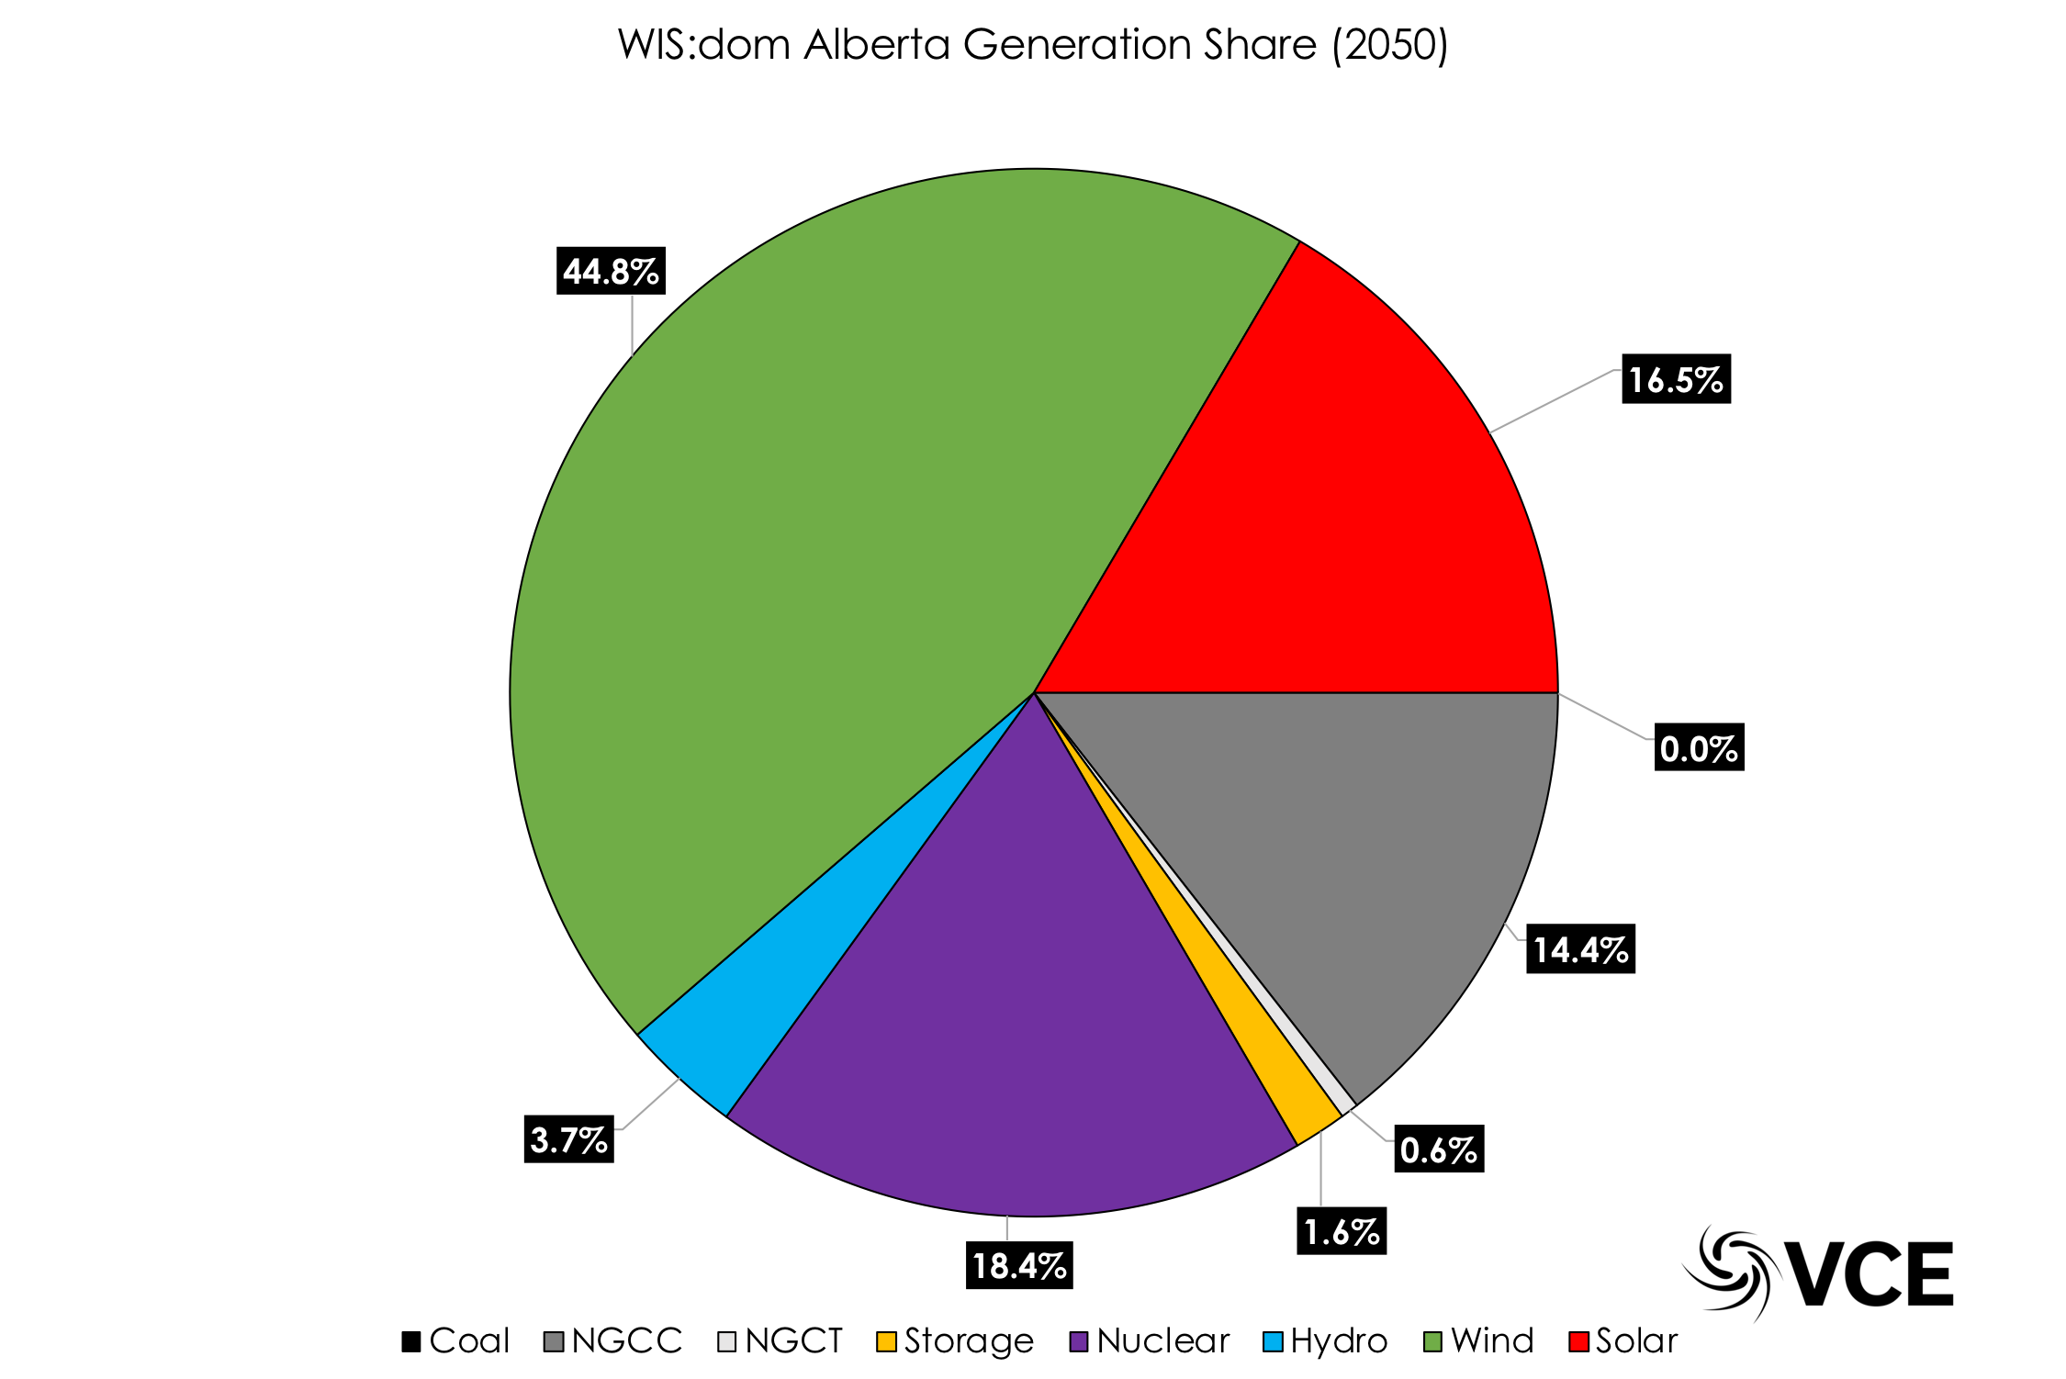
BAU vs E&D of Alberta
BAU (2050)
E&D (2050)
Majority Of Generation Is Still Fossil Thermal!
Most Generation Carbon-Free. Wind & Solar Dominant!
Notes:
Without the solar to support the wind there would be far less. The inverse is also true less wind = less solar! Mention this, as its important.

Slide 35
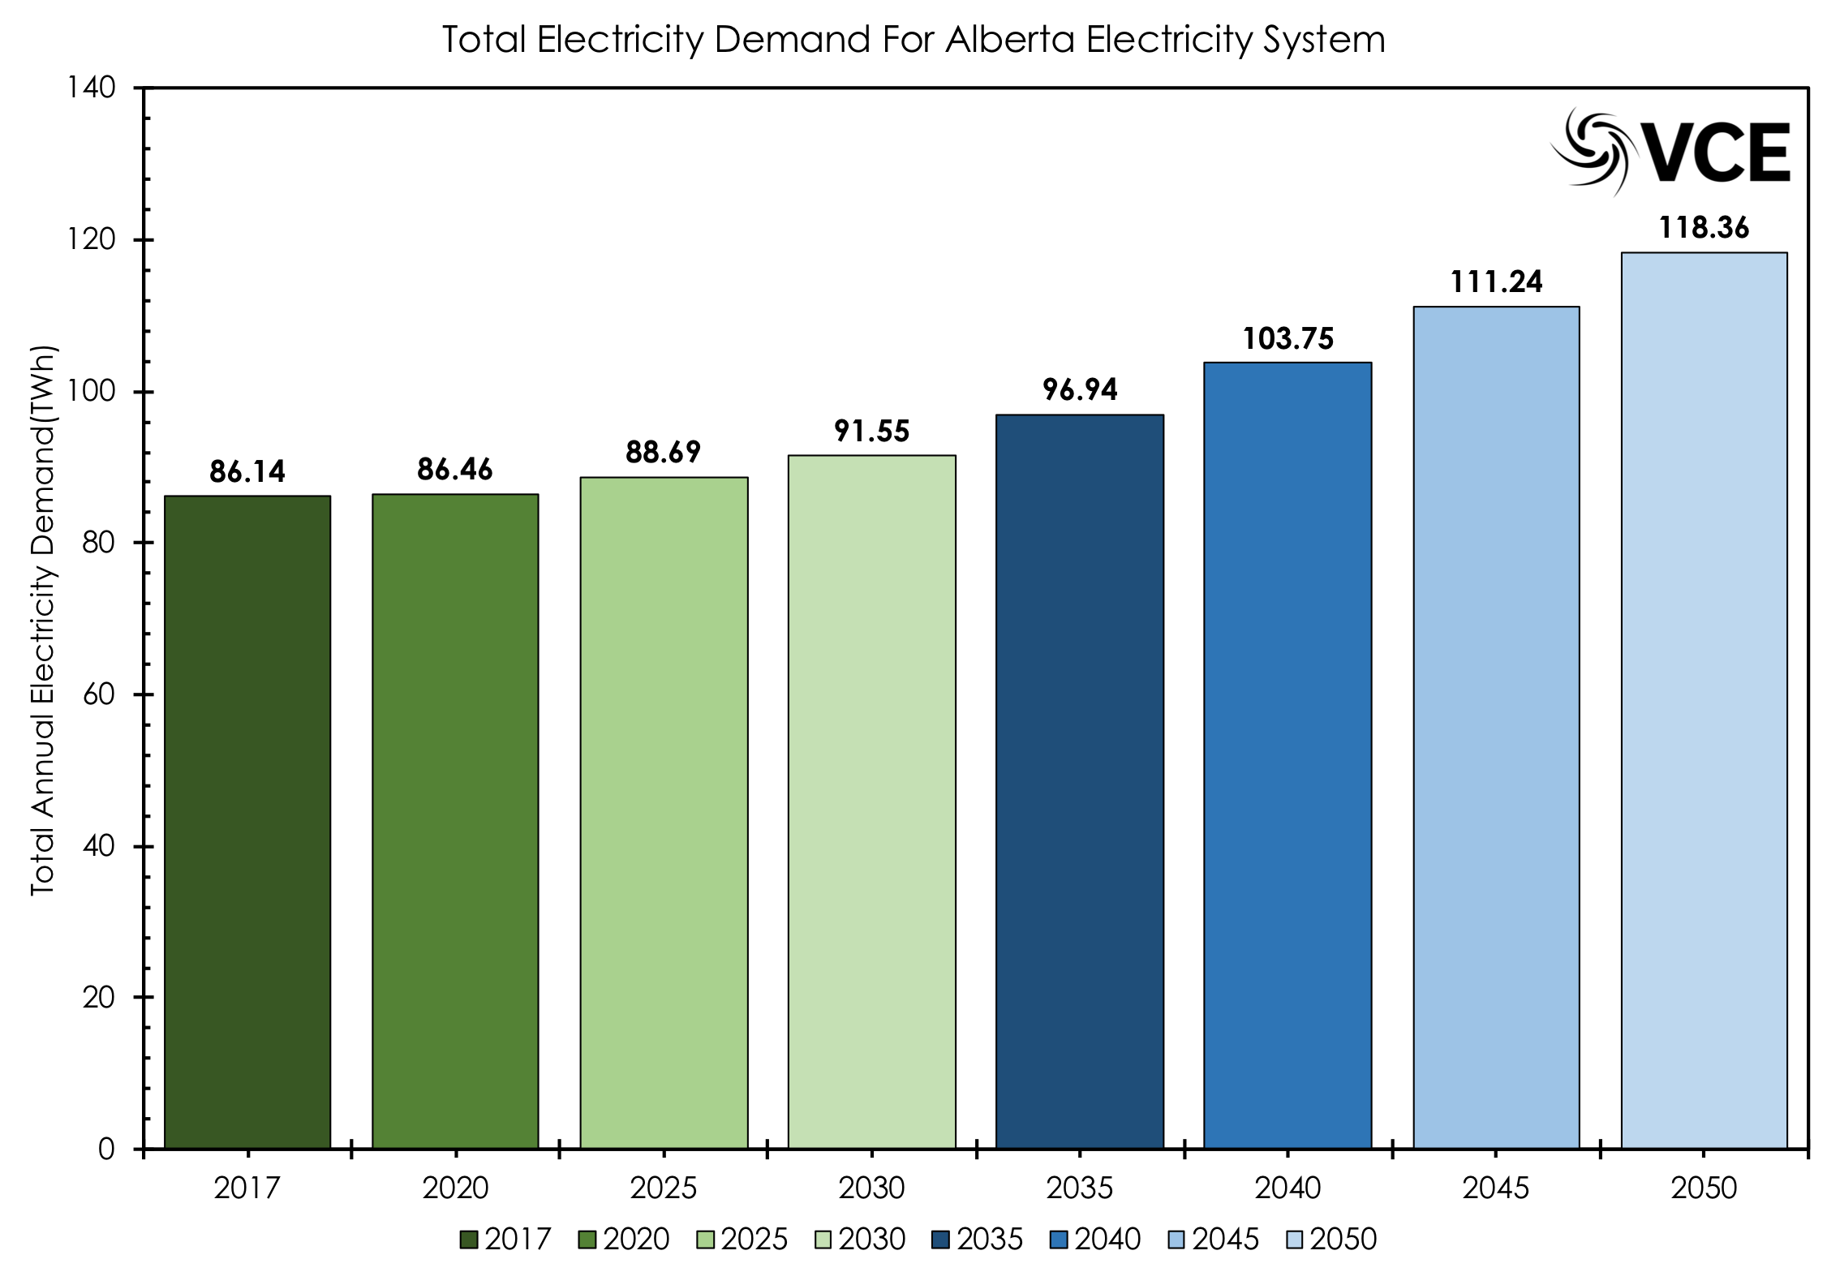

BAU vs E&D of Alberta
BAU
E&D
Generation Increases With More Electrification
Generation Increases Faster & More Decarbonization Occurs

Slide 36
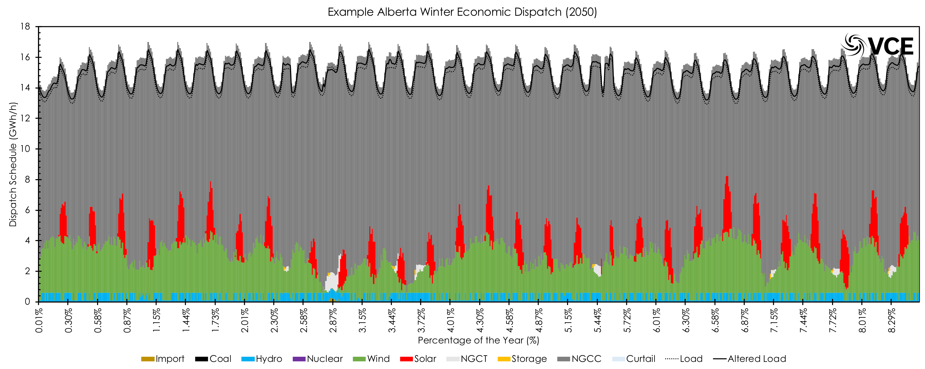
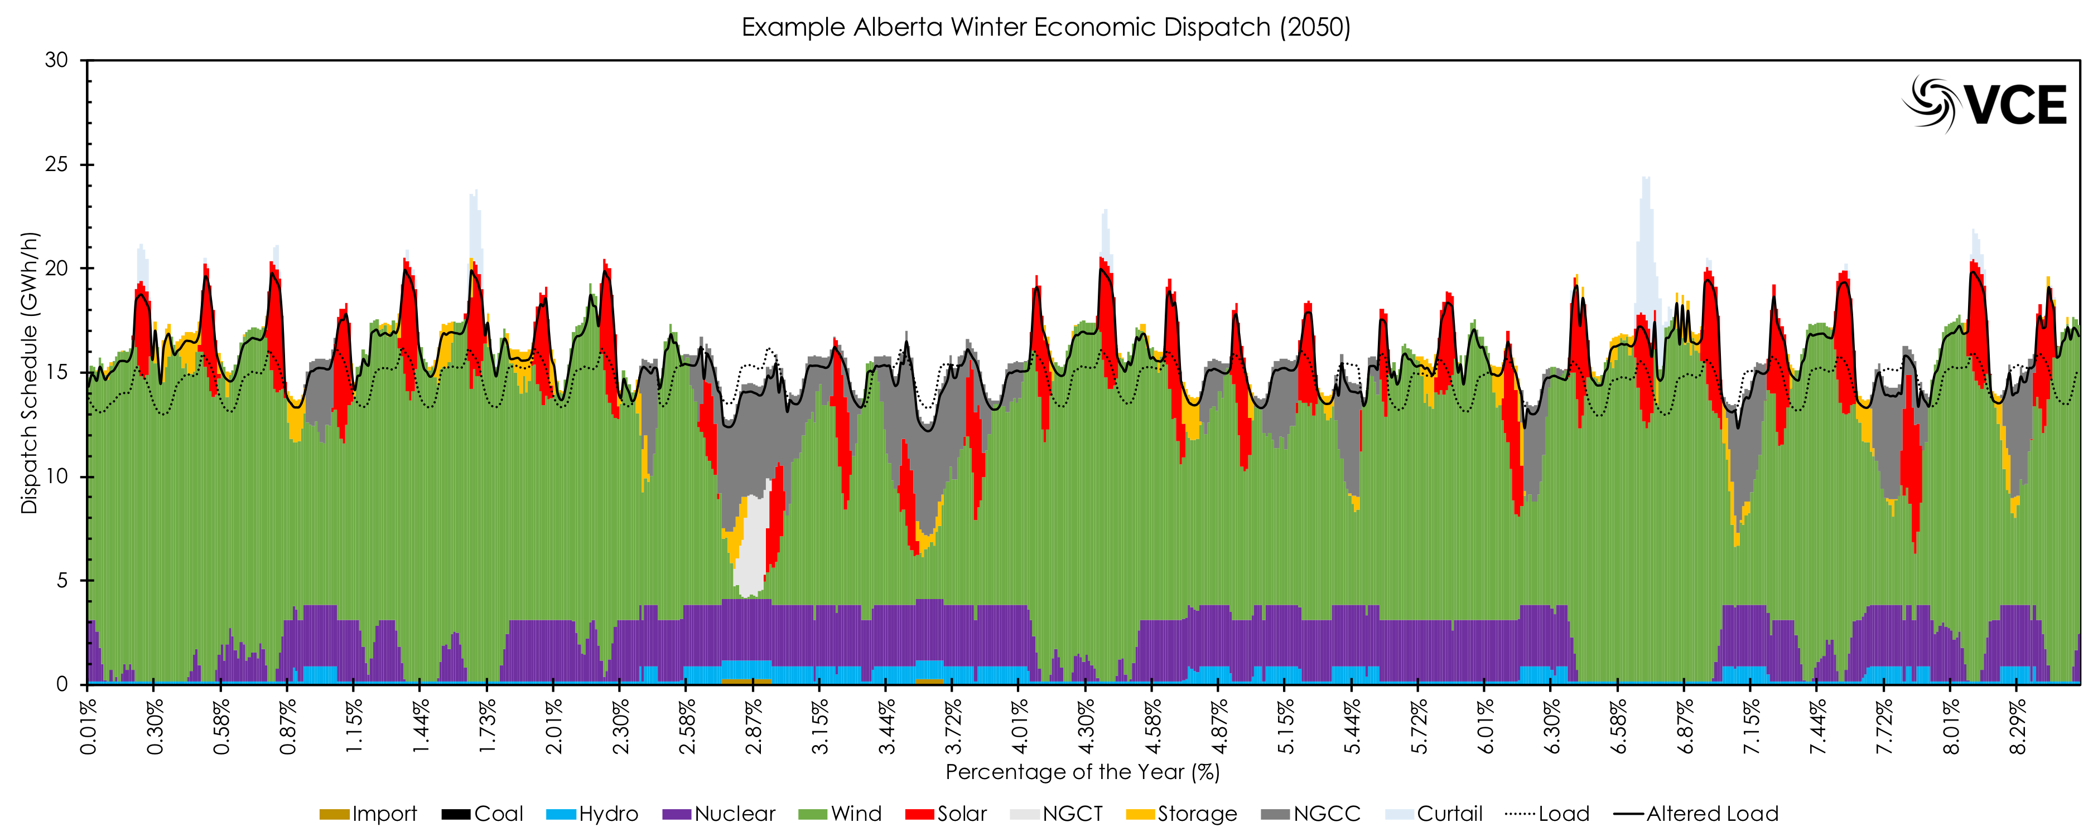
BAU vs E&D of Alberta – Power Reliably Met
BAU
Winter
E&D

Slide 37
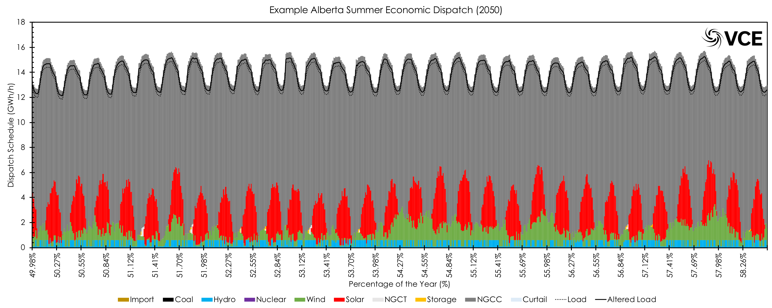
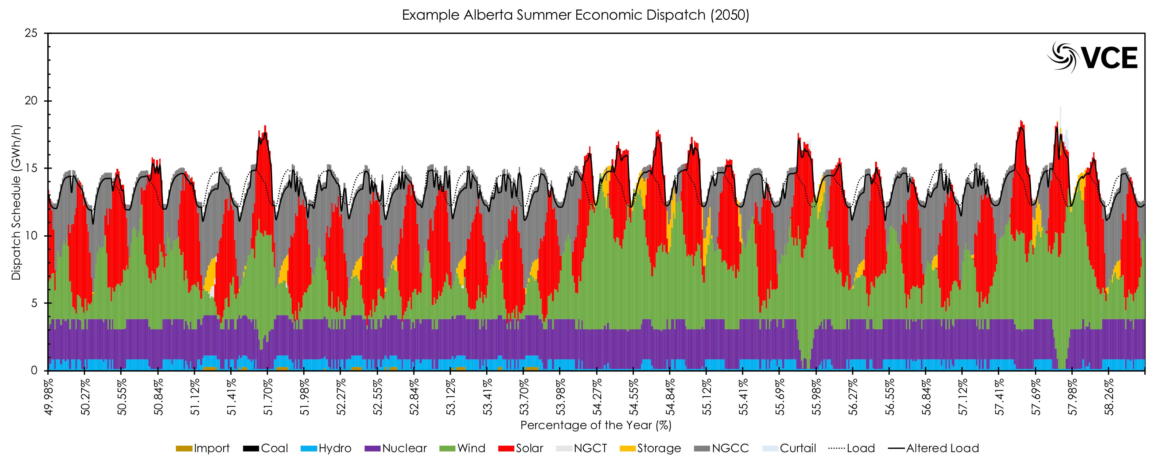
BAU vs E&D of Alberta – Power Reliably Met
BAU
Summer
E&D

Slide 38
How Does The Change Happen?
Rapid deployment of low-emission technologies (wind, solar, storage & Nuclear);
Continual market reforms in the electricity sector to adapt to new paradigms;
Storage becoming a “transmission asset” in the electricity sector;
Demand side management and flexibility being deployed on the consumer end;
Energy efficiency and transition to EVs for light-duty vehicles;
Retrofitting and adapting existing demand resources with more efficient end-use products (e.g. heat pumps, water heaters, LEDs, etc.);
Deployment of VREs allowed in technical regions, without interruption from uninformed parties on the behavior & benefits of VREs.

Slide 39
Some Myths Challenged?
Wind and solar can actually provide adequate power over regions (as aggregated assets);
Peak demand can increase (and should) for a deep decarbonized economy;
Inertia in the system can be provided by other assets (including wind and solar) rather than just by thermal generation;
Reduction in energy use can be substantial and changes the amount necessary for the economy;
Nuclear, geothermal, wind, solar, storage and other assets are all completely fine working together, given correct incentives;
Variable renewables are not “fuel savers”, but deployed properly can become integral energy producers providing the full range of services required for electricity markets (reserves, ancillary services, capacity).

Slide 40
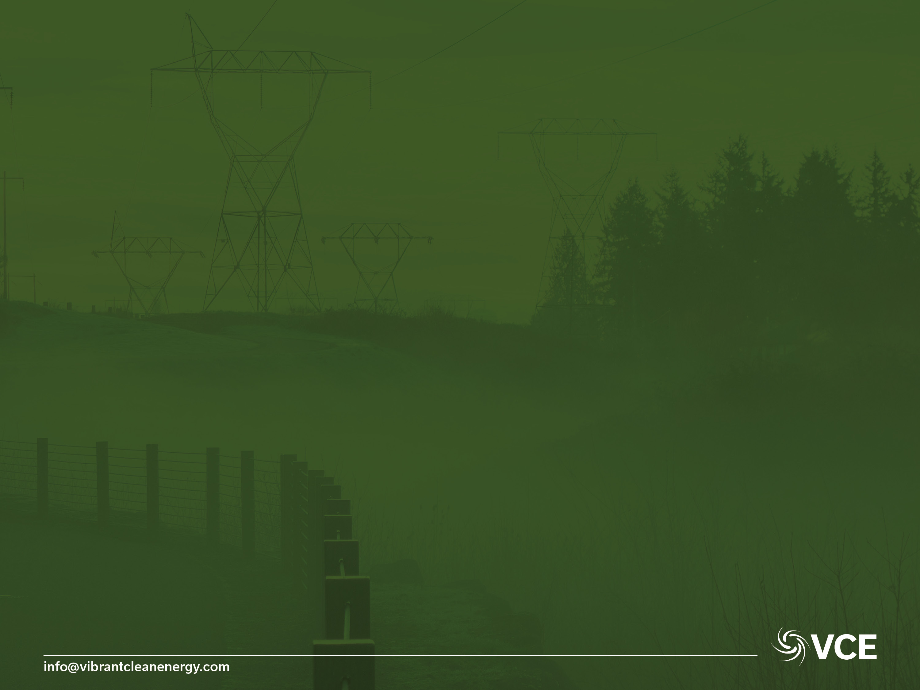
Thank You
Dr Christopher T M Clack
CEO Vibrant Clean Energy, LLC
Telephone: +1-720-668-6873
E-mail: christopher@vibrantcleanenergy.com
Website: VibrantCleanEnergy.com
Twitter: @Clacky007

