Slide 1
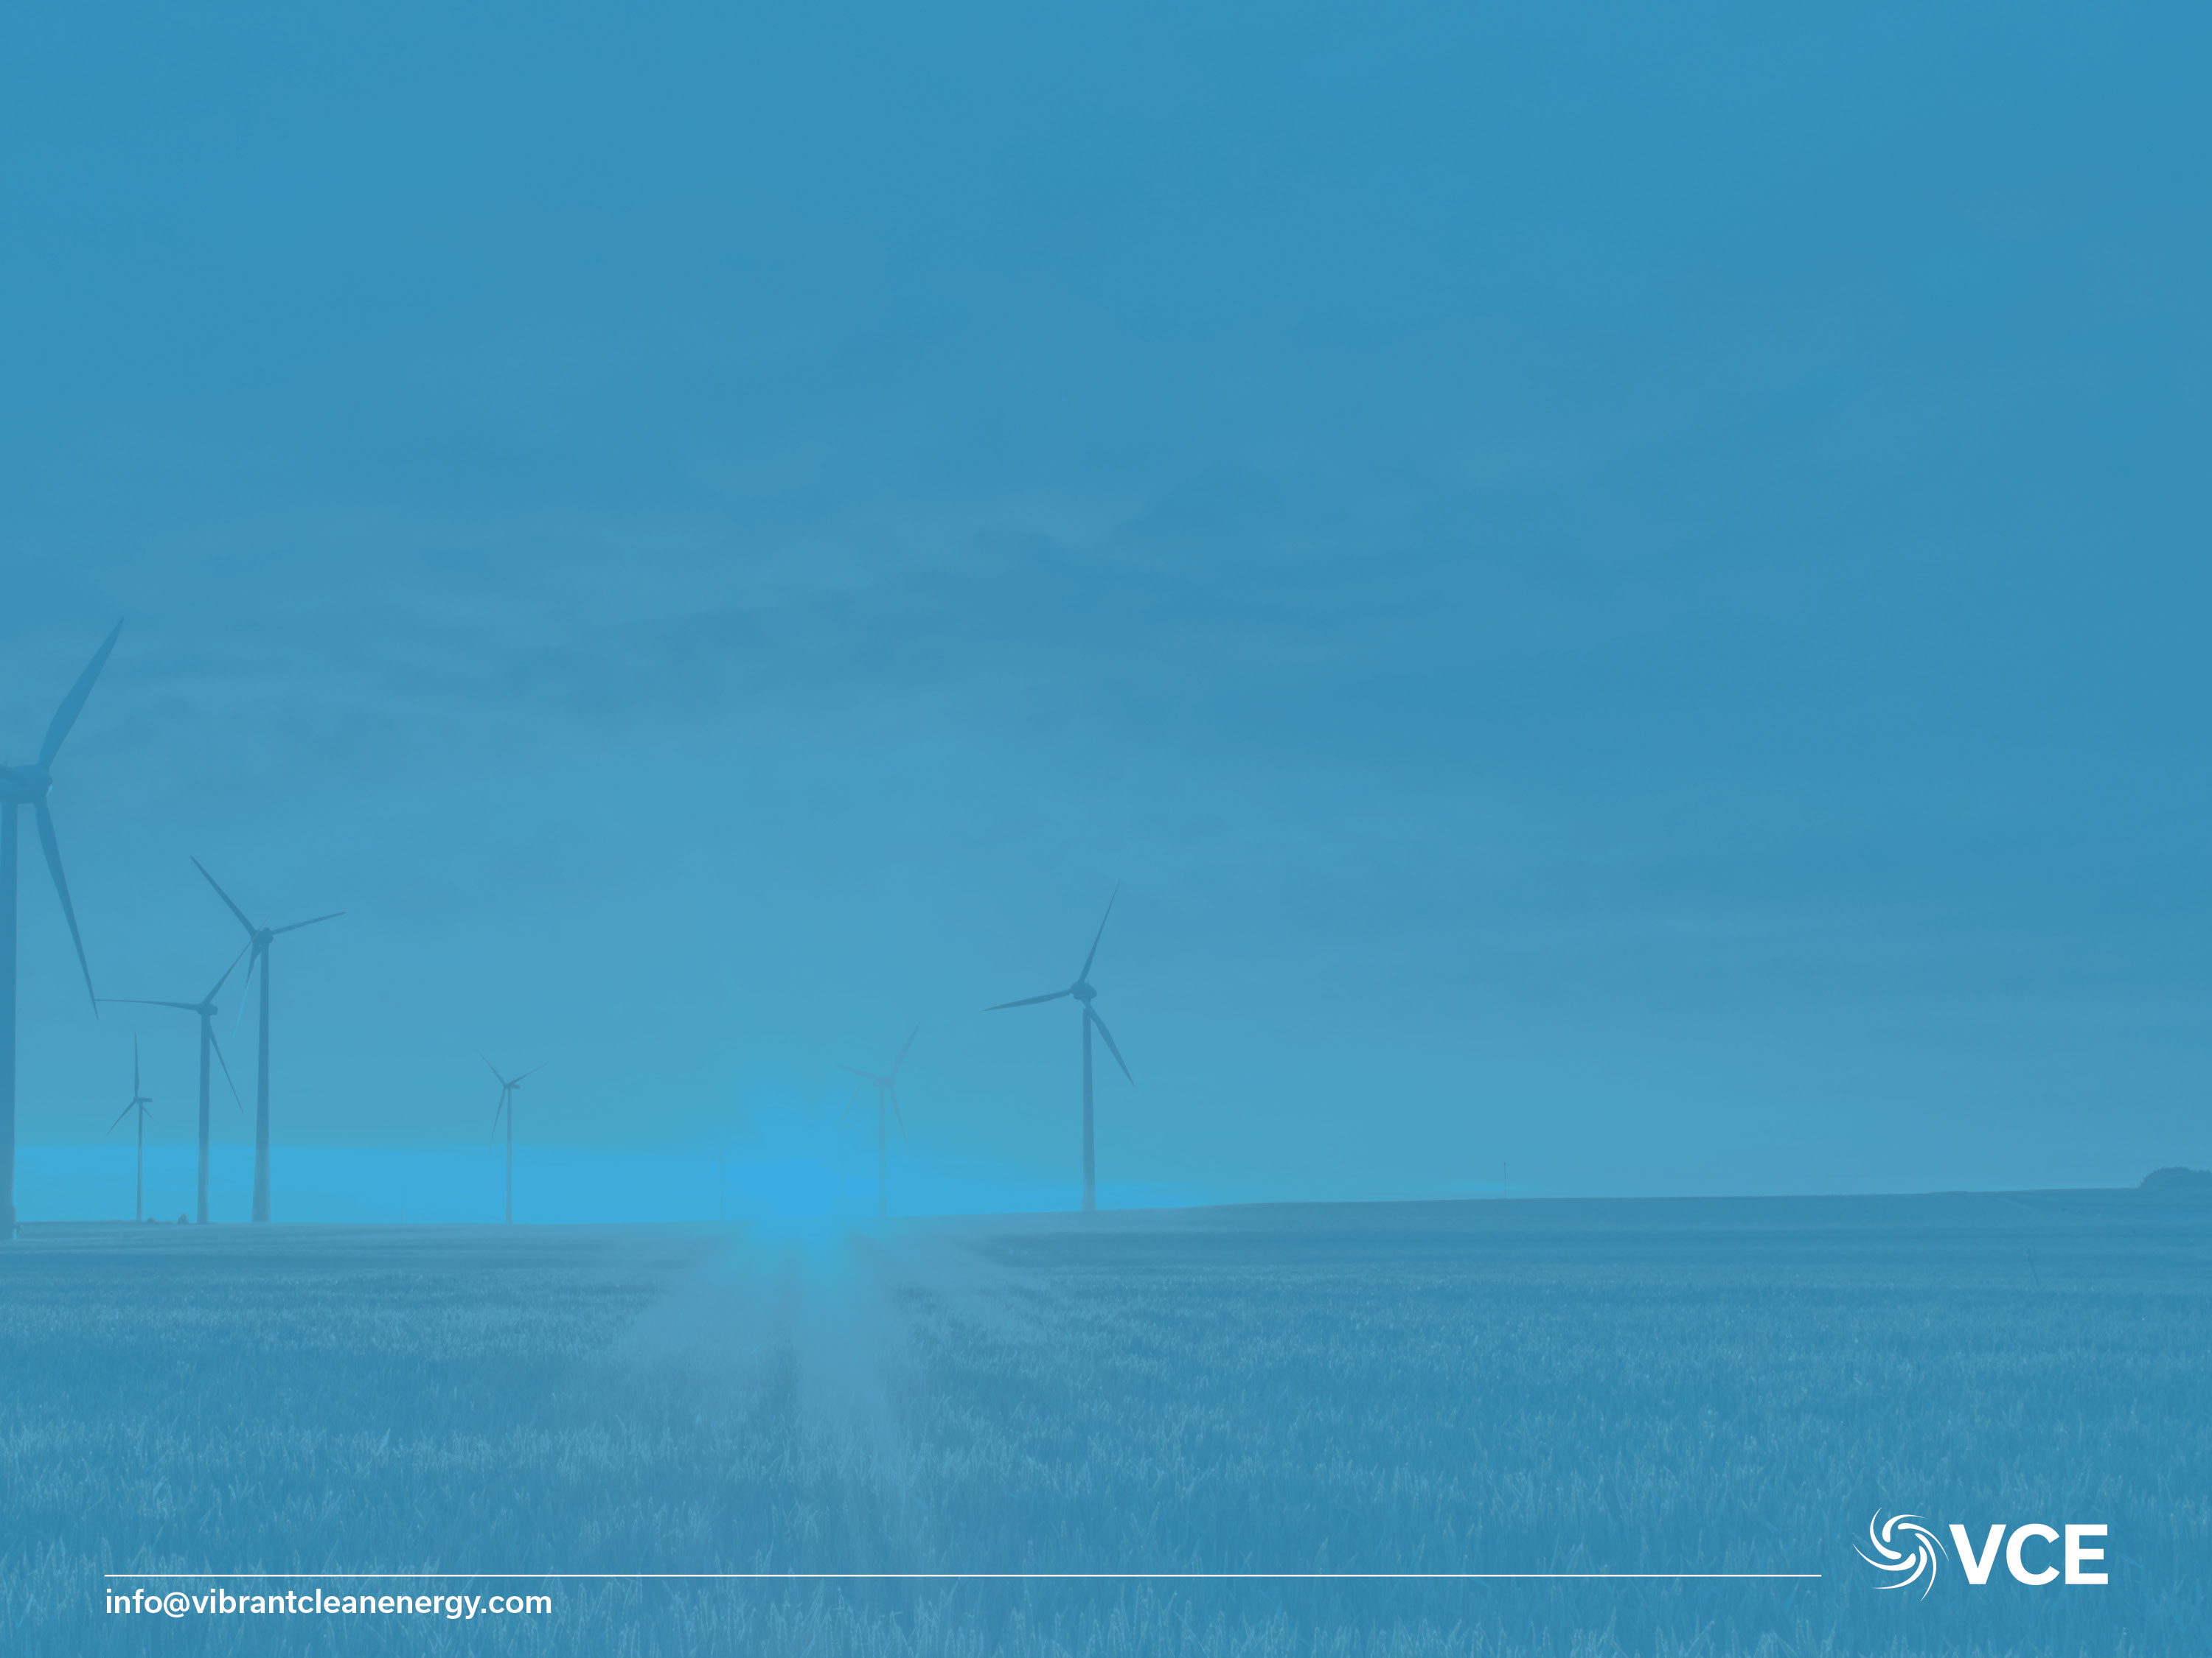
Do We Really Need CCS?
Prepared By:
Vibrant Clean Energy, LLC
Dr Christopher T M Clack
Prepared For:
CCS Forum 2018 – San Michele, Italy
June 4th, 2018
Disclaimer:
This presentation has been prepared in good faith on the basis of information available at the date of publication. The analysis was produced by Vibrant Clean Energy, LLC. No guarantee or warranty of the analysis is applicable. Vibrant Clean Energy, LLC will not be held liable for any loss, damage, or cost incurred by using or relying on the information in this presentation.

Slide 2

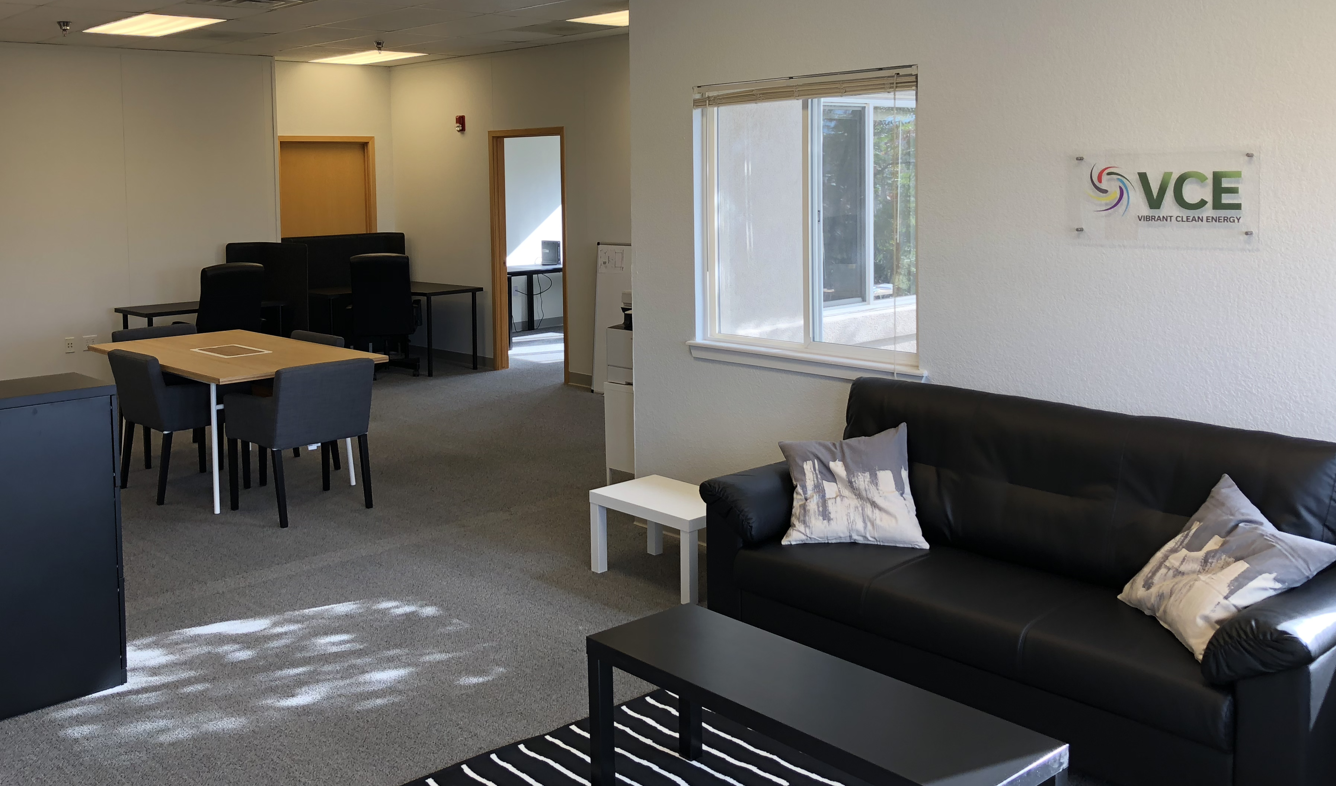
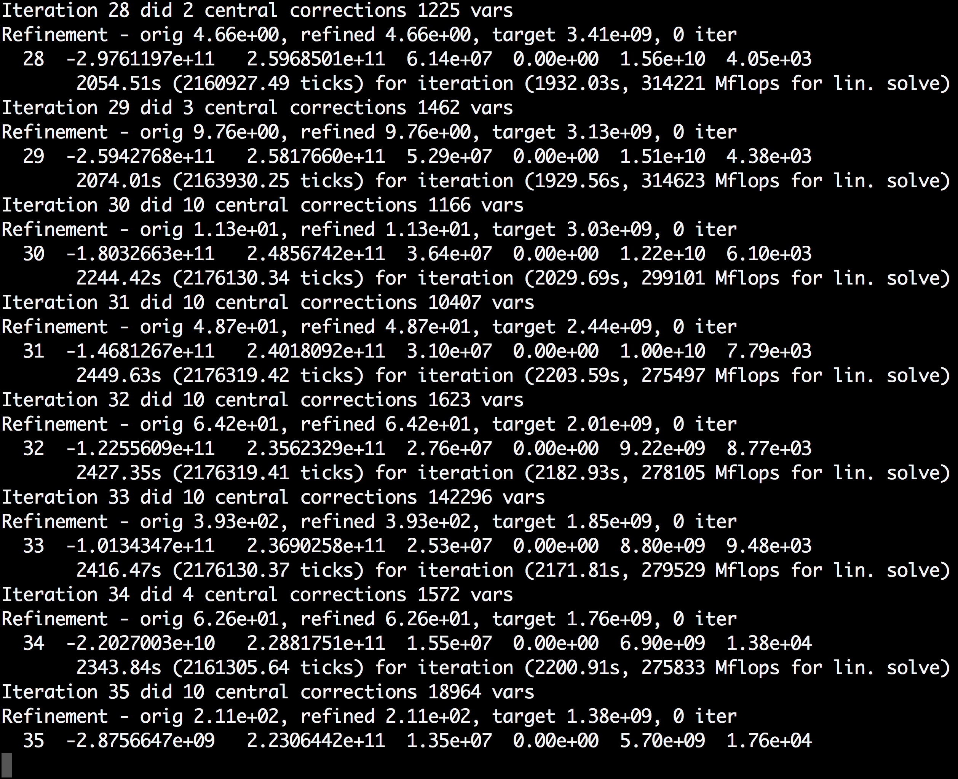
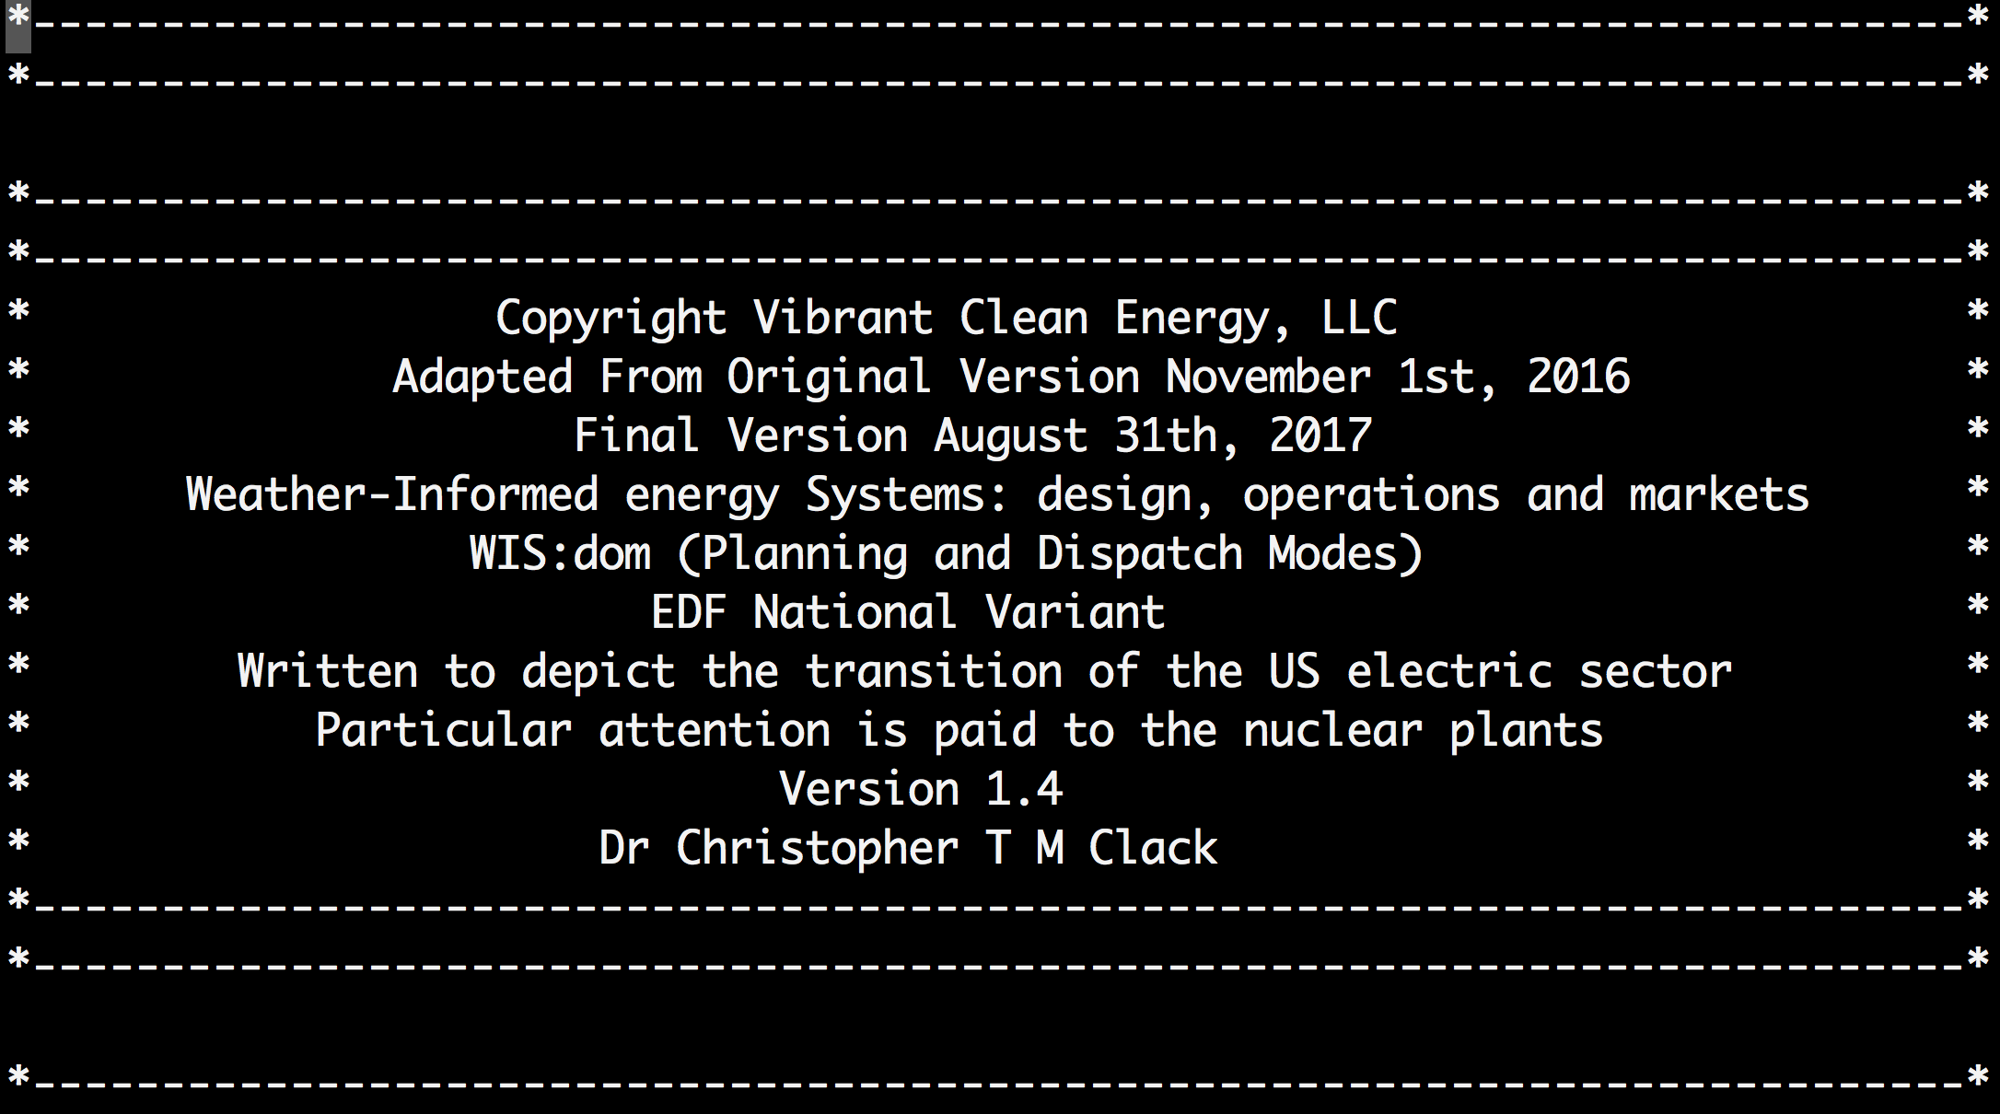
Vibrant Clean Energy
Purpose of Vibrant Clean Energy, LLC:
Reduce the cost of electricity and help evolve economies to near zero emissions;
Co-optimize transmission, generation, storage, and distributed resources;
Increase the understanding of how Variable Generation impacts and alters the electricity grid and model it more accurately;
Agnostically determine the least-cost portfolio of generation that will remove emissions from the economy;
Determine the optimal mix of VG and other resources for efficient energy sectors;
Help direct the transition of heating and transportation to electrification;
License WIS:dom optimization model and/or perform studies using the model;
Ensure profits for energy companies with a modernized grid;
Assist clients unlock and understand the potential of high VRE scenarios, as well as zero emission pathways.

Slide 3
Who We Work With
The current clients include:
Large Independent System Operators In North America;
Large utilities in the United States;
Universities purchasing datasets and studies of microgrids for their campuses;
Universities and Commissions Advancing Modeling Of Integrated Resource Plans;
Nonprofit organizations seeking robust modeling of electricity transitions;
Energy Developers Seeking Advantages in Deployment of New Generators.

Slide 4
Reducing Emissions Without CCS?

Slide 5
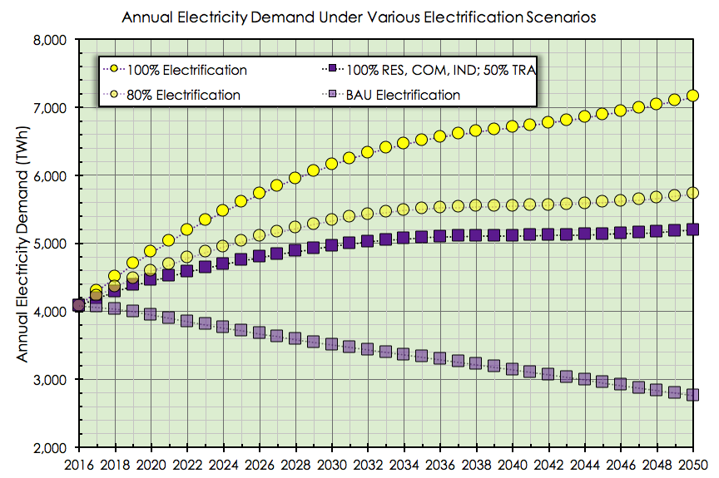
Demand For Energy To 2050 – US Economy

Slide 6
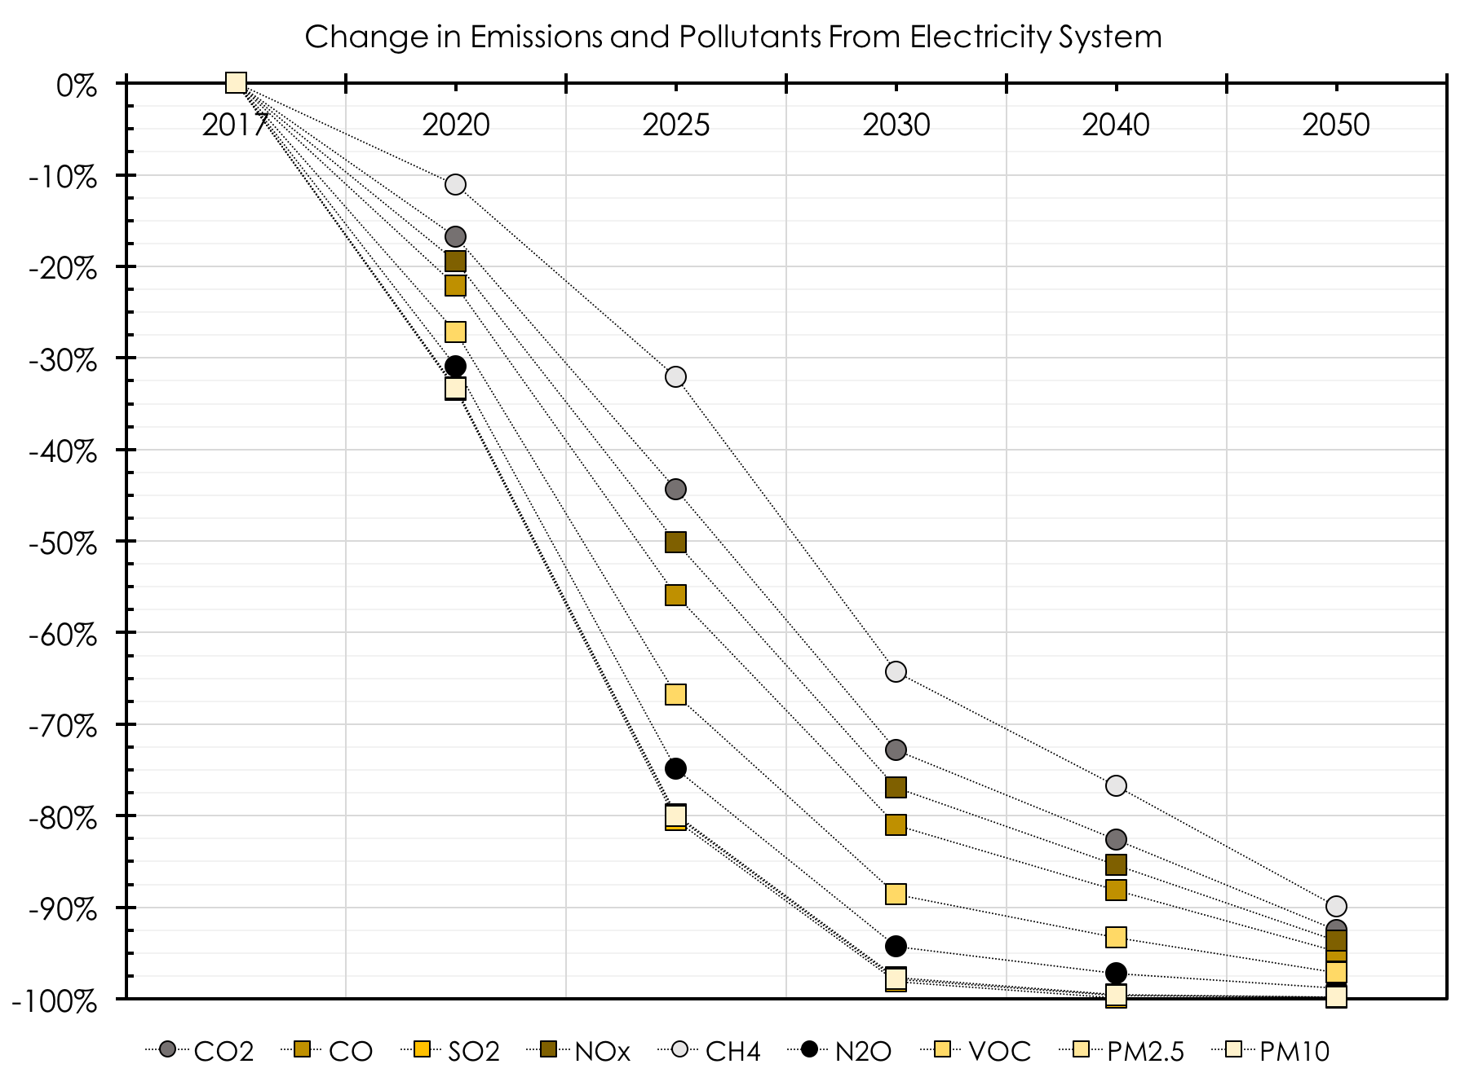
Emissions To 2050 – US Economy

Slide 7
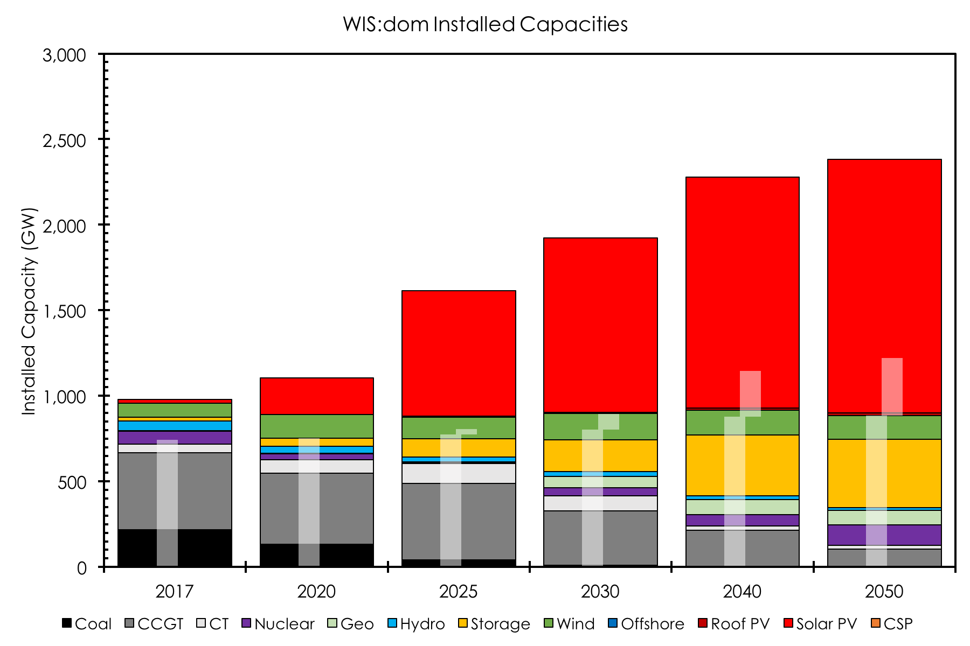
Installed Capacities To 2050 – US Economy

Slide 8
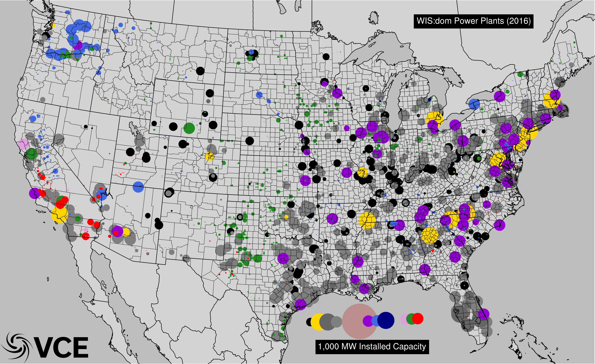
Installed Capacities To 2050 – US Economy

Slide 9
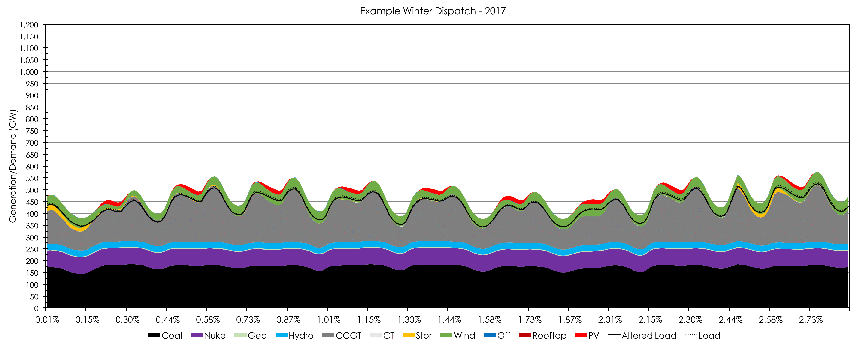
Dispatched Electricity To 2050 – US Economy

Slide 10
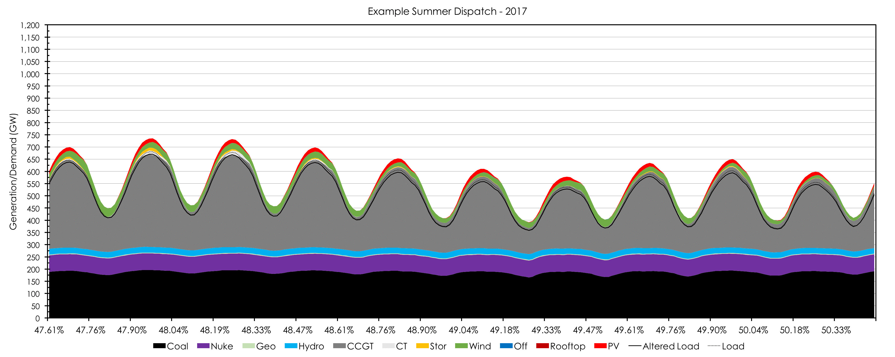
Dispatched Electricity To 2050 – US Economy

Slide 11
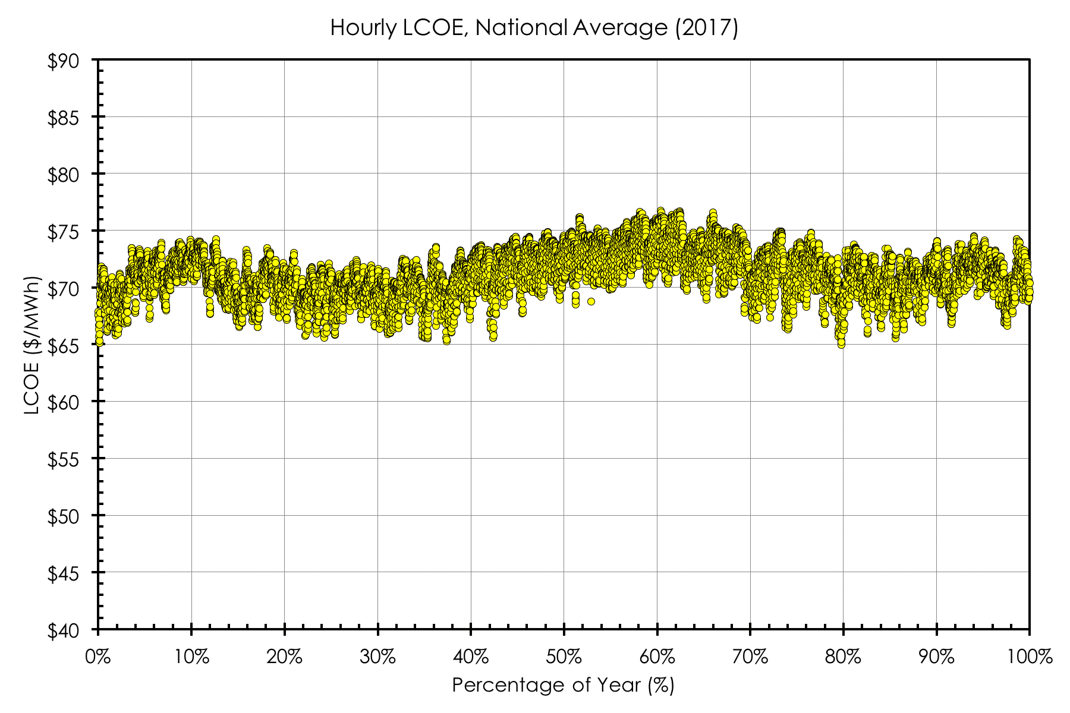
Cost of Energy To 2050 – US Economy

Slide 12
How Does The Change Happen?
Rapid deployment of low-emission technologies;
Continual market reforms in the electricity sector to adapt to new paradigms;
Storage becoming a “transmission asset” in the electricity sector;
Demand side management and flexibility being deployed on the consumer end;
Energy efficiency and transition to EVs for light-duty vehicles;
Retrofitting and adapting existing demand resources with more efficient end-use products (e.g. heat pumps, water heaters, LEDs, etc.);
Deployment of VREs allowed in technical regions, without interruption from environmental protections.

Slide 13
Some Myths Challenged?
Wind and solar can actually provide adequate power over large regions;
Peak demand can increase (and should) for a deep decarbonized economy;
Inertia in the system can be provided by other assets that thermal generation;
Reduction in energy use can be substantial and changes the amount necessary for the economy;
Nuclear, geothermal, wind, solar, storage and other assets are all completely fine working together, given correct incentives;
Variable renewables are not “fuel savers”, but deployed properly can become integral energy producers providing the full range of services required for electricity markets (reserves, ancillary services, capacity).

Slide 14
Scaling of Wind Resources
48 States
e.g., Iowa
Larger geographic areas reduce variability, but transmission needs to be considered;
High resolution data (temporally and spatially) are needed to characterize the resource variability;
If scale, resolution, transmission and generation dispatch can be co-optimized, co-benefits emerge.

Slide 15
To Achieve Low-Emissions Many Aspects Must Come Together

Slide 16
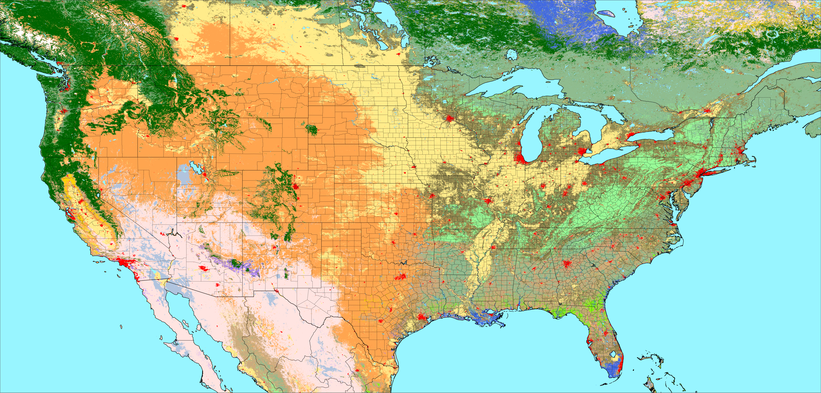

Land Use Restricts Siting
Original Data Source: https://lpdaac.usgs.gov/dataset_discovery/modis/modis_products_table/mcd12c1
Water
Mixed Forest
Grassland
Snow & Ice
Evergreen NL Forest
Closed Shrubland
Permanent Wetland
Barren / Sparse
Evergreen BL Forest
Open Shrubland
Cropland
Unclassified
Deciduous NL Forest
Woody Savanna
Urban & Built up
Deciduous BL Forest
Savanna
Crops & Natural Vegetation

Slide 17
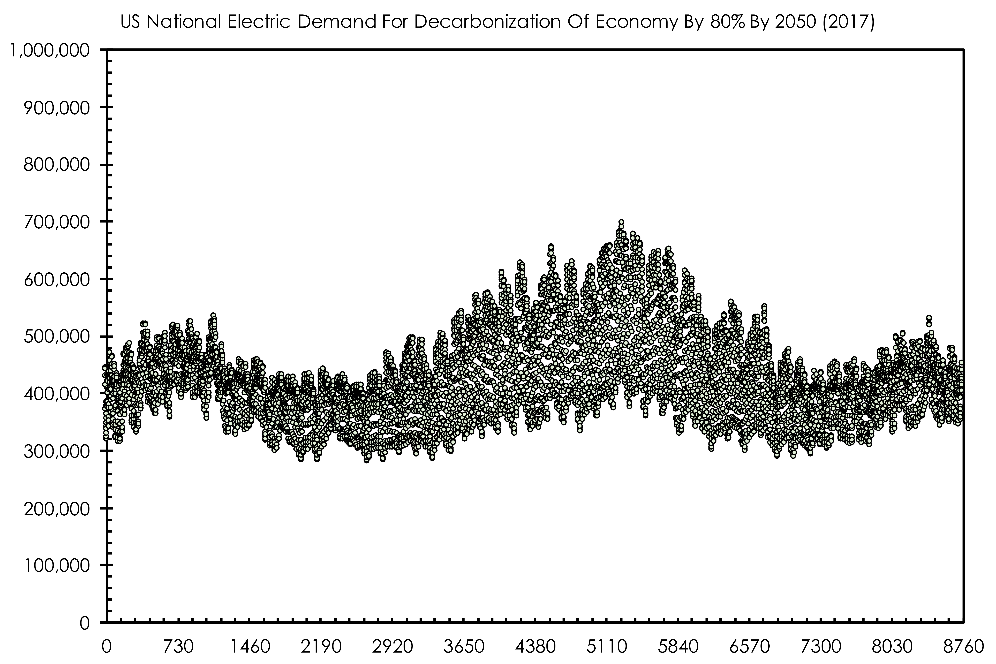
Demand Behavior Changes

Slide 18
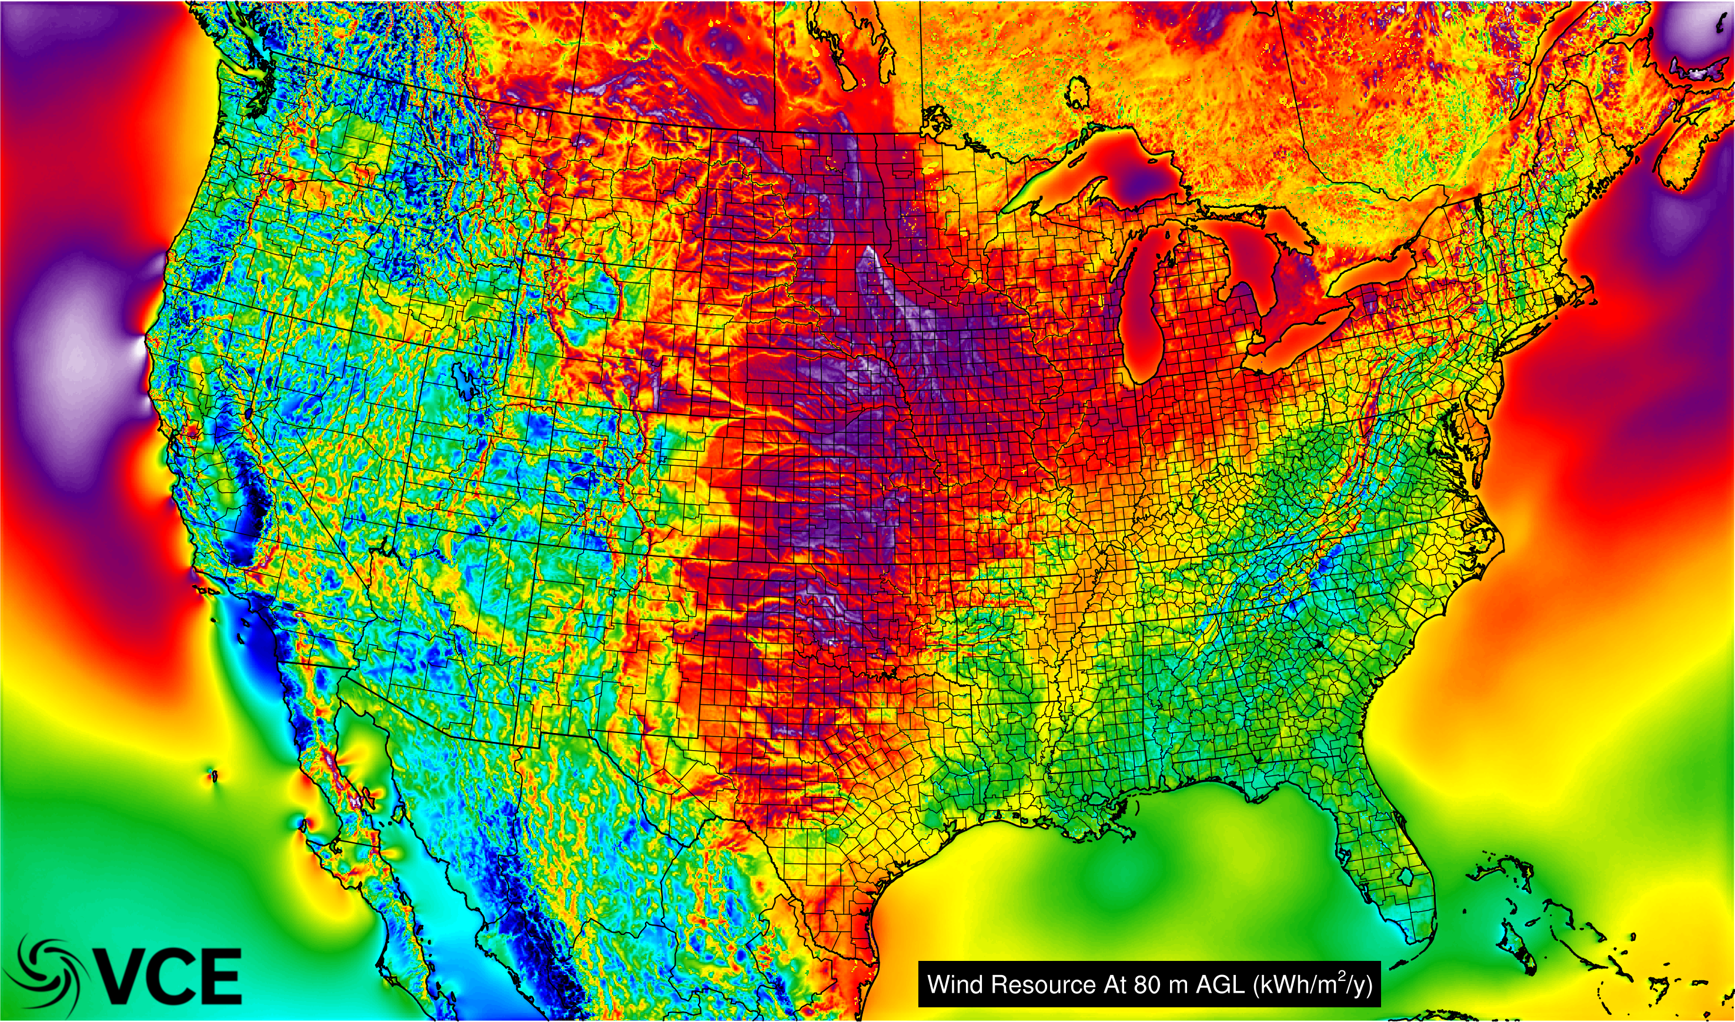
Wind Resource (3-km, 5-min)

Slide 19
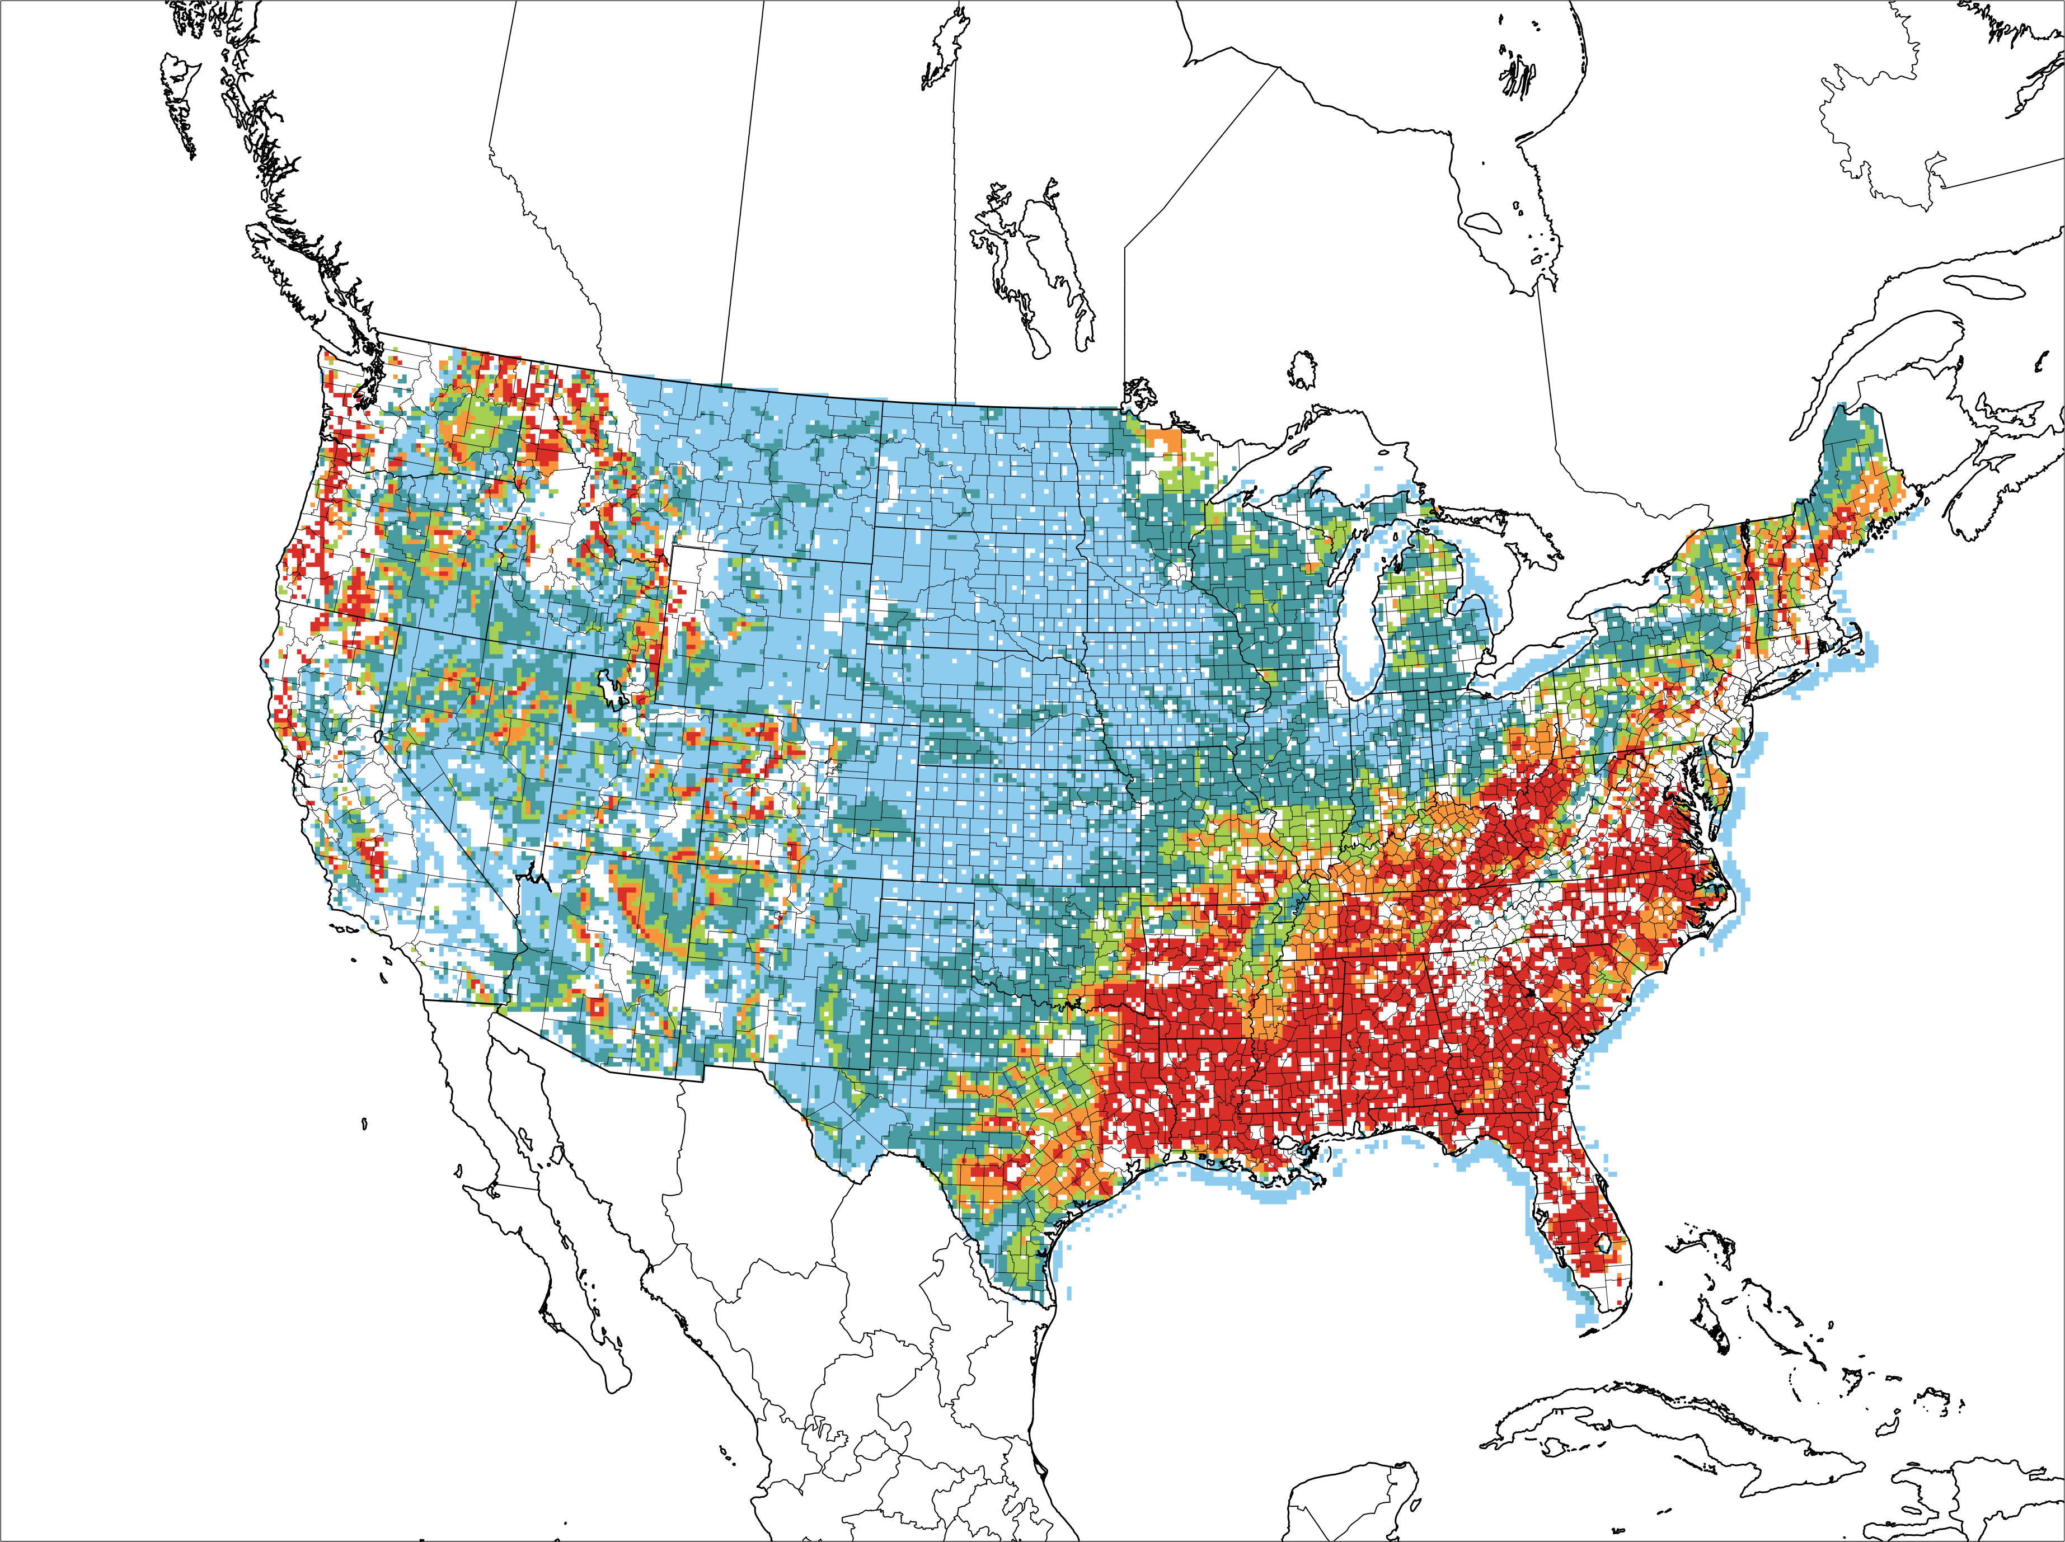
Multiple “Flavors” of Technologies
100m
80m
120m
160m
140m

Slide 20
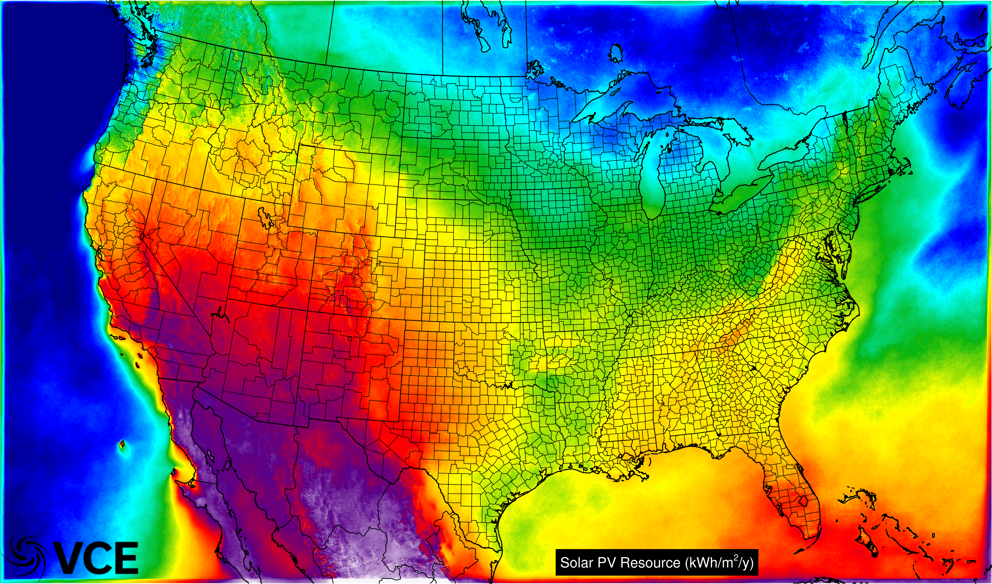
Solar PV Resource (3-km, 5-min)

Slide 21
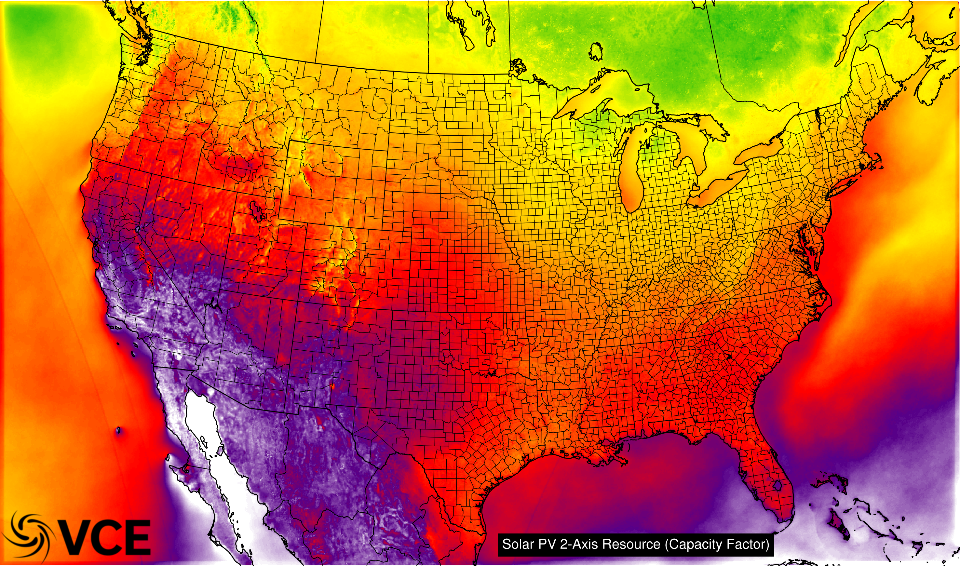
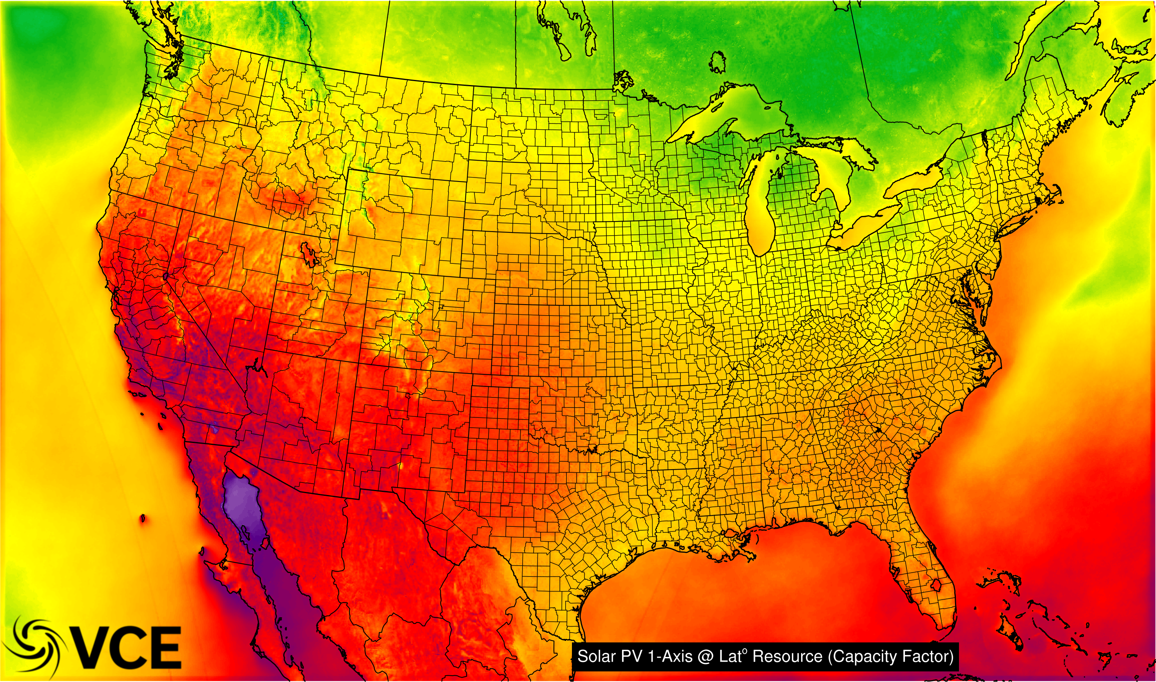
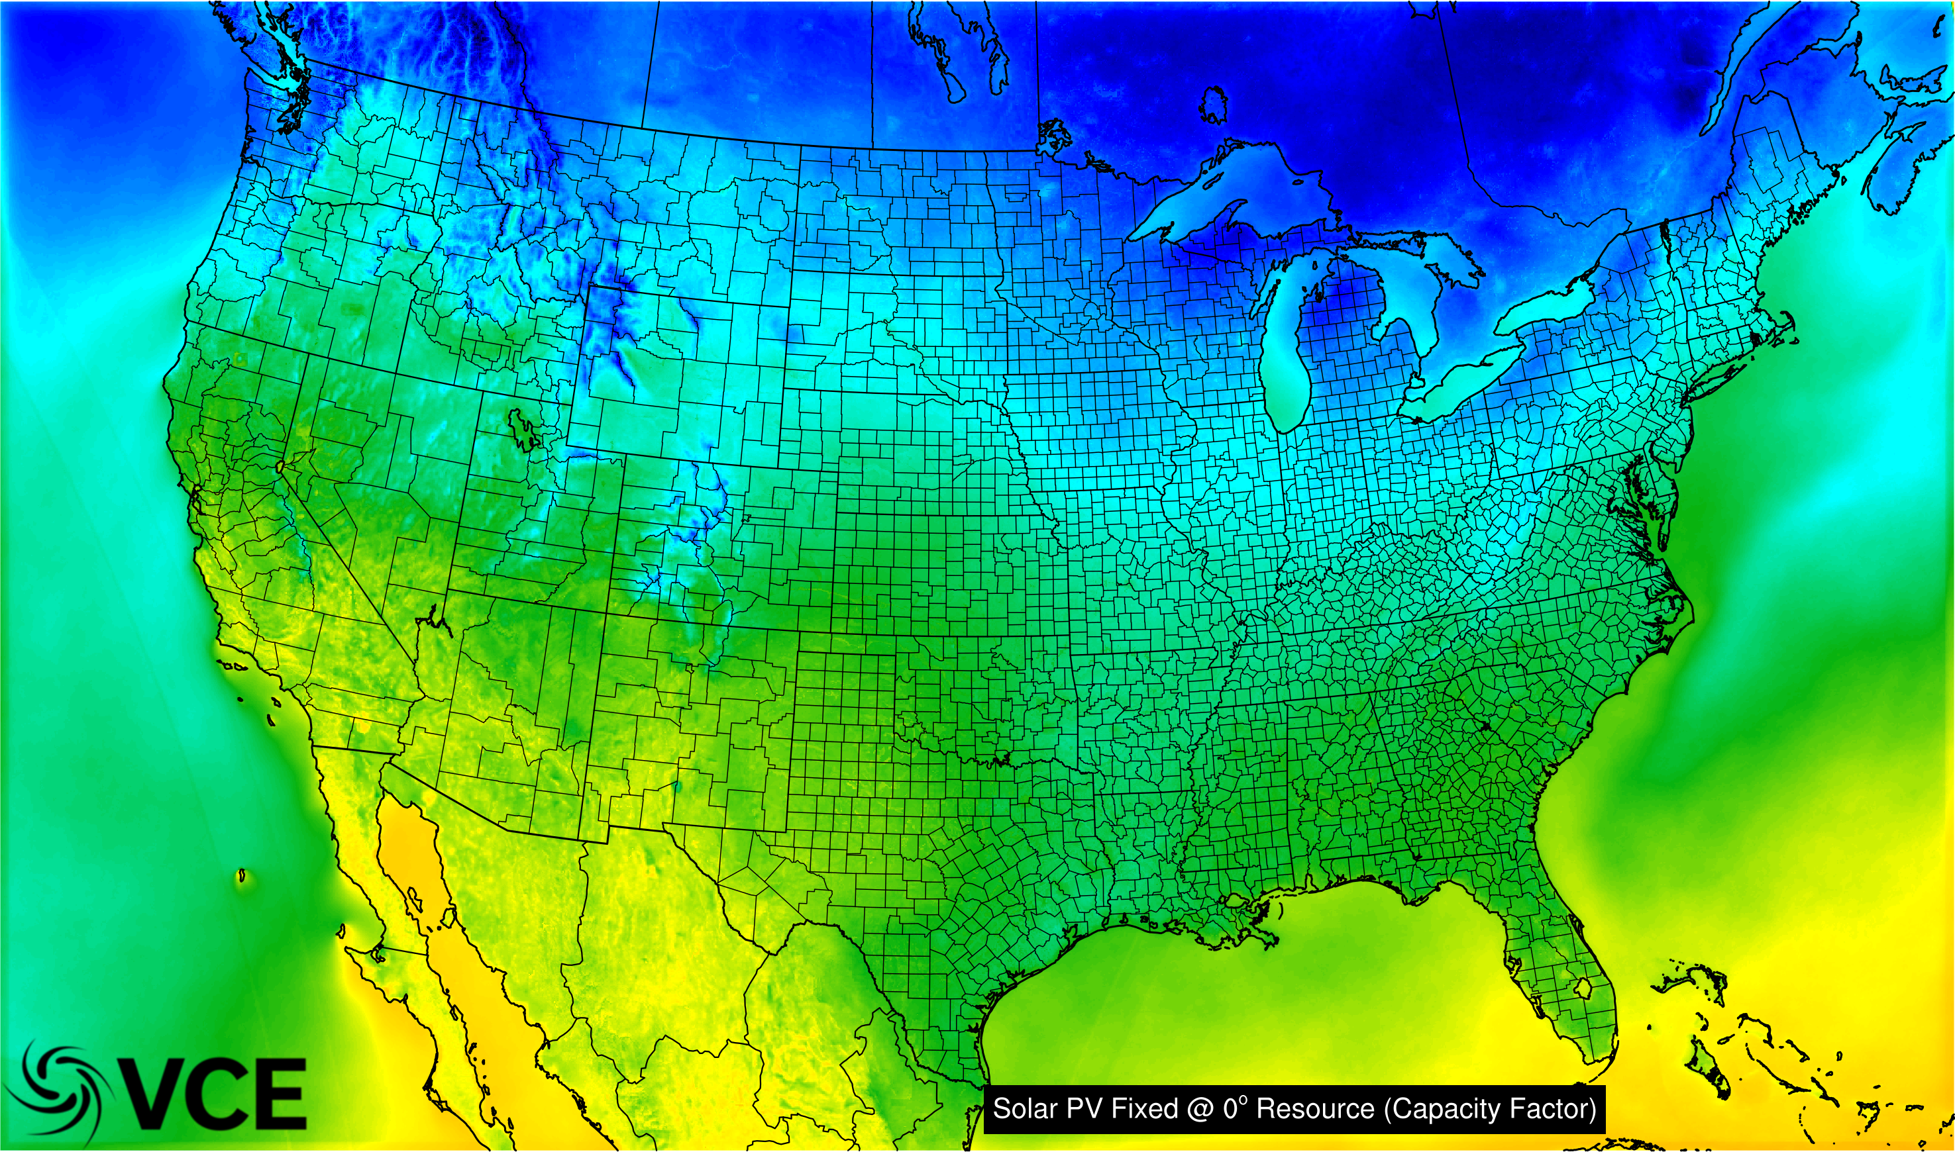
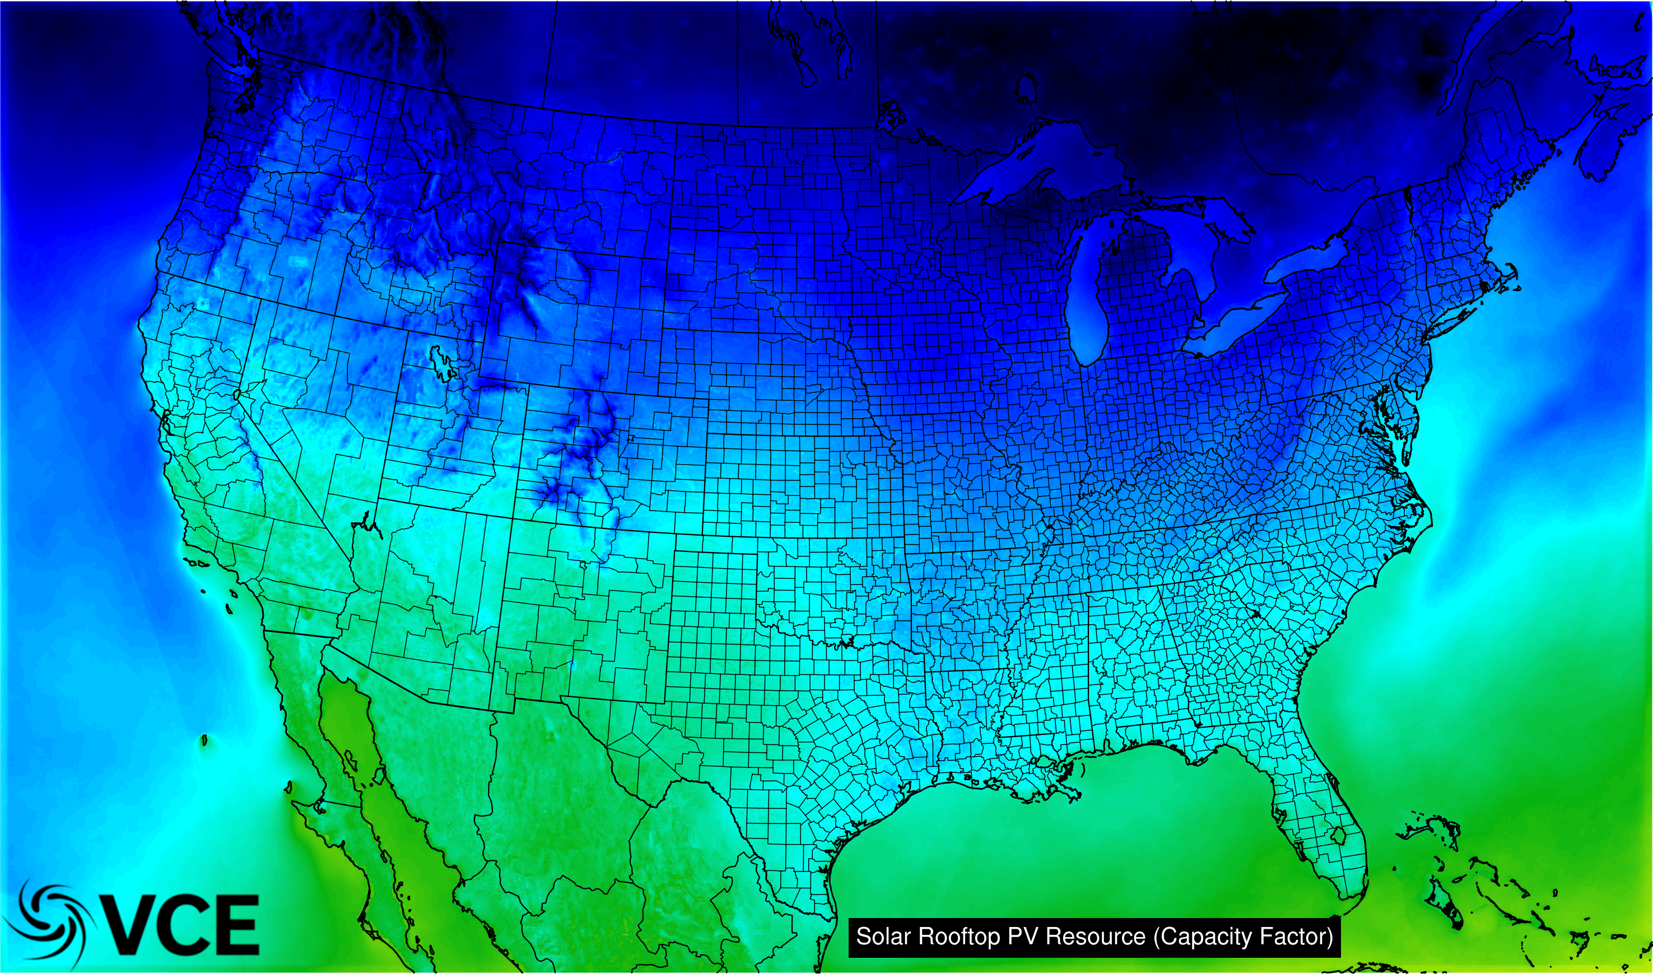
Multiple “Flavors” of Technologies
Notes:
Different flavors of solar…

Slide 22
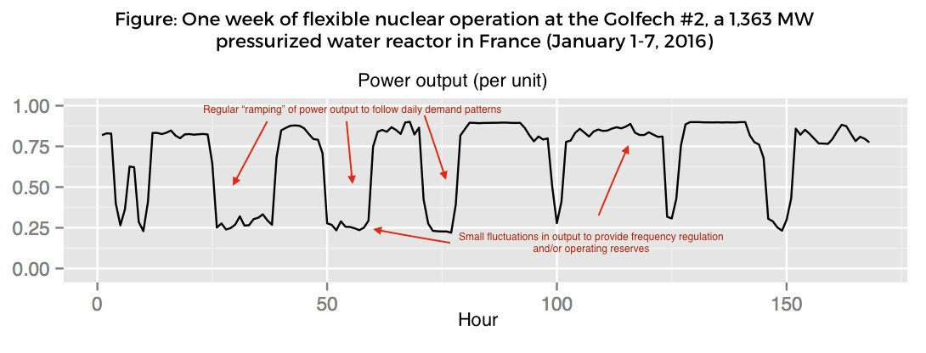
Ramping Nuclear – Happens All The Time
Courtesy of Jesse Jenkins

Slide 23
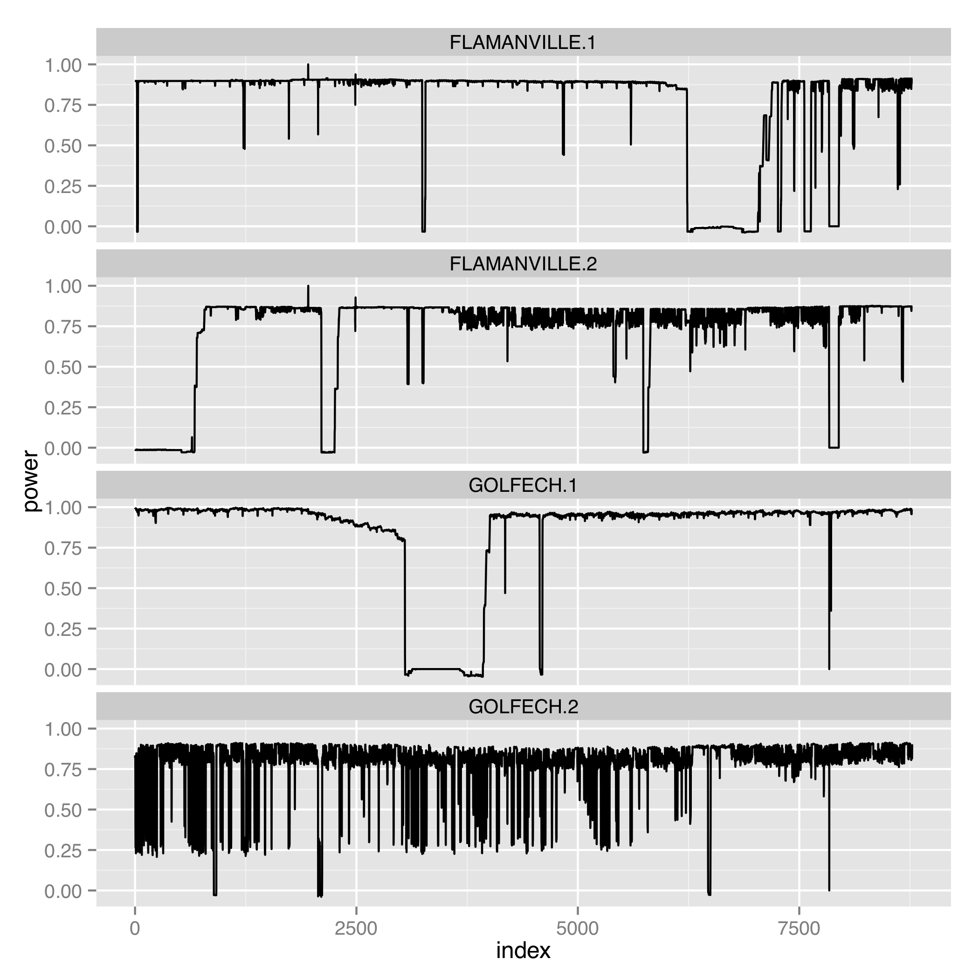
Ramping Nuclear – Happens All The Time
Courtesy of Jesse Jenkins

Slide 24
Final Thoughts For Discussion
Every choice society makes will be part of a trade-off balance;
CCS has opportunities and is simultaneously over-valued by some and under-valued by others;
The world is watching the NET power Allam cycle power plant to see if it can be successful. If so, new opportunities will arrive;
The role of CCS will have to align with the changing paradigm in the energy sector. Low cost VREs are here to stay, nuclear will see a resurgence, and CCS will need to find its place within that changed system. It will not always be a fossil-fuel dominated system;
As with all the technology possibilities – none are needed, they are all desirable (for different reasons). There are no silver bullets;
Solving climate change is going to be difficult, no matter which pathway taken. We have a moral imperative to do it as cheaply and as efficiently as possible. Resources are scarce!

Slide 25
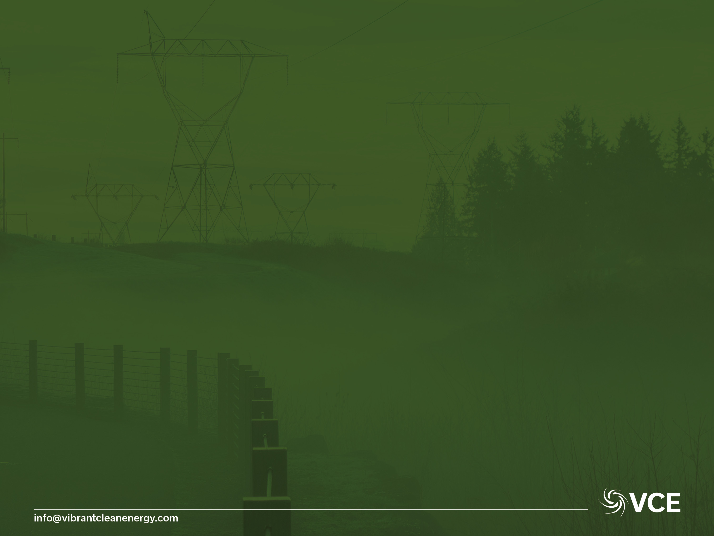
Thank You
Dr Christopher T M Clack
CEO Vibrant Clean Energy, LLC
Telephone: +1-720-668-6873
E-mail: christopher@vibrantcleanenergy.com
Website: VibrantCleanEnergy.com
Twitter: @Clacky007

